Slide 1
The Seven Steps of the Research Process
Presented by Carnegie Mellon University Engineering Librarian, Donna Beck for Summer Engineering Experience for Girls (SEE) 2016.
#1 Identify and Develop Your Topic

Slide 2
Energy from the wind?
Hahner, David P. Leo, the Paper-Eating Lion. Kennywood. Portsmouth, New Hampshire: Arcadia, 2004. 22. Print.
Wow...amusement parks generate a lot of trash every day...where does it go?

Slide 3
https://commons.wikimedia.org/wiki/File%3ALeo_the_Paper-Eating_Lion%2C_Lincoln_Children's_Zoo%2C_Lincoln%2C_Nebraska%2C_USA.jpg
By Hanyou23 (Own work) [CC BY-SA 4.0 (http://creativecommons.org/licenses/by-sa/4.0)], via Wikimedia Commons from Wikimedia Commons
Leo, the Paper-Eating Lion
Amusement parks & my topic…Energy related?

Slide 4
…my Kennywood experiences
Is it energy and cost effective?
Are fumes emitted into the atmosphere?
How much energy is used to power Leo?
How can human power be measured?
Visiting an amusement park
Think of your topic in the form of questions

Slide 5
Are vacuums the most energy efficient method to collect trash?
State your topic as a question

Slide 6
The Seven Steps of the Research Process
#2 Find Background Information

Slide 7
Starting point: Background Info
Compare to other trash cans
Solar Powered
View of “Solar Compactor” outside of Wean Hall, Carnegie Mellon University. Pittsburgh, PA. 2016. Personal photograph by author. JPEG file.
Google Images

Slide 8
garbage
collection search
Encyclopedias

Slide 9
The Seven Steps of the Research Process
#3 Use catalogs to find Books and Media (like DVDs)

Slide 10
Use Catalogs like Carnegie Library to find Books
and Media

Slide 11
The Seven Steps of the Research Process
#4 Use Indexes to Find Articles

Slide 12
Use Indexes to find articles
What does this mean?
Magazine & journal & newspaper articles
find them in
RESEARCH DATABASES
Academic OneFile GreenFILE

Slide 13
garbage cans
electrically compacted
green amusement parks
recycling container
trash bins
built-in vacuum
“smartcan”
waste disposal
paper-eating machines
refuse
suction design
waste management system
vacuum-equipped
receptacle

Slide 14
The Seven Steps of the Research Process
#5 Find Internet Resources

Slide 15
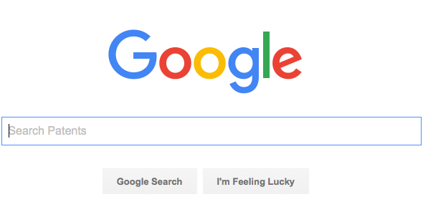
Internet Resources – “gateways”
Try different search engines in addition to Google, like:
Scientific American blogs
Notes:
http://journalstar.com/news/local/devoted-to-leo-the-paper-eating-lion-and-his-ilk/article_86f03428-5b5e-5c15-9059-88449f55cafb.html

Slide 16
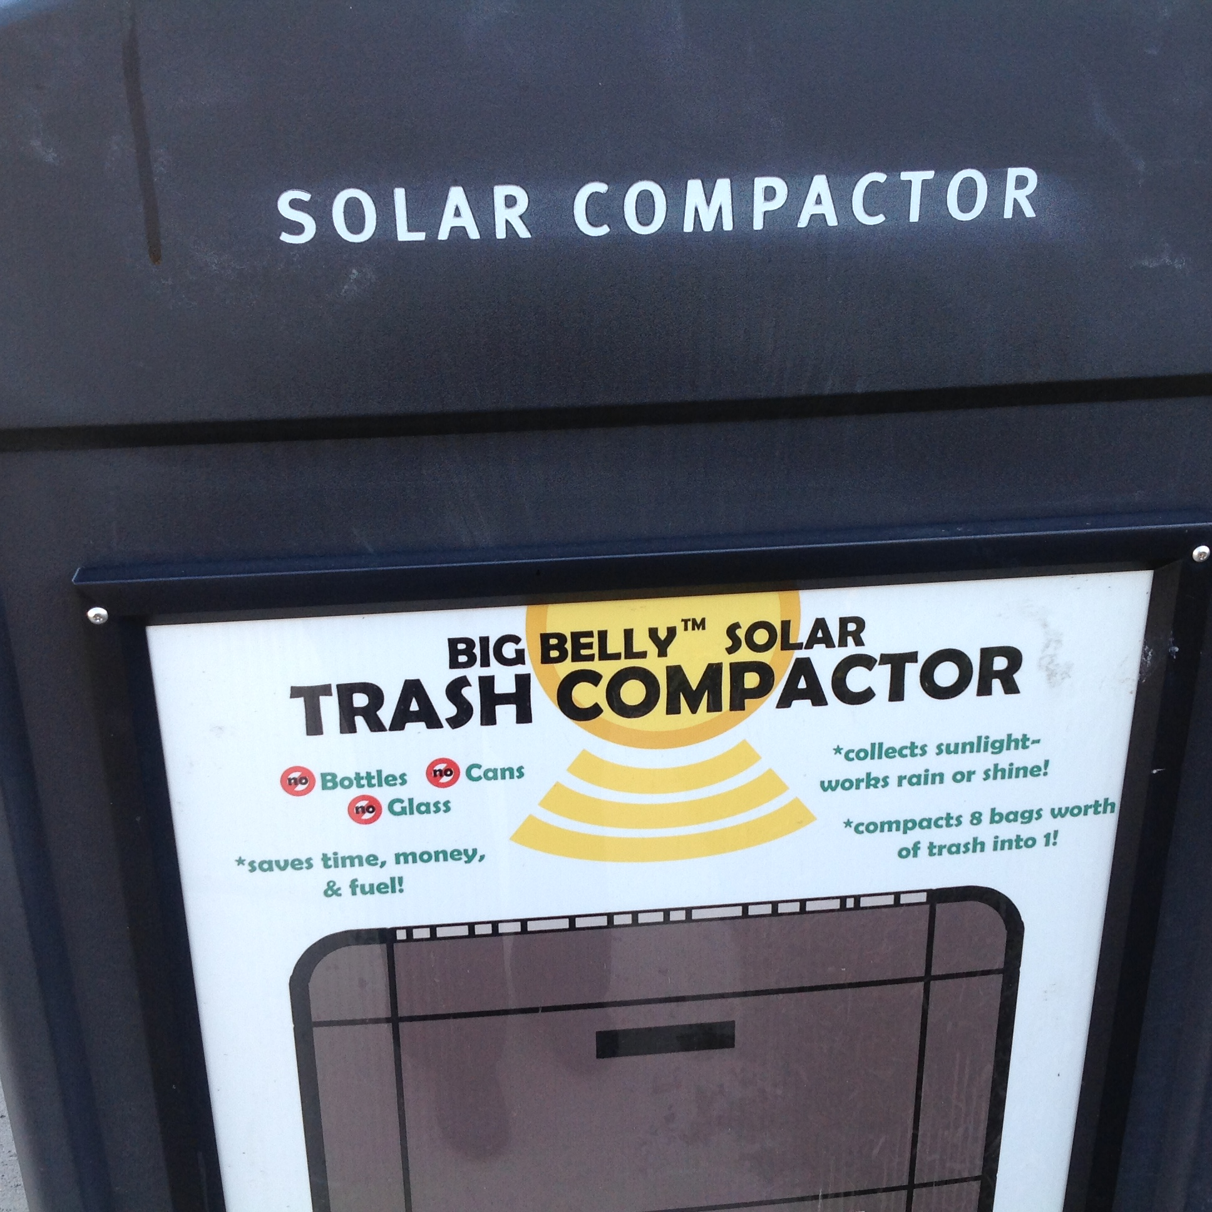
The Seven Steps of the Research Process
Would
you use this photo?
Would
you use that
website?
How can I trust this information to be true?
# 6 Evaluate What You Find

Slide 17
The Seven Steps of the Research Process
MLA format
# 7 Cite what you find using a standard format

Slide 18
Works Cited
Hahner, David P. Leo, the Paper-Eating Lion. Kennywood. Portsmouth, New Hampshire: Arcadia, 2004. 22. Print.
Research & Learning Services, Olin Library, Cornell University Library, Ithaca, NY, “The Seven Steps of the Research Process.” Web. 11 July 2016.
“Solar Compactor outside of Wean Hall,” Carnegie Mellon University, Pittsburgh, PA. 2016. Personal
photograph by author. JPEG file.

