Slide 1
Internet of Things
Michael J. McCarthy, IOT, Heinz College, Carnegie Mellon University

Slide 2
The Internet of Things Two Readings
“How Smart, Connected Products are Transforming Competition”
“Enabling the Internet of Things”

Slide 3
“Some have suggested that the internet of things ‘changes everything’, but that is a dangerous oversimplification. As with the internet itself, smart, connected products reflect a whole new set of technological possibilities that have emerged.”
From: “How Smart Connected Products are Transforming Competition” Harvard Business Review

Slide 4
A few products: not smart or connected
https://en.wikipedia.org/wiki/Jeep_Cherokee#/media/File:1974_Jeep_Cherokee_S_-_Beach_(cropped).jpg
Let’s add some “smarts” to the products…

Slide 5
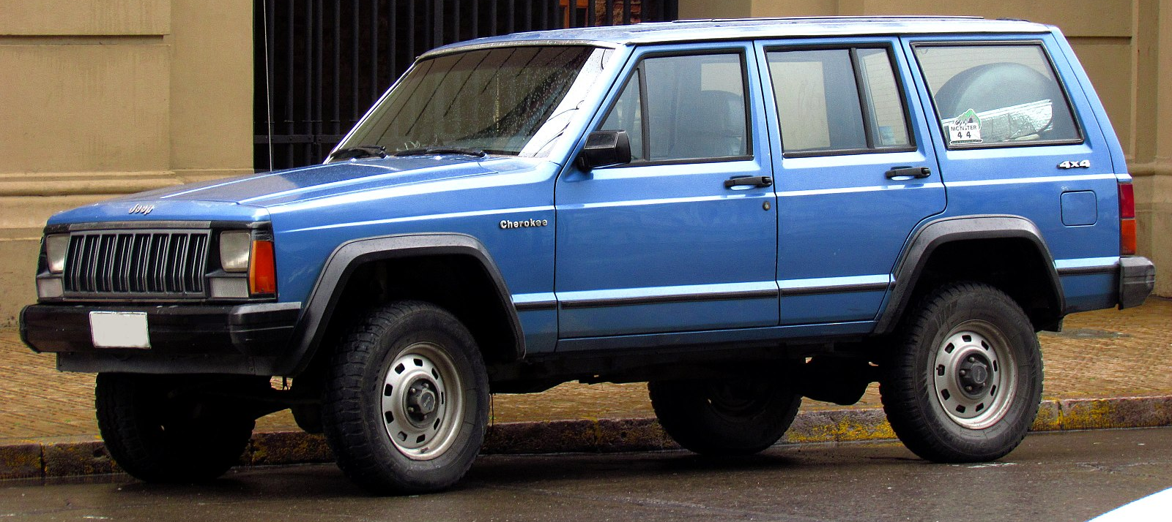
Smarts added to the products
https://en.wikipedia.org/wiki/Jeep_Cherokee#/media/File:1974_Jeep_Cherokee_S_-_Beach_(cropped).jpg
https://en.wikipedia.org/wiki/File:Jeep_Cherokee_2.5_1988_(15289674633)_(cropped).jpg
https://www.amazon.com/Keurig-B60-Special-Brewing-System/dp/B000AQSMPO
Talking doll
Power brakes on the Jeep
Microcontrollers
in the coffee pot
No elevator operator needed
Let’s connect these things to the internet…

Slide 6
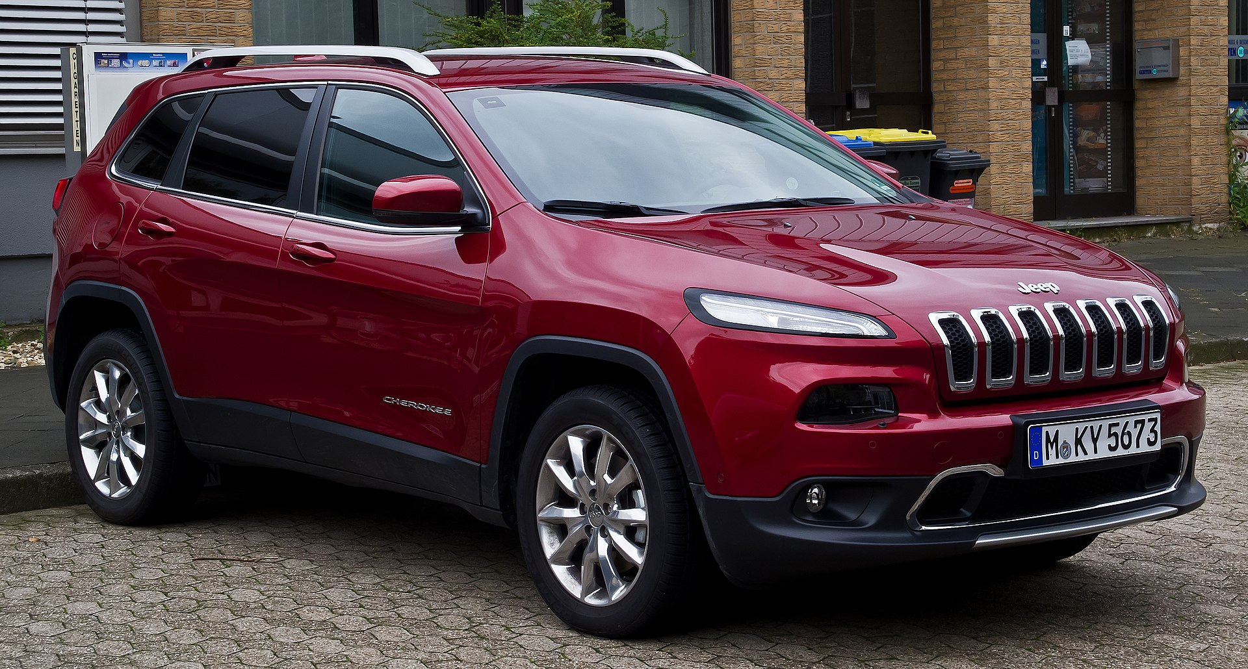
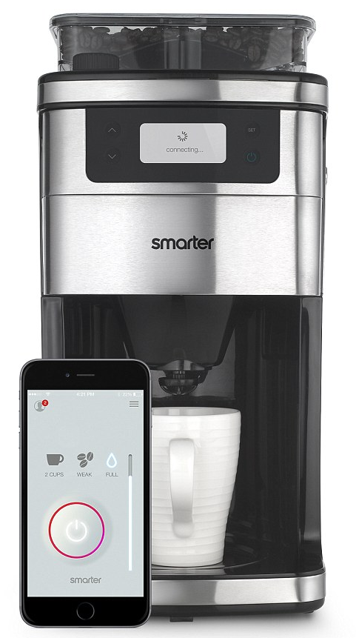
Connectivity added to smart products
https://en.wikipedia.org/wiki/Jeep_Cherokee#/media/File:1974_Jeep_Cherokee_S_-_Beach_(cropped).jpg
https://en.wikipedia.org/wiki/File:Jeep_Cherokee_2.5_1988_(15289674633)_(cropped).jpg
https://www.amazon.com/Keurig-B60-Special-Brewing-System/dp/B000AQSMPO
https://en.wikipedia.org/wiki/Jeep_Cherokee#/media/File:1974_Jeep_Cherokee_S_-_Beach_(cropped).jpg
https://www.engadget.com/2015/01/02/smarter-wifi-coffee-machine/
Notes:
https://www.cbsnews.com/news/your-kids-toys-could-be-spying-on-your-family/
Last doll – parents are worried this kid toy could be spying on your family, it listens and connects to wifi
Cathedral of Learning – all the elevators are connected to a network so they are integrated together

Slide 7
Smart and Connected
My Friend Cayla, which costs $59.93 at Walmart.com, is billed as “a wonderful choice for
a young child who needs a companion.”
The Electronic Privacy Information Center (EPIC) claims the toys allegedly send
recordings to speech-to-text software company Nuance Communications, which
the complaint notes has contracts with military and law enforcement agencies.
Notes:
https://www.cbsnews.com/news/your-kids-toys-could-be-spying-on-your-family/
Last doll – parents are worried this kid toy could be spying on your family, it listens and connects to wifi
Cathedral of Learning – all the elevators are connected to a network so they are integrated together

Slide 8
Smart and Connected
“Connect your vehicle to Alexa via an Amazon Echo that syncs
with any Uconnect®- equipped Jeep®Cherokee. Use your voice
to start your vehicle, check fuel levels, send an address directly
to your Navigation system and more, all from your home.” From
An advertisement describing connected Jeeps at
https://www.jeep.com/uconnect.html/
“Though I hadn't touched the dashboard, the vents in the Jeep
Cherokee started blasting cold air at the maximum setting,
chilling the sweat on my back through the in-seat climate
control system. Next the radio switched to the local hip hop
station and began blaring Skee-lo at full volume. I spun the
control knob left and hit the power button, to no avail. Then
the windshield wipers turned on, and wiper fluid blurred the
glass.” From Wired https://www.wired.com/2015/07/hackers-remotely-kill-jeep-highway/
Notes:
https://www.cbsnews.com/news/your-kids-toys-could-be-spying-on-your-family/
Last doll – parents are worried this kid toy could be spying on your family, it listens and connects to wifi
Cathedral of Learning – all the elevators are connected to a network so they are integrated together

Slide 9
Smart and Connected
“It’s great for the person who is looking to buy smarter; it monitors your supply
of coffee, and sends push notifications to your phone when it is time to pick up
fresh beans or ground coffee.”
From https://ideaing.com/ideas/best-smart-coffee-makers
“A coffee-machine hack may seem harmless, but the Dyn attack proved how easily
IoT devices can cause damage at a grand scale.”
From https://qz.com/901823/the-easy-way-your-smart-coffee-machine-could-get-hacked-and-ruin-your-life/
David Fidler, adjunct senior fellow for cybersecurity at the Council on Foreign Relations,
said he couldn’t recall a DDoS attack even half as big as the one that hit Dyn.
From https://www.theguardian.com/technology/2016/oct/26/ddos-attack-dyn-mirai-botnet
Notes:
https://www.cbsnews.com/news/your-kids-toys-could-be-spying-on-your-family/
Last doll – parents are worried this kid toy could be spying on your family, it listens and connects to wifi
Cathedral of Learning – all the elevators are connected to a network so they are integrated together

Slide 10
Smart and Connected
Proactive maintenance is available. Dashboards showing location and status
of elevator fleet. A rules engine is used to detect and respond to emergency
conditions. API’s and SDK’s are provided for developers. Users are able to
find an appropriate elevator within a bank of elevators using a smart phone.
Improve operating capabilities and efficiency to obtain real-time accurate
information remotely.
“The idea of a hackable elevator, where someone can trap and move around
its occupants on a whim, maybe while watching the whole thing via the
security camera, is just horrifying.”
From https://www.infosecurity-magazine.com/slackspace/connected-elevators-iot-doomsday/
Notes:
https://www.cbsnews.com/news/your-kids-toys-could-be-spying-on-your-family/
Last doll – parents are worried this kid toy could be spying on your family, it listens and connects to wifi
Cathedral of Learning – all the elevators are connected to a network so they are integrated together

Slide 11
Smart and Connected Products
IT is revolutionizing products.
Once, solely mechanical and electrical parts.
Now, complex systems with connectivity.
Smart, connected products are unleashing a new era of competition.
Some companies will ask “What business am I in ?”
The product contains a computer and has a representation in the
cloud.
This changes product design, marketing, manufacturing, and after sales service.
This creates opportunities for rich data analytics.
Security is a recurring concern.

Slide 12
Connectivity
One-to-one: An individual product connects to the user, manufacturer or another product. For
example, a car connected to a diagnostic machine.
One-to-many: A central system collects data from many products simultaneously. For example,
a Tesla car makes reports to a single manufacturer system – monitoring performance, provide
remote services and upgrades.
Many-to-many: Multiple products connected to many other types of products and to the cloud
as well. For example, automated tillers inject nitrogen fertilizer at precise depths and intervals,
and seeders follow, placing corn seeds directly in the fertilized soil.

Slide 13
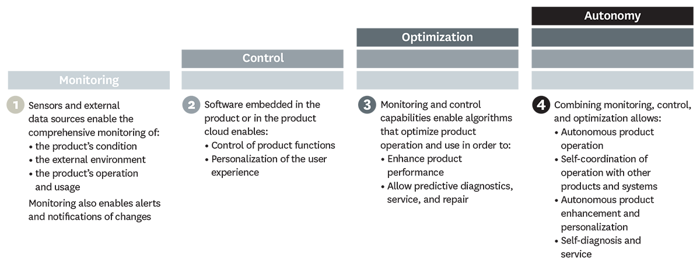
What can smart, connected products do?
From HBR article by Porter and Heppelmann

Slide 14
Monitoring
In some cases, such as medical devices, monitoring is the core element of value creation. Medtronic’s digital blood-glucose meter uses a sensor inserted under the patient’s skin to measure glucose levels in tissue fluid and connects wirelessly to a device that alerts patients and clinicians up to 30 minutes before a patient reaches a threshold blood-glucose level, enabling appropriate therapy adjustments.
From HBR article by Porter and Heppelmann

Slide 15
Control
Users can adjust their Philips Lighting hue lightbulbs via smartphone, turning them on and off, programming them to blink red if an intruder is detected, or dimming them slowly at night. Doorbot, a smart, connected doorbell and lock, allows customers to give visitors access to the home remotely after screening them on their smartphones.
From HBR article by Porter and Heppelmann

Slide 16
Optimization
The rich flow of monitoring data from smart, connected products, coupled with the capacity to control product operation, allows companies to optimize product performance in numerous ways, many of which have not been previously possible.
Diebold, for example, monitors many of its automated teller machines for early signs of trouble. After assessing a malfunctioning ATM’s status, the machine is repaired remotely if possible, or the company deploys a technician who has been given a detailed diagnosis of the problem, a recommended repair process, and, often, the needed parts.
From HBR article by Porter and Heppelmann

Slide 17
Autonomy
More-sophisticated products are able to learn about their environment, self-diagnose their own service needs, and adapt to users’ preferences. Autonomy not only can reduce the need for operators but can improve safety in dangerous environments and facilitate operation in remote locations.
Joy Global’s Longwall Mining System, for example, is able to operate autonomously far underground, overseen by a mine control center on the surface. Equipment is monitored continuously for performance and faults, and technicians are dispatched underground to deal with issues requiring human intervention.
From HBR article by Porter and Heppelmann

Slide 18
We used to make tractors!
From HBR article by Porter and Heppelmann
To build a system of systems, we need to interoperate well with others.
The principles from the Web, provide us with guidance on the construction of such systems.

Slide 19
Enabling The Internet of Things
“Fools ignore complexity. Pragmatists suffer it. Some avoid it.
Geniuses remove it.”
Alan Perlis
Turing Award 1966

Slide 20
IOT Enablers
Consider the IoT as an extension of the World Wide Web.
Build a physical web = web technologies + IoT.
Web technologies include URL’s, JSON, HTTP, Websockets,
REST, and CoAp.
To overcome scale and complexity, preferentially discover things
nearby.
Useful processing may be performed on the edge.
Consider peer to peer connections and cloudlets.
Consider the integration of devices that have little or no processing
capabilities.

Slide 21
IdentifyingThings
Things need to be identified
At a low level, IPV6 supports 128-bit addresses
At a higher level, identify things with URI’s (URL’s and URN’s)
URL’s in conjunction with DNS route and connect to services
URN’s provide a name but not necessarily a location

Slide 22
Connecting Things
Any device, in practice, that connects directly to the internet
requires a physical Ethernet, Wi-Fi radio, or cellular modem.
All of these increase cost and power consumption.
It might be best to have one bridging device that supports Wi-Fi and
enables simple peripheral IoT devices to talk to the bridge.

Slide 23
Providing a Web Presence for Things
Smart phone or browser client interaction
with services
Fitbit.com
Proxy web service for poster
Phone or
gateway
Low level peer to
Peer – Bluetooth
or wi-fi
Identification data
Status and Control
URI
NFC Tag on Poster
FitBit
Figure 1
Bluetooth LE Tag

Slide 24
Tagging passive Things
Passive things are not suitable for direct wired or wireless connections to the internet.
For these things, we need perhaps a tag, a smartphone and a proxy web service.
See the NFC tag on the movie poster.
Three popular approaches to passive tagging
(1) UHF RFID < 10 ft not successful
NFC is a form of RFID with potential (Apple pay)
(2) Optical tags (Quick Response Codes)
Requires a camera and an application
Yields text, number or URI
(3) Bluetooth Low Energy (BLE)
All modern smart phones support
Advertise a packet, perhaps a URL, every second
One year on one small battery
BLE is used by iBeacon (Apple) and Eddystone (Google)

Slide 25
RFID and NFC
RFID is the process by which items are uniquely identified using radio waves.
NFC is a subset of RFID but with other capabilities.
At a minimum, an RFID system comprises three things: a tag, reader and an antenna.
The reader requests the antenna to signal the tag. The tag responds with its unique
identifier. The tag may be active or passive.
Active tags have their own power source and may broadcast with a range of up to 100 M.
Passive tags have no power of their own. They leverage the power provided by the reader.
The range of passive tags is up to 25 M.
RFID uses three frequency ranges: LF, HF, and UHF.
NFC uses the same frequency as HF RFID readers and tags: 13.56 MHz
NFC capable devices may act as both readers and tags. P2P capable.
NFC devices must be in close proximity (usually no more than a few centimeters)
NFC found in hundreds of millions of devices.

Slide 26
RFID and NFC (2)
The bottom line: NFC builds on the standards of HF RFID and turns the limitations
of near field HF RFID into a feature.
An NFC device may have the following capabilities:
- Act as a reader and tag
- Provide peer to peer capability
- Typically included in smart phones for payments
- May read passive RFID or NFC tags
- Data on a tag may include commands for the device to execute (open an app)
- Along with HF RFID Tags, may be found on posters, advertisements, and signs.
- An NFC tag may contain a URL to a configured web site, blog, how-to video, or
coupon.
- As opposed to QR codes, NFC does not require that the user open an application
and focus a camera.

Slide 27
NFC and BLE
The wireless coverage of a cell tower is measured in miles.
The wireless coverage of Wi-Fi is measured in yards.
BLE wireless coverage is measured feet. Available 1 to many.
NFC wireless coverage is measure in centimeters. Forces 1 to 1 interaction.
NFC requires user attention and engagement. BLE does not.
BLE Beacons continually transmit a discovery signal to be received by a
BLE enabled device (Smartphone)
NFC Tags communicate only when close to an NFC enabled device (smartphone)
BLE beacons have been around since 2006
NFC is based on RFID and RFID has been around since the 1940’s.
From: Mobile Payements Today

Slide 28
NFC and BLE (2)
Location awareness:
- BLE user device knows if it is close, near, or far from the
beacon. With an ID from the beacon, you know where you are.
- NFC location may be determined if the tag is in a fixed location and
the reader picks up its unique ID.
Energy:
- BLE typically uses a battery that will need replacing.
- NFC Tags leverage the power of the reader – no battery replacement.
Price:
- BLE price measured in a few 10’s of dollars.
- NFC beacons measured in 10’s of cents.
From: Mobile Payements Today

Slide 29
The physical Web
The Physical Web associates People, Places, and Things with web pages or services.
Searching the Physical Web will likely be based on proximity.
HTML provides fine support for human to machine interaction.
Schema.org approaches work well for machine to machine interactions.
The Physical Web may employ beacons attached to objects.
From: Mobile Payements Today

Slide 30
The physical Web
An Eddystone Beacon
RadBeacon Dot for The Physical Web
From the advertisement:
“Simply include the PhysicalWebURL you will
like your beacon configured for, and we will
get the beacon configured prior to shipping.
To place an order for beacons with
different URLs, please follow the steps below:”

Slide 31
Digital Twins
From the article: “It seems like a good idea for the IoT architecture to register every device with a cloud service and communicate with that service alone.
Users or other computers would then interact with this service to determine the device’s status or control its behavior.
This approach provides economics of scale, automatic backup of data, and security provided by providers on the cloud.”
General Electric promotes its PREDIX platform. Digital Twins are described as :
- providing a software representation of a physical asset.
- providing a single source of truth about the asset
- holding data about past and present state, condition, and performance of
the asset providing analytics

Slide 32
Client server or peer to peer
Simple device and powerful cloud service. (a centralized model)
Complex device on its own (perhaps involved in a peer to peer network)
Tradeoffs Complex Device Simple Device Cloudlet
Latency Low High Low
Security Low Higher Higher
Privacy High Lower Lower
Cost High Lower Lower
Management High Low Low
Autonomy High Low Low

Slide 33
Proximity sharing
One nearby device has a capability needed by another (need a big screen?)
Companies may not adopt standards so they can lock you in and dominate.
European banking PSD2 regulates API’s in order to increase competition.
Not easy. For proximity sharing we need:
Discovery,
Trust,
Connection through standard data formats and protocols.

Slide 34
Edge Computing
An innovative solution to latency problems (using the cloud) is edge computing.
Cloudlets (from CMU) are an example:
A cloudlet is dynamically provisioned with software and services.
Is nearby and holds only soft state.
Is more powerful than local devices.
Another example is IBM’s Apache Edgent. Apache Edgent is a lightweight embedded
streaming analytics runtime that analyze events locally, on the edge of your system,
sending only relevant events downstream. (From Apache Edgent)

Slide 35
Final Thoughts
The World Wide Web is a good guide to building an interoperable IoT.
Context awareness and machine learning may lead to very smart devices.
Security problems will continue but will not stop the show.

