Slide 1
HDFS Architecture
Gregory Kesden, CSE-291 (Storage Systems) Fall 2017
Based Upon: http://hadoop.apache.org/docs/r3.0.0-alpha1/hadoop-project-dist/hadoop-hdfs/HdfsDesign.html

Slide 2
Assumptions
At scale, hardware failure is the norm, not the exception
Continued availability via quick detection and work-around, and eventual automatic rull recovery is key
Applications stream data for batch processing
Not designed for random access, editing, interactive use, etc
Emphasis is on throughput, not latency
Large data sets
Tens of millions of files many terabytes per instance

Slide 3
Assumptions, continued
Simple Coherency Model = Lower overhead, higher throughput
Write Once, Read Many (WORM)
Gets rid of most concurrency control and resulting need for slow, blocking coordination
“Moving computation is cheaper than moving data”
The data is huge, the network is relatively slow, and the computation per unit of data is small.
Moving (Migration) may not be necessary – mostly just placement of computation
Portability, even across heterogeneous infrastructure
At scale, things can be different, fundamentally, or as updates roll-out

Slide 4
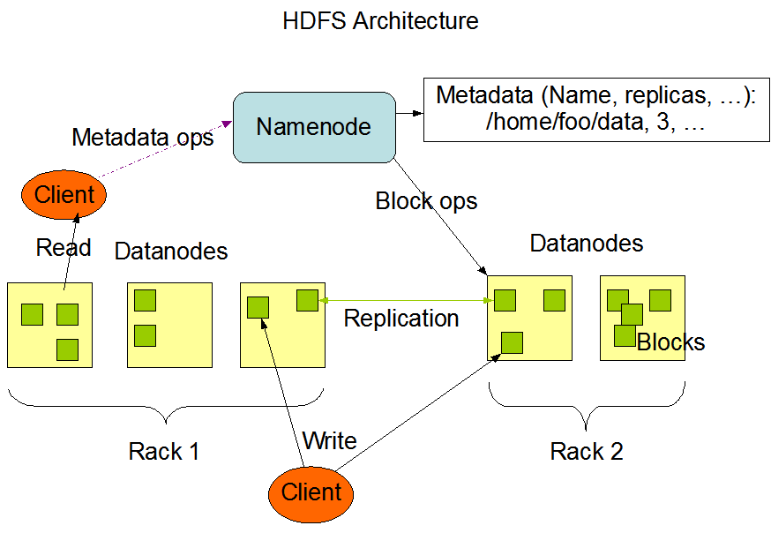
Overall Architecture

Slide 5
NameNode
Master-slave architecture
1x NameNode (coordinator)
Manages name space, coordinates for clients
Directory lookups and changes
Block to DataNode mappings
Files are composed of blocks
Blocks are stored by DataNodes
Note: User data never comes to or from a NameNode.
The NameNode just coordinates

Slide 6
DataNode
Many DataNodes (participants)
One per node in the cluster. Represent the node to the NameNode
Manage storage attached to node
Handles read(), write() requests, etc for clients
Store blocks as per NameNode
Create and Delete blocks, Replicate Blocks

Slide 7
Namespace
Hierarchical name space
Directories, subdirectories, and files
Managed by NameNode
Maybe not needed, but low overhead
Files are huge and processed in entirety
Name to block lookups are rare
Remember, model is streaming of large files for processing
Throughput, not latency, is optimized

Slide 8
Access Model
(Just to be really clear)
Read anywhere
Streaming is in parallel across blocks across DataNodes
Write only at end (append)
Delete whole file (rare)
No edit/random write, etc

Slide 9
Replication
Blocks are replicated by default
Blocks are all same size (except tail)
Fault tolerance
Opportunities for parallelism
NameNode managed replication
Based upon heartbeats, block reports (per dataNode report of available blocks), and replication factor for file (per file metadata)

Slide 10
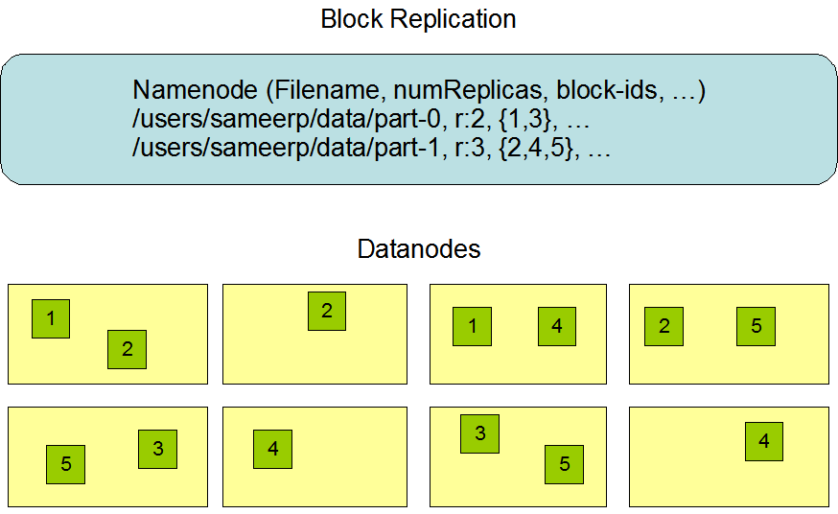
Replication

Slide 11
Location Awareness
Site + 3-Tier Model is default

Slide 12
Replica Placement and Selection
Assume bandwidth within rack greater than outside of rack
Default placement
2 nodes on same rack, one different rack (Beyond 3? Random, below replicas/rack limit)
Fault tolerance, parallelism, lower network overhead than spreading farther
Read from closest replica (rack, site, global)

Slide 13
Filesystem Metadata Persistence
EditLog keeps all metadata changes.
Stored in local host FS
FSImage keeps all FS metadata
Also stored in local host FS
FSImage kept in memory for use
Periodically (time interval, operation count), merges in changes and checkpoints
Can truncate EditLog via checkpoint
Multiple copies of files can be kept for robustness
Kept in sync
Slows down, but okay given infrequency of metadata changes.

Slide 14
Failure of DataNodes
Disk Failure, Node Failure, Partitioning
Detect via heartbeats (long delay, by default), blockmaps, etc
Re-Replicate
Corruption
Detectable by client via checksums
Client can determine what to do (nothing is an option)
Metadata

Slide 15
Datablocks, Staging
Data blocks are large to minimize overhead for large files
Staging
Initial creation and writes are cached locally and delayed, request goes to NameNode when 1st chunk is full.
Local caching is intended to support use of memory hierarchy and throughput needed for streaming. Don’t want to block for remote end.
Replication is from replica to replica, “Replication pipeline”
Maximizes client’s ability to stream

