Slide 1
Drugs & Disease – Fall 2024
Course Overview:
Introductory Biochemistry
DNA, RNA, protein synthesis, biotechnology
Immunology & Immunotherapy
Drug Discovery – Enzyme Inhibitors
Genome Editing – CRISPR
Final presentations
My Story
Born in Ottawa Canada
Undergraduate: University of Waterloo, largely physics
MS: Penn State University
PhD: Carnegie Mellon
Post-doc: Stanford University
Faculty: University of Virginia, Carnegie Mellon
Research area:
Protein structure and dynamics
Drug discovery
Expectations:
6 Problem sets
One mid-class exam
Presentation (10 min, topic of choice)
Short paper (Same topic as presentation)
Take-home exercise:
Send me an email with a short paragraph describing why you took the course and what you hope to take away from the course.
Course materials:
https://www.andrew.cmu.edu/user/rule/Drugs_Disease/

Slide 2
Chemistry and Biology Fundamentals
Chemical Bonding
Functional Groups

Slide 3
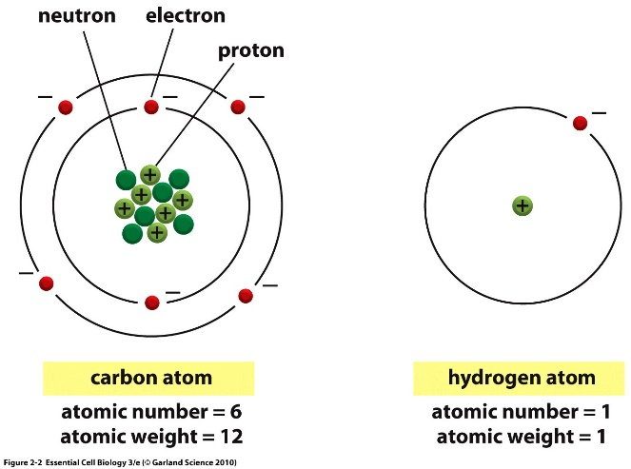
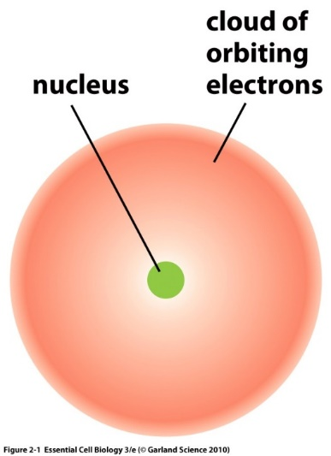
Atoms are composed of:
Protons – positively charged particles
Neutrons – neutral particles
Electrons – negatively charged particles
Protons and neutrons are located in the nucleus.
Electrons are found in orbitals surrounding the nucleus.
The overall charge on an element is neutral (#electrons = # protons).
Atomic number = # of protons = # electrons in element
Isotope = different # of neutrons = same bonding capability

Slide 4
Electron Orbitals
Electrons arranged around the nucleus in specific regions called orbitals.
Each orbital can only hold two electrons
Orbitals are grouped into electron shells
Numbered 1,2,3…
Lower numbers = shells closer to the nucleus
First shell can hold a maximum of 2 electrons
Second shell can hold up to 8
Third shell can also hold 8
Orbitals are usually filled from lowest energy (inner shell) to highest energy (outer shell)
Outer shell is the valence shell and is used for forming bonds with other elements.
The most stable configuration is a complete (full) outer shell.
Electron Configuration of Ne – an inert gas (10e)
Shells: 1st = 1s, 2nd = 2s + 2p, 3rd = 3s + 3p
Shell is a collection of orbitals with similar energy

Slide 5
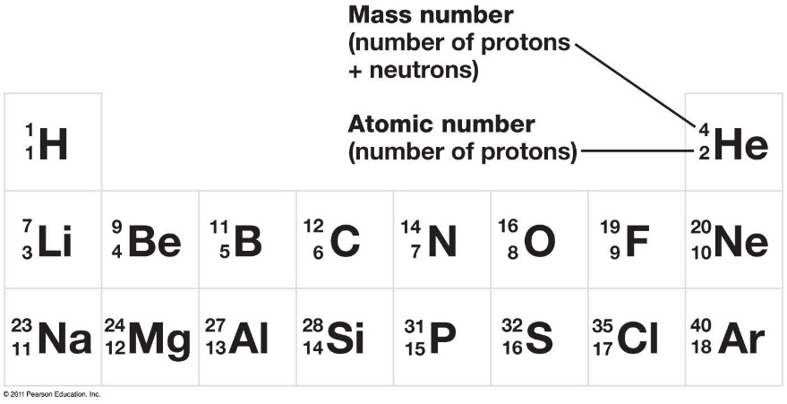
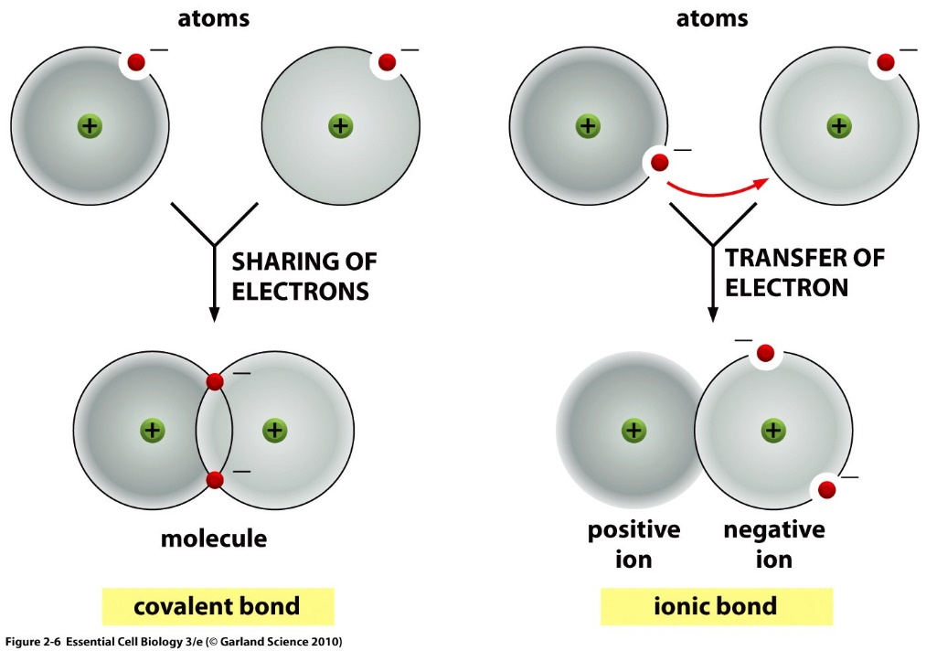
Ions or Covalent Chemical Bonds – What’s an Element going to do?
Elements like Li, Na, F, Cl, Mg, readily form ions to generate a complete outer shell.
Some elements cannot form stable ions because it would involve the loss or gain of too many electrons. This includes C, N, and O – which are common in biological systems.
Unfilled electron orbitals on elements like C, N, and O allow for the formation of covalent bonds, and atoms are most stable when each electron orbital is filled.
Each atom’s unpaired valence electrons are shared by both nuclei to fill their orbitals.
Substances held together by covalent bonds are called molecules
Example:
Li with 3 electrons

Slide 6
Covalent Bonds – Filling the Outer Shell by Sharing
The number of unpaired electrons in the outer shell determines the number of bonds an atom can make.
Multiple bonds form when atoms share multiple electrons.
The number of covalent bonds (valence) formed by common elements.
Oxygen = 2 bonds
Nitrogen = 3 bonds
Carbon = _________
Sulfur = 2 bonds (in biological systems)
Hydrogen = 1 bond
Phosphorous = 5 bonds in biological molecules
You must know these numbers.
Abbreviated Chemical Drawings:
“C” for carbon is not drawn, but carbons are found at the ends of lines and when lines join or “kink”
Hydrogens attached to carbon are not shown, you need to add them to complete to complete the valence of the carbon atoms.
You must know how to do this.
6e
o.s.
5e
o.s.
How many bonds will carbon form?
4e
o.s.
“C” for carbons
Complete valence with H

Slide 7
Representation of Molecules

Slide 8
Electron Sharing and Bond Polarity – Are All Bonds Equal?
Polar bonds = different electron density of each atom.
The polarity of a bond depends on the electronegativity of the atoms.
Electronegativity - ability of atoms to pull electrons from other atoms.
Atoms with higher electronegativity will develop a partial negative charge, the atom they are bonded will have a partial positive charge.
The order of electronegativity is:
H ~ C < N < O
Increased pos. charge of nucleus.
Electron Sharing Continuum

Slide 9
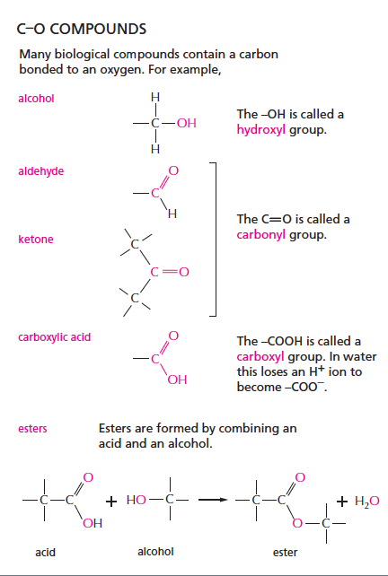
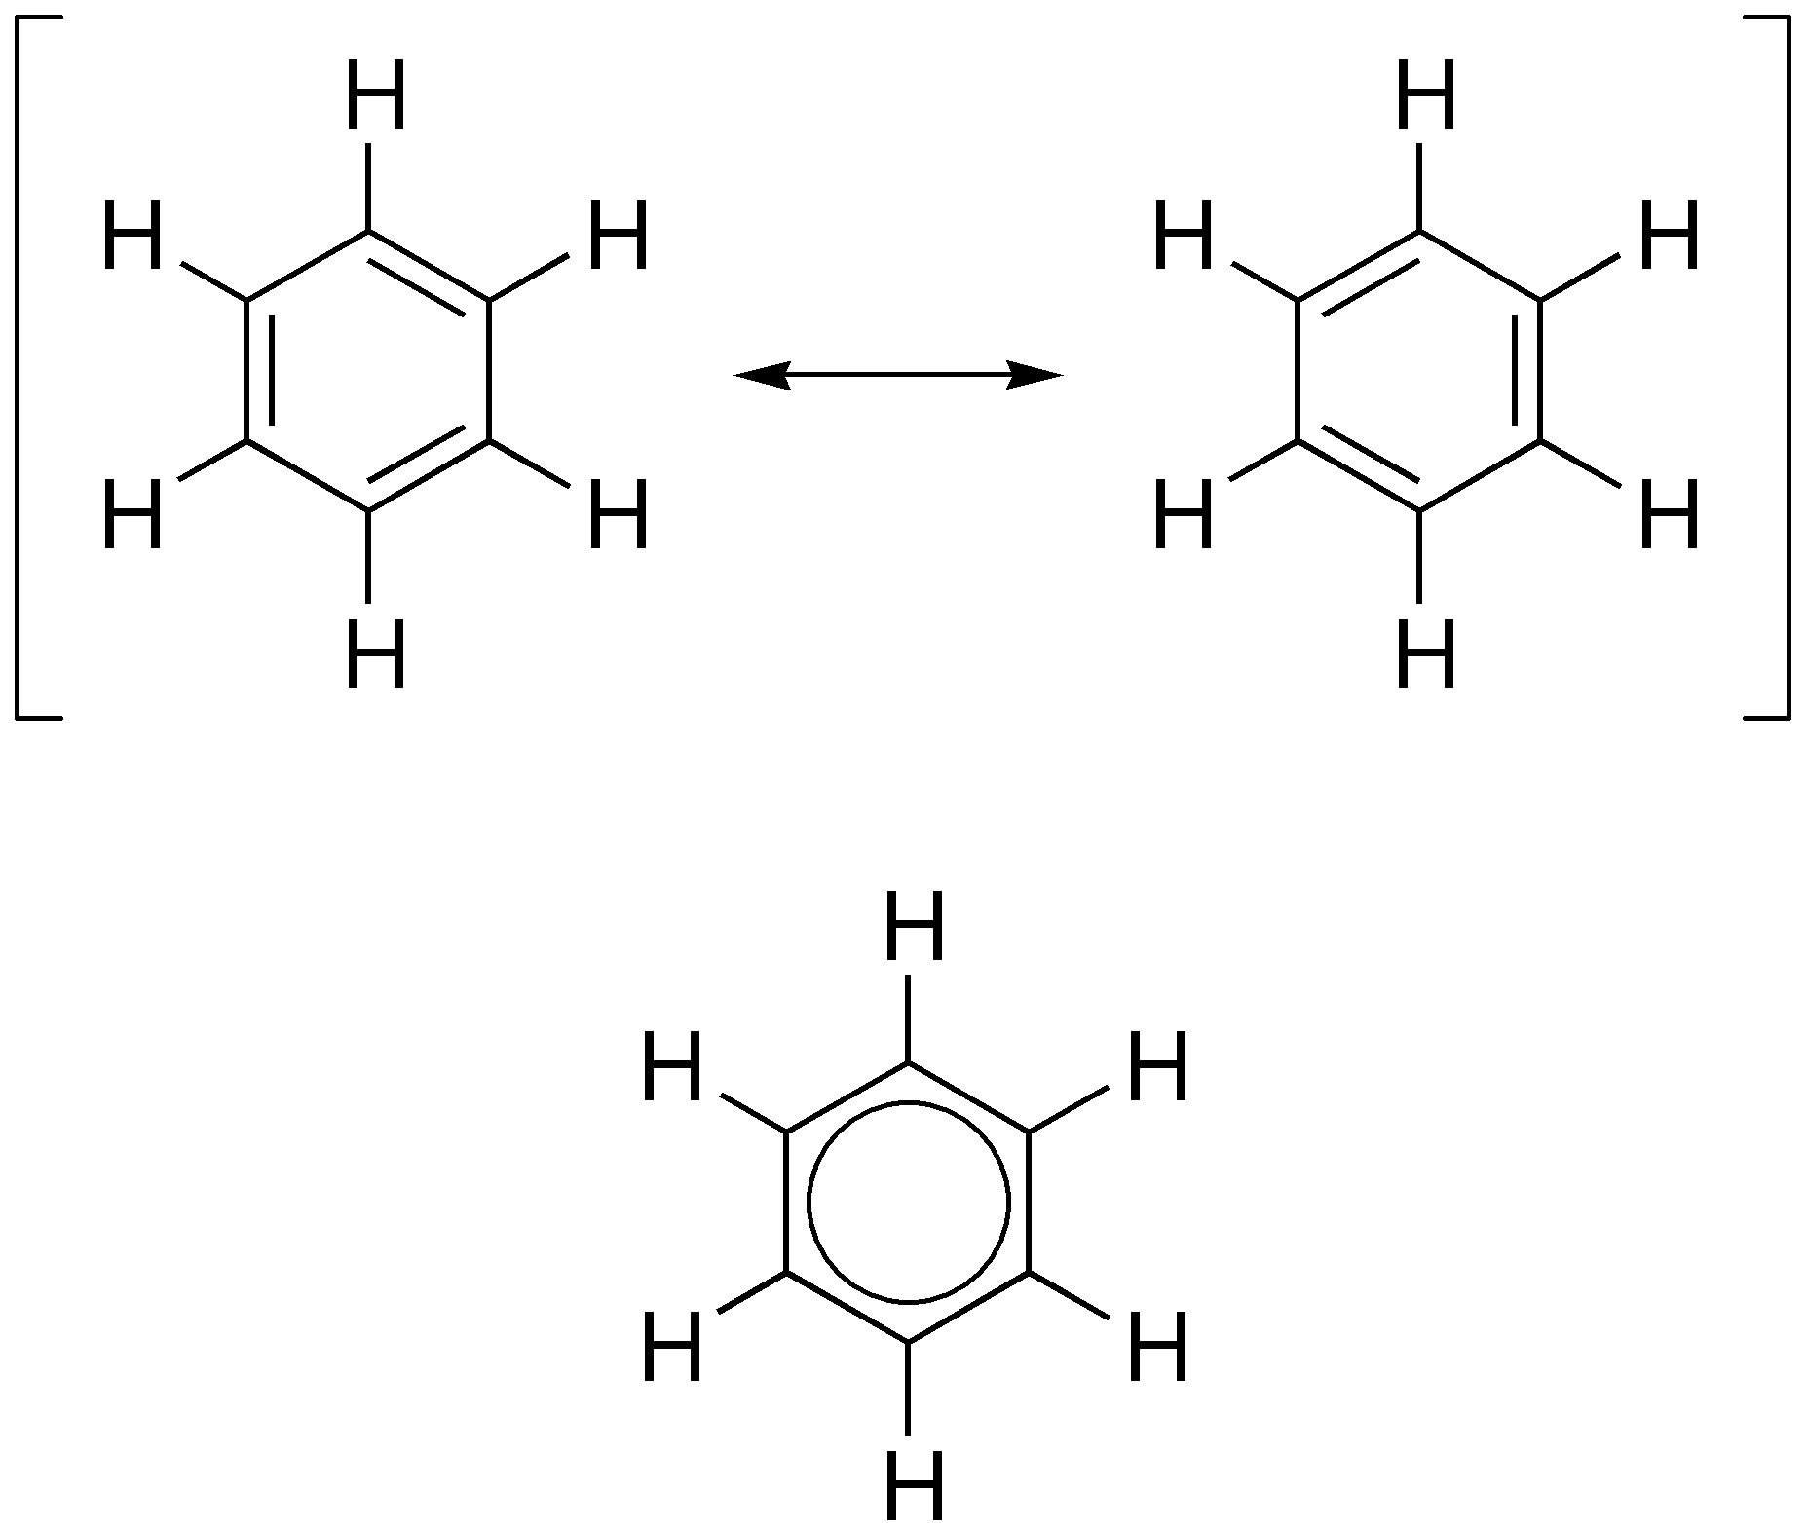
Functional Groups – You should Become Familiar with These
C–H Groups
(hydrophobic)
Methyl
Alanine (amino acid)
Aromatic – planer rings, alt double bonds
C–S Compounds
thiol
Phenyl
Phenylalanine (amino acid)
Cysteine (amino acid)

Slide 10
Key Points & Expectations
Chemistry
Number of bonds formed by common elements:
(N=3, C=4, O=2, S=2, H=1).
You should be able to complete chemical structures by adding hydrogens to carbons.
Predict degree of bond polarity based on electronegativies, N-H and O-H and C=O are polar, C-H is not.
Be able to draw the following functional groups & identify them on larger molecules.
Non-polar:
Methyl
Phenyl
Polar:
Alcohol (C-OH)
Thiol (C-SH)
Carboxylate (ketone, aldehyde) (C=O)
Ester
Carboxylic acid
Amide
Amino
A. Give the names of the functional groups on these two amino acids.
B. Which functional groups are common?
1.
2.
3.
1.
2.
3.

