Slide 1
Lecture 1 Chemistry and Biology Fundamentals II
Chirality of carbon, chiral drugs
Molecular interactions
pH and charge
Protein Structure and Stability
Ligand Binding
Proteins as enzymes (PKU disease)
Notes:
The characteristics of substances including those in cells, depend on which atoms they contain.

Slide 2
Molecular Interactions
The energy change when two things come together can be approximated to be due to new inter-molecular interactions: $E_{A∪B}$.
$$∆E=E_{AB}−{(E}_{A}+E_{B})\sim E_{A∪B}$$
Interaction | Interaction | Energy (kJ/mol)
Electrostatic interactions (in water) | Full charges | ~5 kJ/mol/single interaction
Van der Waals: Dipole-Dipole | Perm. partial charges | ~0.05 kJ/A² x 100 A² = 5 kJ/mol for 100 A²
Van der Waals: Induced-dipole | Induced partial charges | ~0.02 kJ/A² x 100 A² = 2 kJ/mol for 100 A²
H-Bonds | Electrostatic + e sharing | ~20 kJ/mol gross, ~5 kJ/mol net

Slide 3
Electrostatic energy of point charges.
i) Electrostatics: The interaction energy between two charged particles is:
$$E=\frac{1}{D}\frac{1}{4πε_{o}}\frac{q_{1}q_{2}}{r}$$
The energy depends on the charges of the particles (q1, q2), distance (r)
between the two charges, and the dielectric constant (D) of the media.
How strong are electrostatic interactions?
Na⁺ Cl⁻ = ~ -700 kJ/mol in vacuum (D=1) when r = 2A
Water has a high dielectric constant of 80 due to its polar nature. How does this affect the energy of interaction?
Van Der Waals Forces:
ii) Dipole-dipole – an electrostatic interaction that involves permanent partial charges (these are sometimes called Keesom forces).

Slide 4
iii) Induced dipole (often referred to as London Dispersion)
E
d

Slide 5
iii) Induced dipole (often referred to as London Dispersion)
isobutane: 261 K
butane: 272 K
Although weak, the effects of van der Waals are easily observed: Boiling points of two hydrocarbons:
1. Same number of carbons, why the difference in boiling points?
3. Which of these will have the most favorable vdw interaction:
1 2 3
2. How will van der Waals interaction energies scale with contact area?
4. Which of these will have the least favorable vdw interaction:
1 2 3
E
0
Contact area (A²)

Slide 6
https://www.youtube.com/watch?v=uhfXbSSrabw

Slide 7
iv) Hydrogen Bonds
H-bonds are primarily (90%) an electrostatic attraction between:
Electropositive hydrogen, attached to an electronegative atom is the hydrogen bond donor (i.e. NH).
Electronegative hydrogen bond acceptor (e.g. the lone pairs of oxygen, or C=O group of an amide).
A “bond” implies electron sharing – about 10% of the electron is shared from one molecule to the next in the case of H-bonds
The energy released when an H-bond forms depends on the distance and angle of the bond.
Usually hydrogen bonds are exchanged, resulting in small net energy differences:
Note that the proton is NOT transferred to the acceptor, it remains covalently bonded to the donor atom. The Hydrogen Bond is the interaction between the X-H donor and electronegative acceptor.

Slide 8
Relative Energy of Interactions
Interaction | Interaction | Energy (kJ/mol)
Covalent Bond | Electron sharing | 200-400 kJ/mol
Electrostatic interactions (in water) | Full charges | ~5 kJ/mol/single interaction
VdW - Dipole-dipole (Keesom) | Perm. partial charges | ~0.05 kJ/A² x 100 A² = 5 kJ/mol for 100 A²
VdW – Induced dipole (London) | Induced partial charges | ~0.02 kJ/A² x 100 A² = 2 kJ/mol for 100 A²
H-Bonds | Electrostatic + e sharing | ~20 kJ/mol gross, ~5 kJ/mol net
How does the energy of the last four interactions compare to covalent bonds?
1. Stronger 2. Weaker 3. The Same
2. Which of these are closer to thermal energy, kT = 2.5 kJ/mol @ room temp.
3. What is the advantage of a weak interaction in biology?

Slide 9
The Geometry of Simple Molecules
The shape of a molecule is determined by the geometry of its bonds.
Carbon, oxygen, and nitrogen often form bonds with a tetrahedral geometry

Slide 10
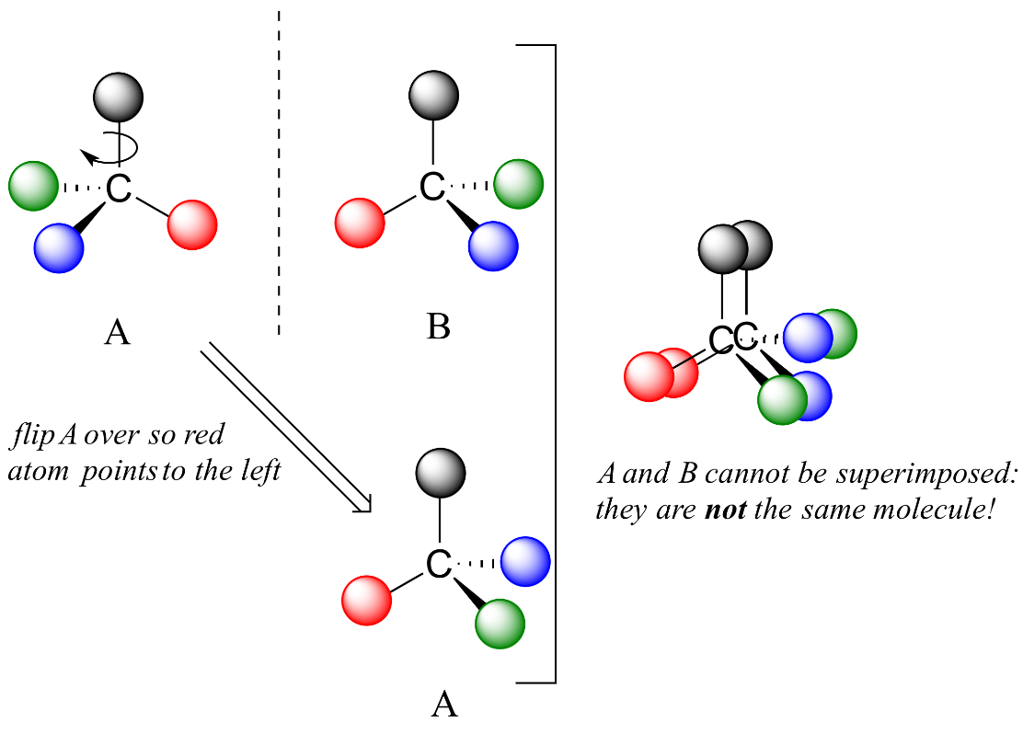
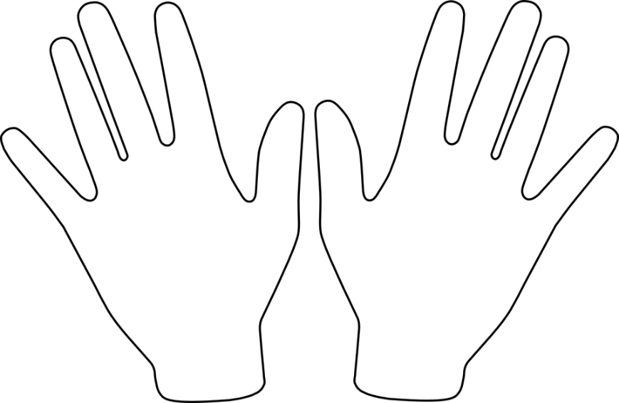
Unique Feature of Tetrahedral Carbon - Chirality
A single tetrahedral carbon atom can have four groups attached (group = collection of atoms)
If the four groups are different, then two forms of the molecule are possible, they are mirror images of each other.
The carbon that has four different groups is called a chiral carbon.
The two different mirror-image molecules are called enantiomers
These two cannot be superimposed on each other (superimposed = rotated so that the same atoms overlap)
A mixture of both enantiomers is called a racemic mixture.
One naming system to distinguish enantiomers is D & L

Slide 11
Identify the Chiral Centers on Threonine
Can you identify chiral centers?
Which carbon is chiral?
1 Yes or No?
2 Yes or No?
3 Yes or No?
4 Yes or No?
4
3
2
1

Slide 12
Chirality and Molecular Interactions
Two Different enantiomers (L and D alanine) binding to the same receptor protein
L-Alanine binds better because of more favorable _______________ interactions.

Slide 13
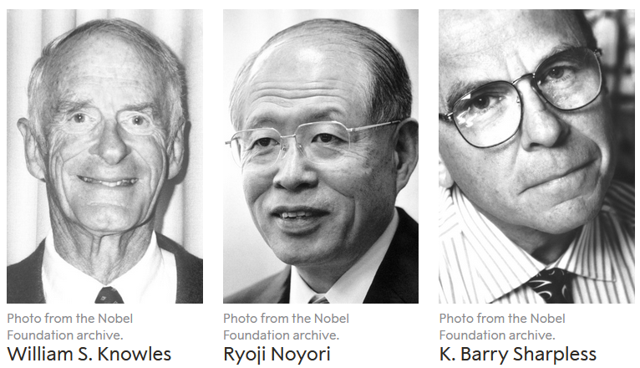
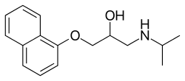
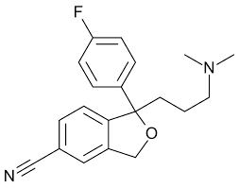
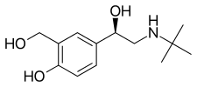
Drugs with Chiral Centers
Nobel Prize for Chiral Synthesis 2001
and a fun game:
https://educationalgames.nobelprize.org/educational/chemistry/chiral/game/game.html
levamisole
Propranolol
1. Racemic mixture is used to treat high blood pressure.
3. L-form used to treat parasitic worm infections
citalopram
levalbuterol
4. Antidepressent (escitalopram is L)
2. R-enantiomer used to treat asthma
Notes:
Propranolol – beta blocker – high blood pressure (racemic)
Valsrtan – aniotensin II receptor blocker – high blood pressure
Levalbuterol – b2-adrenergic receptor agonist – asthma – R-enantiomer
Levamisole – parasitic worm infections – L-form
Citalopram – antidepressant – racemic (Escitalopram is L)
Thalidomide – current use is cancer treatment, was originally prescribed as anxiety & morning sickness – causes birth defects.

Slide 14
pH, Strong Acids & Bases
pH = –log [H⁺] = -log[H₃O⁺]
The pH of a solution tells us how acidic the solution is.
The pH scale is used to transform the large range of possible [H+] values to more manageable numbers.
Note a low pH is a high [H+].
The pH is a property of the solvent (water) and can be changed by the addition of a strong acid or base, such as HCl or NaOH.
Acids release protons and will lower the pH of the solution, e.g.
HCl + H₂O H₃O⁺ + Cl⁻
Bases (e.g. ammonia, sodium hydroxide) will absorb protons and lower the hydrogen ion concentration. These increase the pH.
NaOH Na⁺ + OH⁻
OH⁻ + H₃O⁺ 2 H₂O
Hydronium ion
Water
Hydroxide ion
1. Which solution has a higher H⁺ concentration, pH=3 or pH 4.
2. How large is the difference?

Slide 15
Acids and Bases.
Strong acid – complete ionization in solution. e.g.
HCl H⁺ + Cl ⁻
Why this is important: protonation/deprotonation changes the charge on species, either creating or destroying strong electrostatic interactions!
Weak Acid – incomplete ionization in solution.
“HA”=protonated form
“A”=deprotonated form (conjugate base)

Slide 16
What Affects the Degree of Protonation?
1. The extent of protonation/deprotonation depends on the pH of the solution:
Low pH values will favor protonation of acids since there are many protons that will collide with (A) to make (HA).
High pH values will favor deprotonation of acids since there are fewer protons to protonate the acid.
What would you expect to happen to the fraction of the acid that is protonated (f_{HA}) as the pH of the solution is decreased?
$$f_{HA}=\frac{[HA]}{\left[HA\right]+[A]}$$
Fraction
protonated
2. The amount of protonated/deprotonated species also depends on the chemical properties of the acid.
Comparing acetic acid to a protonated amine. At neutral pH (7) most of the acetic acid will be deprotonated while most of the amine will be protonated.
Favored at pH=7
(stronger acid)
pH
99%
The pKa of an acid is the pH where equal amounts of protonated and deprotonated species are found.
Favored at pH=7
(weaker acid)
99%

Slide 17
Key Points & Expectations
Chemistry
Number of bonds formed by common elements:
(N=3, C=4, O=2, S=2, H=1).
You should be able to complete chemical structures by adding hydrogens to carbons.
Chiral carbon and enantiomers - different enantiomers can have different properties. You need to identify chiral carbons.
Polar (unequal charge distribution, e.g. N-H) versus non-polar bonds (e.g. C-H). You need to be able to identify polar and non-polar bonds.
H-bond - Partial charges due to X-H interacting with Y (X & Y electronegative)
H-bond - Identify donors and acceptors, partial charges
pH – be able to predict the charge on a group, given the pH of the solution and the pKa of the acid.
Notes:
Simplest cell
- no nucleus, but has genetic material (information storage and replication
-bounded by cell membrane.
- extracts energy from environment to fuel growth, machinery must be in the cytoplasm

Slide 18
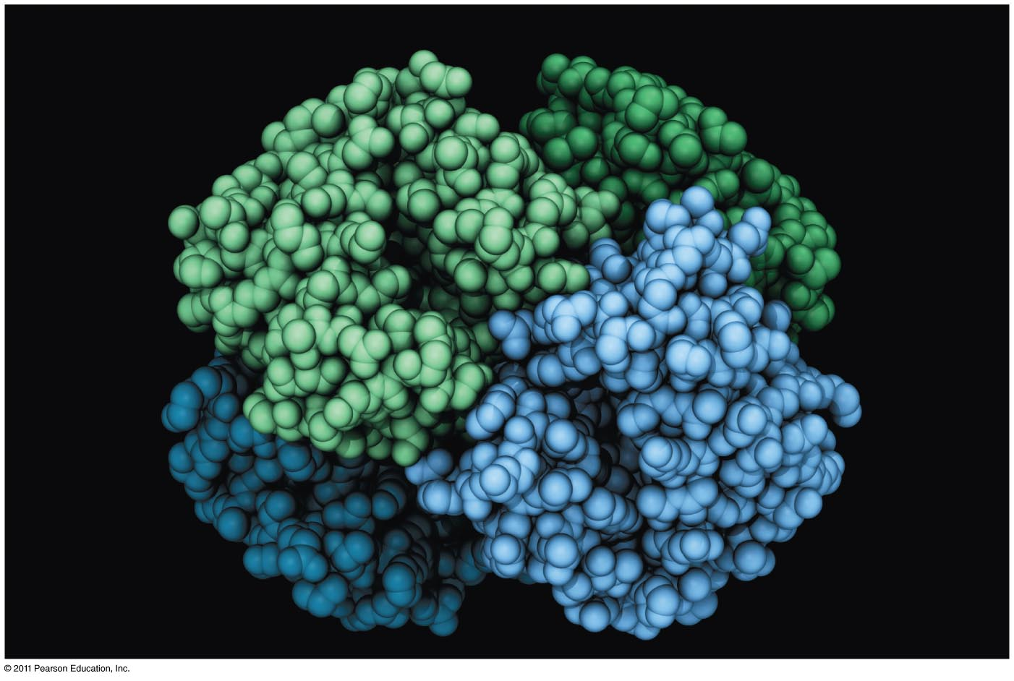
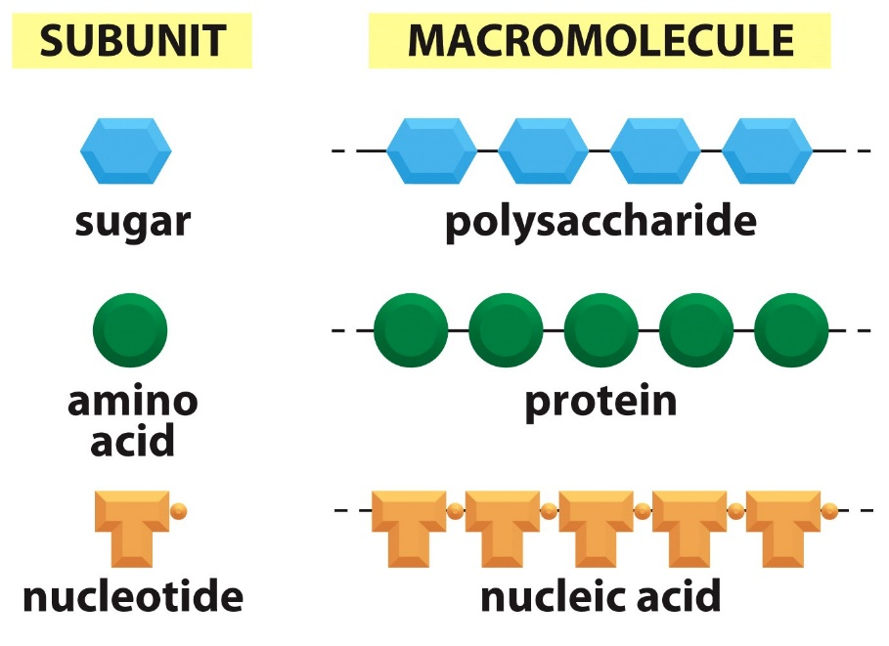
Proteins and Amino Acids

Slide 19
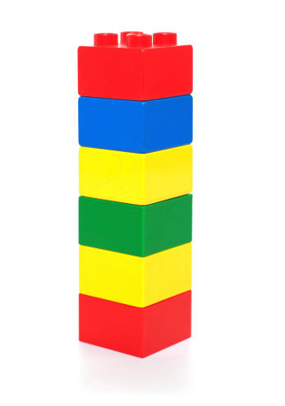
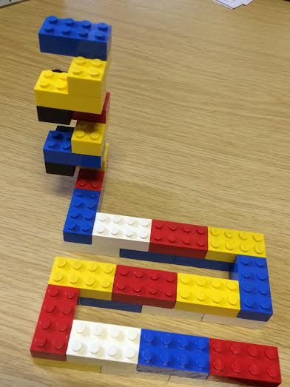
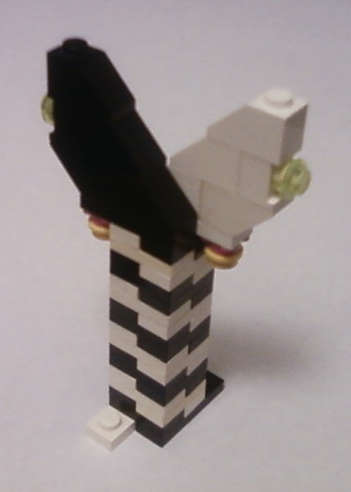
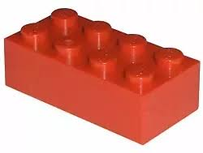
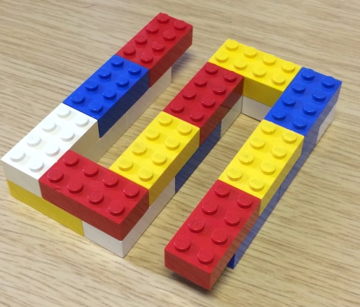
Structural Hierarchy of Proteins
Primary - sequence of amino acids, no 3D structural information
Secondary - local structural elements, only mainchain atoms involved
Tertiary - 3D position of all atoms, functional form of many proteins.
Quaternary - multiple chains – multiple chains often required for function.
Biological Function
(White and black represent two different chains)

Slide 21
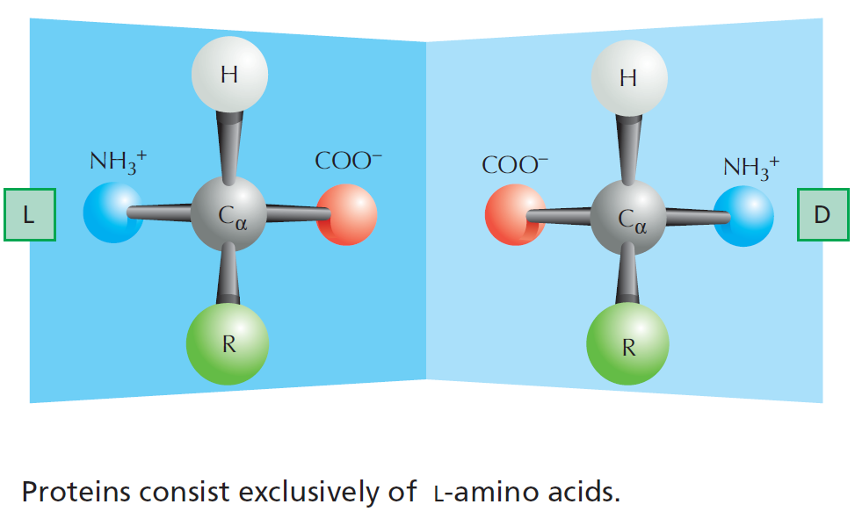
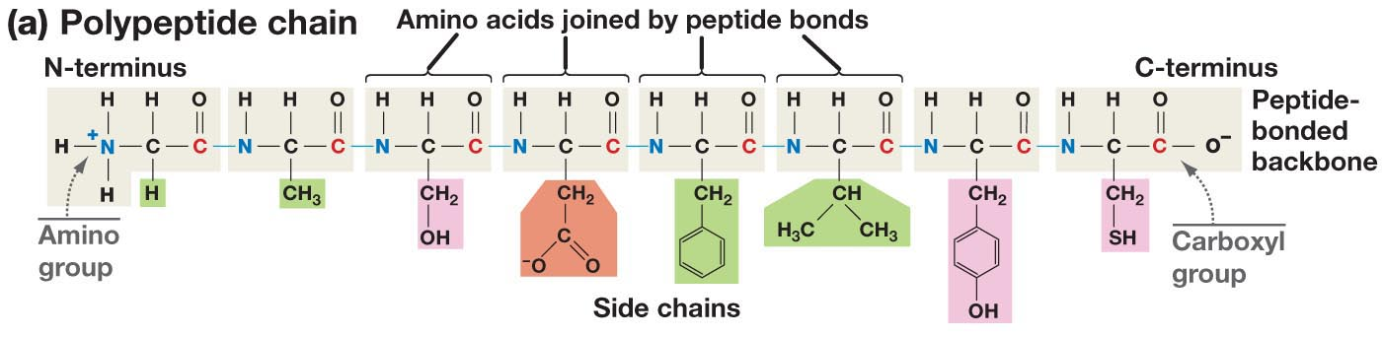
The Structure of Amino Acids and Proteins
Is there a chiral carbon on amino acids?
The amino group, Cα (and one hydrogen), and the carbonyl group are common to all amino acids
The N-Cα-C=O are the mainchain of the protein polymer.
The R groups are different –there are 20 common R groups they are the sidechain of the protein polymer – their sequence defines the properties of the protein.
(as does the ribosome that make them)

Slide 22
Primary Structure
Amino acids are joined together to form linear polymers by the formation of a peptide bond between the carboxyl of one amino acids and the amino group of the next.
This reaction releases water: a dehydration reaction.
The peptide bond can be broken (lysis) by the addition of water = hydrolysis.
Incorporated amino acid = residue (atoms are lost when the peptide bond is formed).
Polarity of chain direction – amino (N) terminus to carboxy(C) terminus = order of amino acids = sequence = primary structure
Mainchain (or backbone) – linear atoms of the polymer
Sidechain – atoms off the Ca carbon
Primary Structure – Expectations
Draw chemical structure given the sequence.
Determine the seq. from chemical structure.
Distinguish/identify:
Mainchain & Sidechain atoms,
Residue = aa in polymer,
N & C terminus,
Peptide bond(s).

Slide 23
Sidechain Functional Groups Affect Behavior (and the order is important)
Sidechains (R-groups) differ in their size, shape, reactivity, and interactions with water.
Nonpolar Sidechains: hydrophobic; do not form hydrogen bonds; coalesce in water - typically form the core of folded proteins.
Polar Sidechains: hydrophilic; form hydrogen bonds; readily dissolve in water
Ionizable Sidechains: Can be charged at certain pH values. Interact strongly with water.

Slide 24
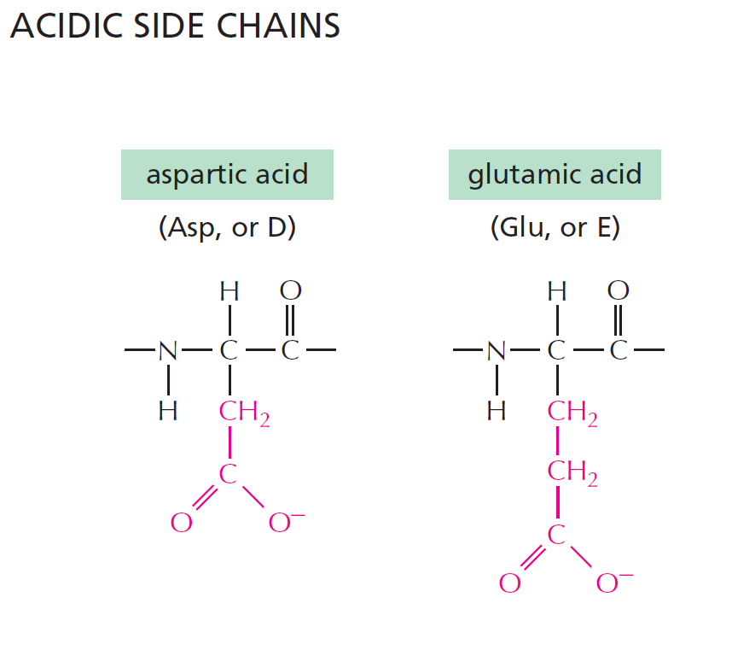
pK_{a} of sidechain ~ 4
pK_{a} of sidechain ~ 4
Have a net negative charge at pH 7.0
Notes:
Weak acids but still strong enough to give up its proton at pH = 7.0. Negative charges play an important role in proteins. Binding metal ions or acting in enzymatic reactions.

Slide 25
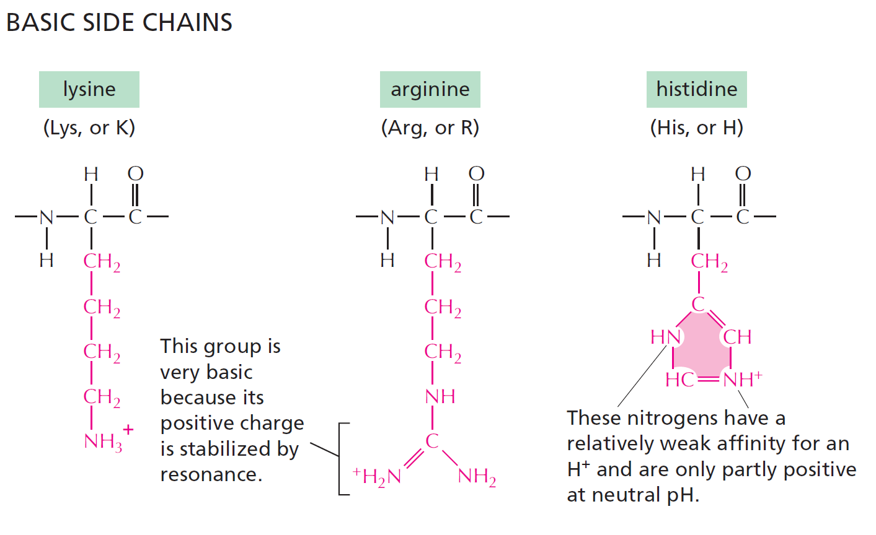
pK_{a} ~ 10
pK_{a} ~ 12
pK_{a} ~ 6
Have a net positive charge at pH 7.0
Positive charge when protonated
10% Protonated at pH 7.0
Notes:
Histidine is only 10% protonated at pH 7.0. With a pKa near neutral, plays an important role as a proton donor and acceptor in enzymatic reactions.

Slide 26
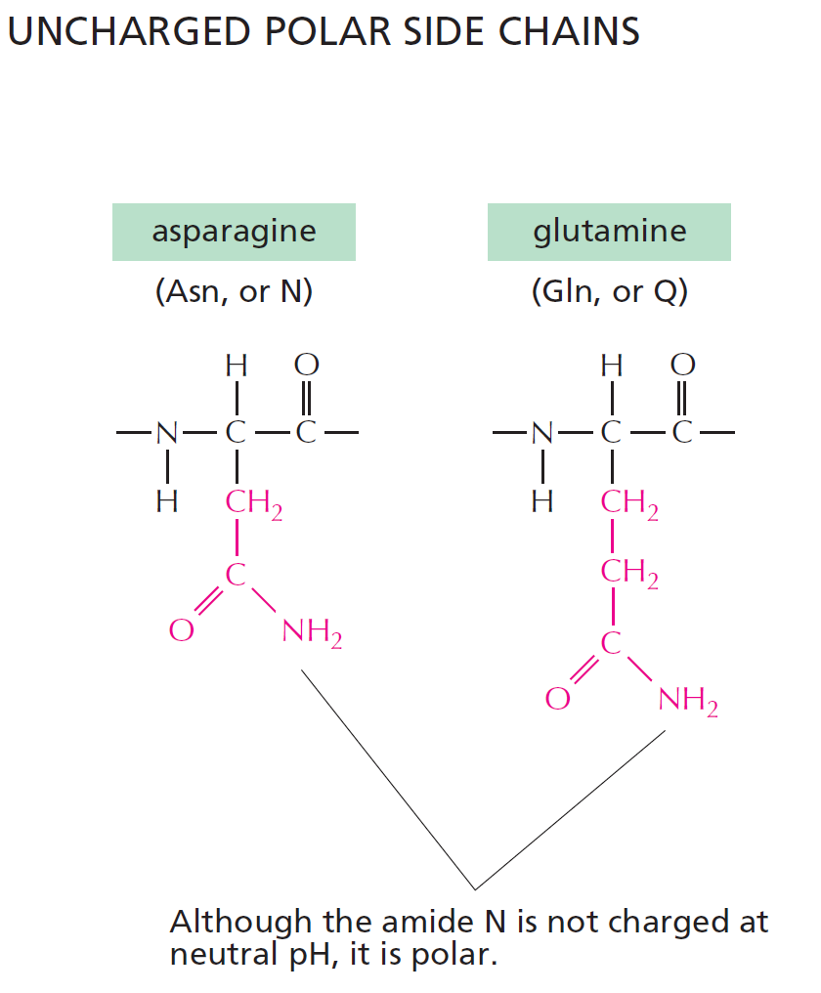
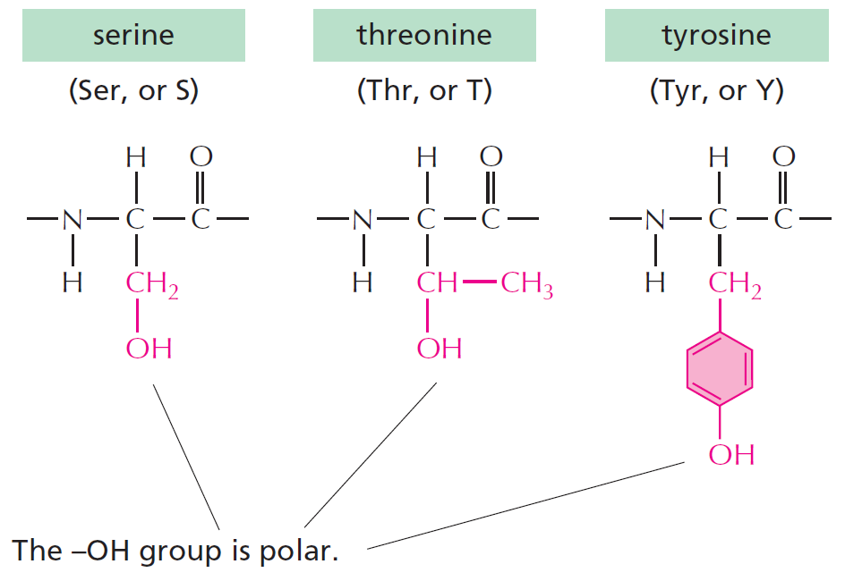
This is a significant
non-polar functionality
Forms weak H-bonds
Can ionize with a pK=8, forming thiolate ion (-S⁻)
Can form S-S disulfide bonds with other Cys residues
These can form what type of bond with water?

Slide 27
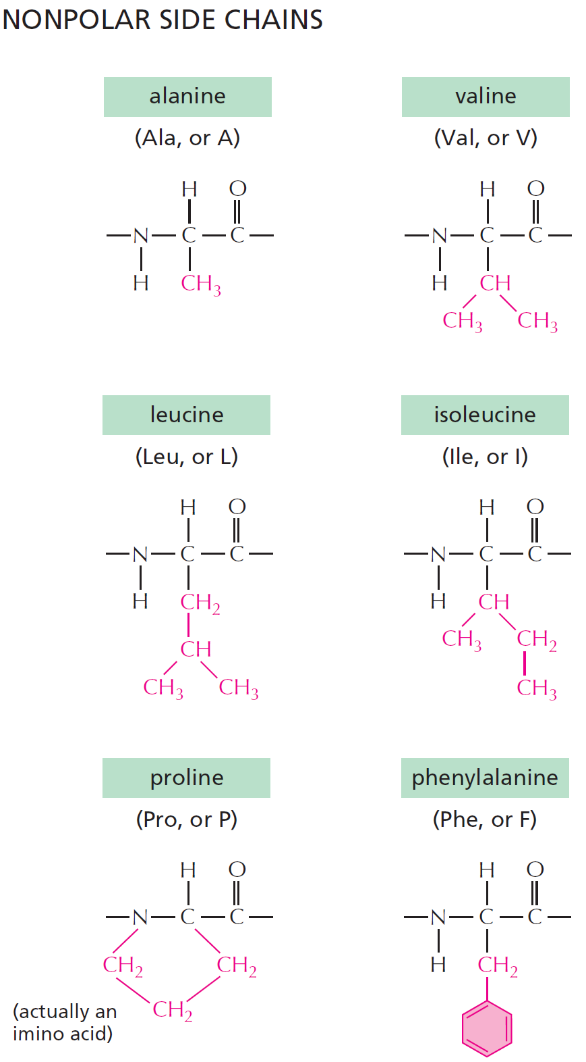
NONPOLAR SIDE CHAINS
H-bond donor
(polar functionality)
And lastly there is glycine:
Ring results in no NH group for H-bonding
No real functionality for its R group (H)
Only AA that is achiral

Slide 28
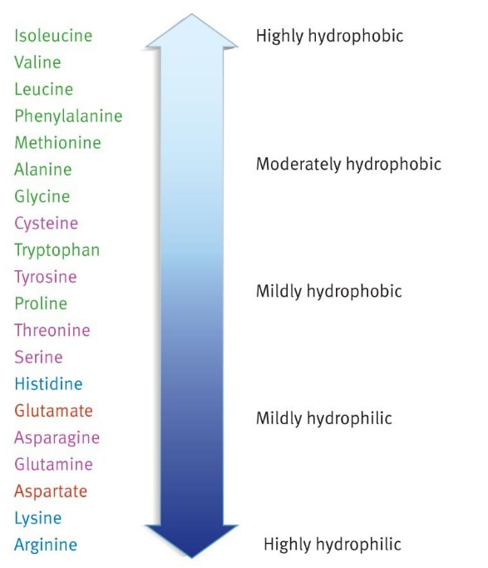
Summary of what you should know about amino acids:
Relative Hydrophobicity of Sidechains (one of many)
All amino acids have a carbon atom bonded to an amino group, a hydrogen atom and a carboxyl group. What makes each amino acid unique is its sidechain.
The common atoms will form the mainchain of the protein.
Most amino acids have at least one chiral center - the alpha carbon, exception is glycine, which is achiral.
You should be able to look at the functional groups on the side-chain and determine how they will interact with water:
Polar
Charged
Non-polar (hydrophobic). You should be able to justify large differences in hydrophobicity, e.g. Val versus Ala

