Slide 1
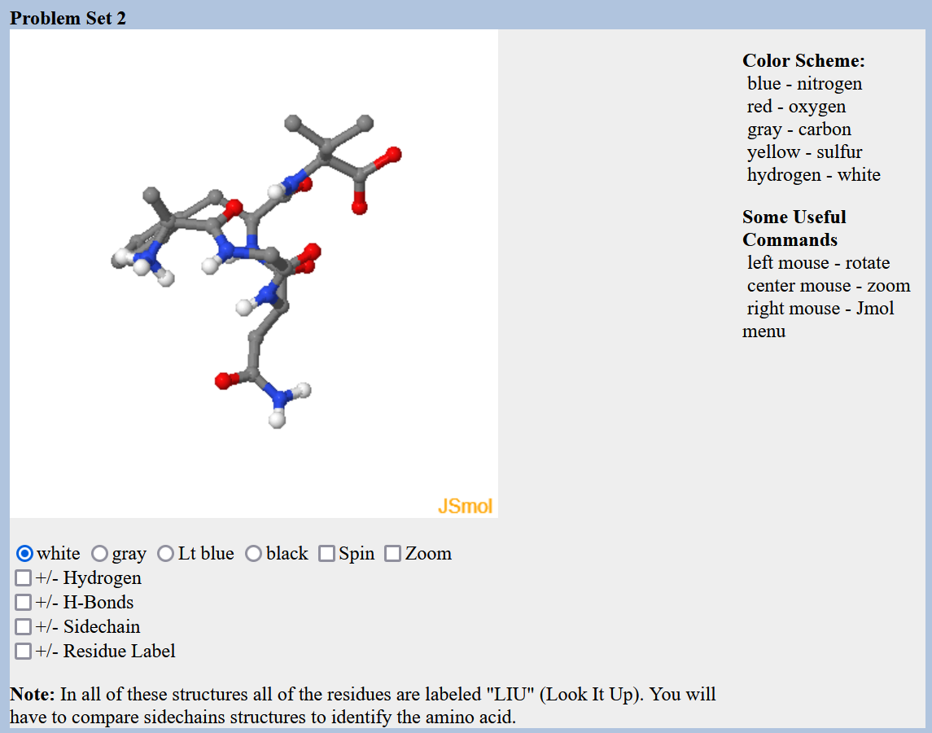
Lecture 2 Protein Structure and Function, Carbohydrates
Protein Structure and Stability
Ligand Binding
Proteins as enzymes (PKU disease)
Carbohydrates
Prior to lecture 3, please review the lecture material on introduction to nucleic acids (slides and video link posted on course web site)

Slide 2
Molecular Interactions
The energy change when two things come together can be approximated to be due to new inter-molecular interactions: $E_{A∪B}$.
$$∆E=E_{AB}−{(E}_{A}+E_{B})\sim E_{A∪B}$$
Interaction | Interaction | Energy (kJ/mol)
Electrostatic interactions (in water) | Full charges | ~5 kJ/mol/single interaction
Van der Waals: Dipole-Dipole | Perm. partial charges | ~0.05 kJ/A² x 100 A² = 5 kJ/mol for 100 A²
Van der Waals: Induced-dipole | Induced partial charges | ~0.02 kJ/A² x 100 A² = 2 kJ/mol for 100 A²
H-Bonds | Electrostatic + e sharing | ~20 kJ/mol gross, ~5 kJ/mol net

Slide 3
iv) Hydrogen Bonds
H-bonds are primarily (90%) an electrostatic attraction between:
Electropositive hydrogen, attached to an electronegative atom is the hydrogen bond donor (i.e. NH).
Electronegative hydrogen bond acceptor (e.g. the lone pairs of oxygen, or C=O group of an amide).
A “bond” implies electron sharing – about 10% of the electron is shared from one molecule to the next in the case of H-bonds
The energy released when an H-bond forms depends on the distance and angle of the bond.
Usually hydrogen bonds are exchanged, resulting in small net energy differences:
Note that the proton is NOT transferred to the acceptor, it remains covalently bonded to the donor atom. The Hydrogen Bond is the interaction between the X-H donor and electronegative acceptor.

Slide 4
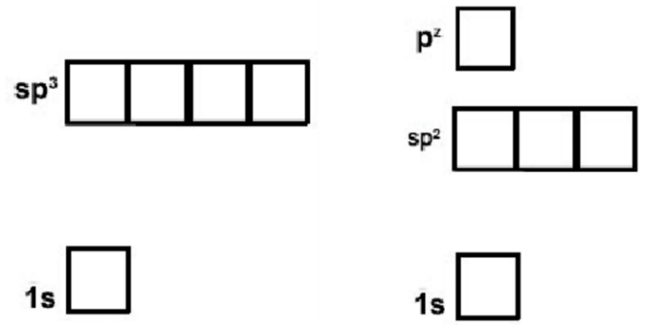
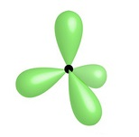
How to Identify Hydrogen Bond Donor and Acceptors
Exceptions, N in a delocalized system:
Will not accept from above or below the plane of the system, because the lonepair is delocalized.
Can accept in the plane of the ring if there is no attached hydrogen, via lone pair in sp2 orbital
Sp2 is used in amides, allowing favorable overlap of the full pz orbital with the pz on C and O
The lone pair in the pz is shared with the pz electrons on carbon and oxygen.
Due to electron sharing, there is only a slight neg. charge and the group does not accept an H-bond.
N – 7 electrons
Sp3 is used in ammonia, keeping the three hydrogen atoms as far from each other as possible. The fourth sp3 orbital is full with two electrons (lone pair).
The lone pair is an excellent acceptor.
Sp2
Sp3
Nitrogen in rings with three bonds can accept in the plane of the ring due to a filled lonepair orbital.
Hybrid orbitals are a mixture of atomic orbitals.
Nitrogen can form two types of hybrid orbitals, sp3 (tetrahedral geometry) or sp2 (planer) + pz

Slide 5
Indicate which atoms could donate an H-bond and which could accept and H-bond
ATOM | Donor(D)? | Acceptor(A)? | Neither (N)
1 (F)
2 (C_{aro}-H)
3 (N)
4 (-NH₂)
5 (C=O)
6 (O)
7 (O-H)
Can you?
Identify groups that can donate or accept hydrogen bonds?

Slide 6
Relative Energy of Interactions
Interaction | Interaction | Energy (kJ/mol)
Covalent Bond | Electron sharing | 200-400 kJ/mol
Electrostatic interactions (in water) | Full charges | ~5 kJ/mol/single interaction
VdW - Dipole-dipole (Keesom) | Perm. partial charges | ~0.05 kJ/A² x 100 A² = 5 kJ/mol for 100 A²
VdW – Induced dipole (London) | Induced partial charges | ~0.02 kJ/A² x 100 A² = 2 kJ/mol for 100 A²
H-Bonds | Electrostatic + e sharing | ~20 kJ/mol gross, ~5 kJ/mol net
How does the energy of the last four interactions compare to covalent bonds?
1. Stronger 2. Weaker 3. The Same
2. Which of these are closer to thermal energy, kT = 2.5 kJ/mol @ room temp.
3. Are there significant molecules with enough energy at room temperature to break the interaction?

Slide 7
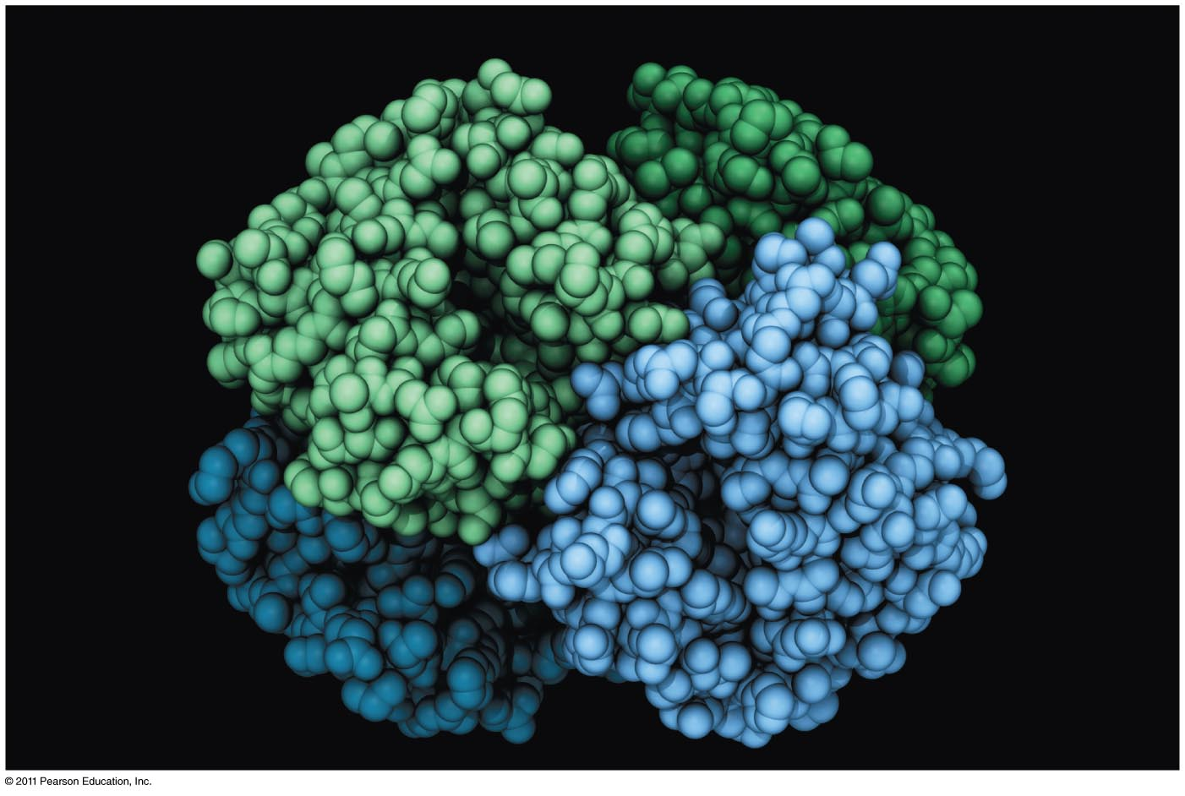
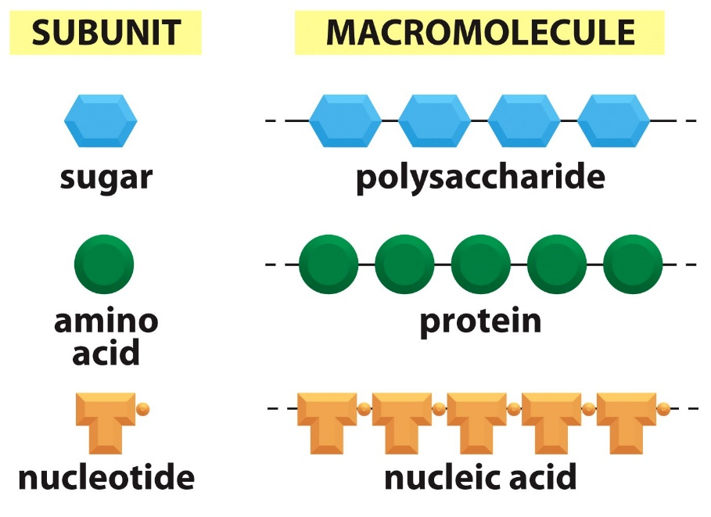
Proteins and Amino Acids

Slide 8
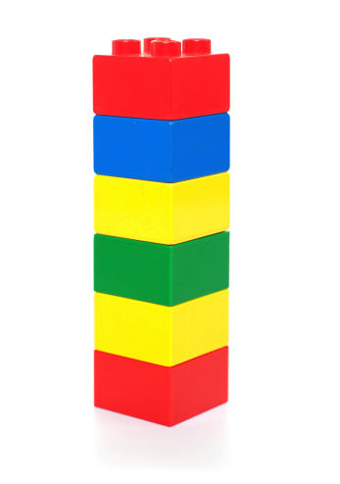
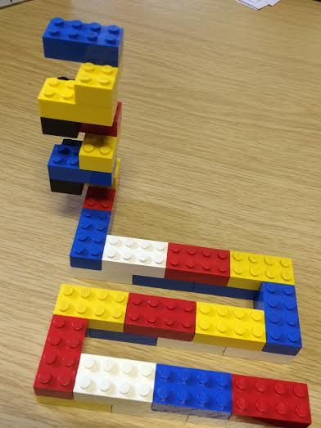
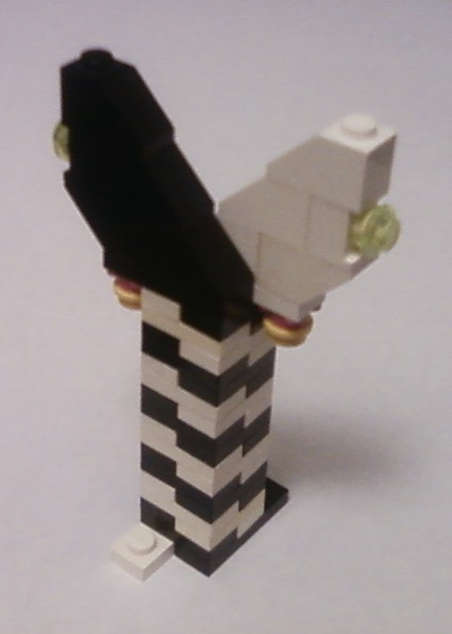
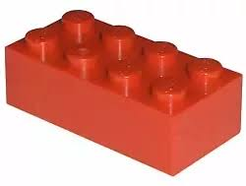
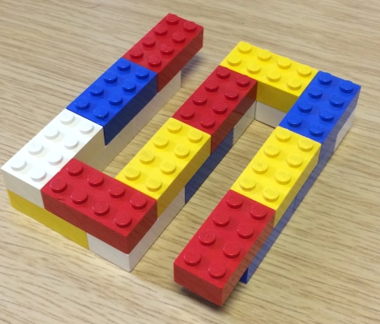
Structural Hierarchy of Proteins
Primary - sequence of amino acids, no 3D structural information
Secondary - local structural elements, only mainchain atoms involved
Tertiary - 3D position of all atoms, functional form of many proteins.
Quaternary - multiple chains – multiple chains often required for function.
Biological Function
(White and black represent two different chains)

Slide 10
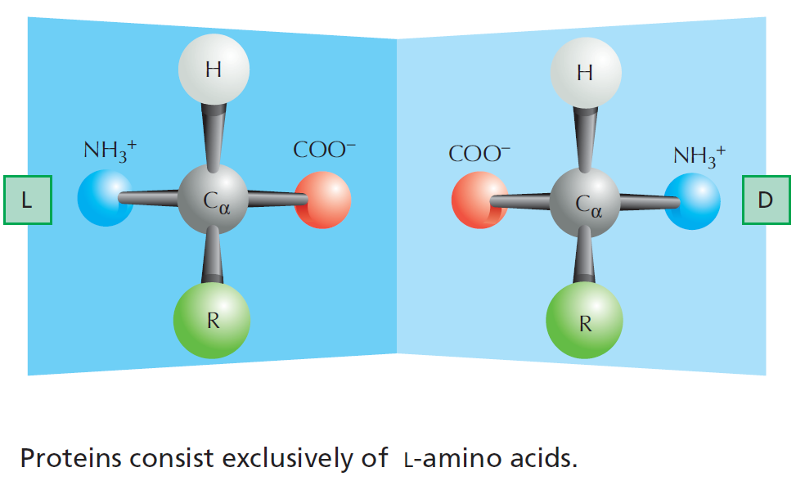
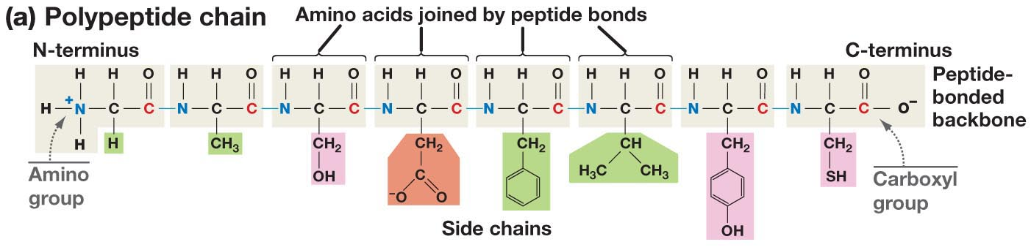
The Structure of Amino Acids and Proteins
Is there a chiral carbon on amino acids?
The amino group, Cα (and one hydrogen), and the carbonyl group are common to all amino acids
The N-Cα-C=O are the mainchain of the protein polymer.
The R groups are different –there are 20 common R groups they are the sidechain of the protein polymer – their sequence defines the properties of the protein.
(as does the ribosome that make them)

Slide 11
Primary Structure
Amino acids are joined together to form linear polymers by the formation of a peptide bond between the carboxyl of one amino acids and the amino group of the next.
This reaction releases water: a dehydration reaction.
The peptide bond can be broken (lysis) by the addition of water = hydrolysis.
Incorporated amino acid is called a residue (atoms are lost when the peptide bond is formed).
Polarity of chain direction – amino (N) terminus to carboxy(C) terminus = order of amino acids = sequence = primary structure
Mainchain (or backbone) – linear atoms of the polymer
Sidechain – atoms off the Ca carbon
Primary Structure – Expectations
Draw chemical structure given the sequence.
Determine the seq. from chemical structure.
Distinguish/identify:
Mainchain & Sidechain atoms,
Residue = aa in polymer,
N & C terminus,
Peptide bond(s).

Slide 12
Sidechain Functional Groups Affect Behavior (and the order is important)
Sidechains (R-groups) differ in their size, shape, reactivity, and interactions with water.
Nonpolar Sidechains: hydrophobic; do not form hydrogen bonds; coalesce in water - typically form the core of folded proteins.
Polar Sidechains: hydrophilic; form hydrogen bonds; readily dissolve in water
Ionizable Sidechains: Can be charged at certain pH values. Interact strongly with water.

Slide 13
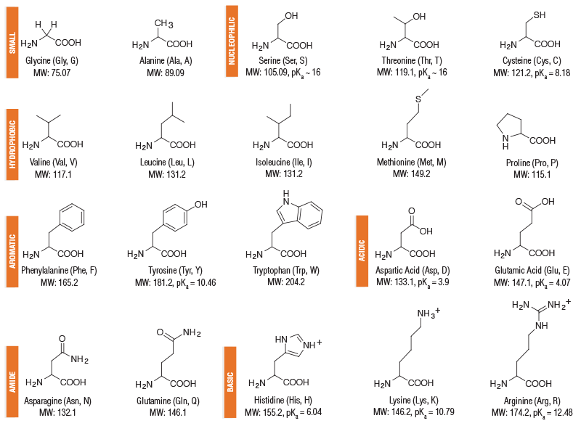
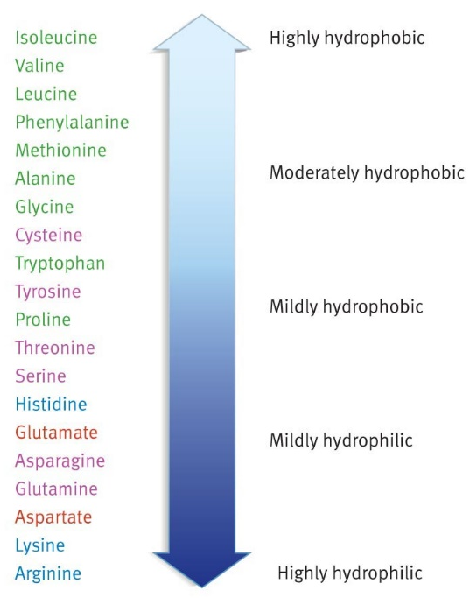
Amino Acids – Structure and Properties
Charge
Polar sidechains
Non-polar sidechains
Hydrophobicity
Aromatic sidechains
Ionizable sidechains
Polar sidechains
Ionizable sidechains

Slide 14
Secondary Structure
“Building blocks of proteins”
Hydrogen bonds between the mainchain carbonyl group of one amino acid and the mainchain amino group of another form a protein’s secondary structure.
A polypeptide must bend to allow this hydrogen bonding, forming:
α-helices
β-pleated sheets
The large number of hydrogen bonds in a protein’s secondary structure increases its stability - each hydrogen bond that is formed releases some energy.
All amino acids can be incorporated into either secondary structure
(However, some are found more frequently in one structure)
General Rule for Hydrogen Bonds:
X-H Y
X & Y are electronegative (N and O usually)
X-H = Donor of the hydrogen bond
Y = Acceptor of the hydrogen bond
Mainchain hydrogen bonds
N-H O=C
The NH is the hydrogen bond_________.
The C=O is the hydrogen bond __________.

Slide 15
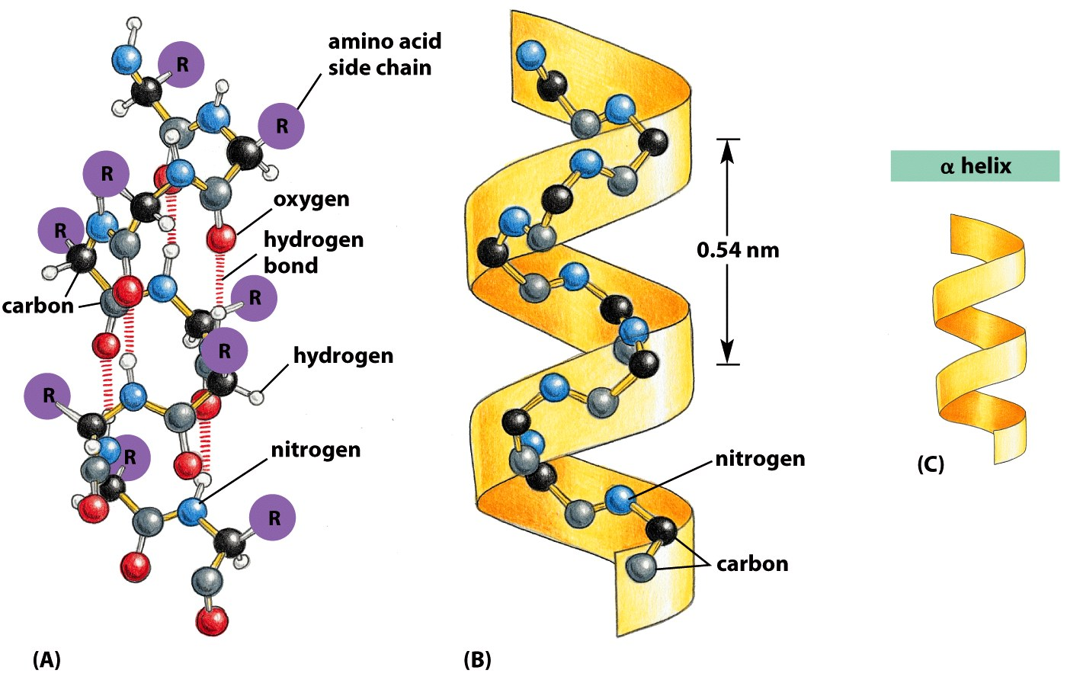
Alpha Helix
Spiral conformation (helix) in which every backbone N-H group donates a hydrogen bond to the backbone C=O group of the amino acid four residues earlier:
Intra-strand H-bonds, parallel to helix axis.
Side-chains project outwards.
Notes:
is a righthand-coiled or spiral conformation (helix) in which every backbone N-H group donates a hydrogen bond to the backbone C=O group of the amino acid four residues earlier (

Slide 16
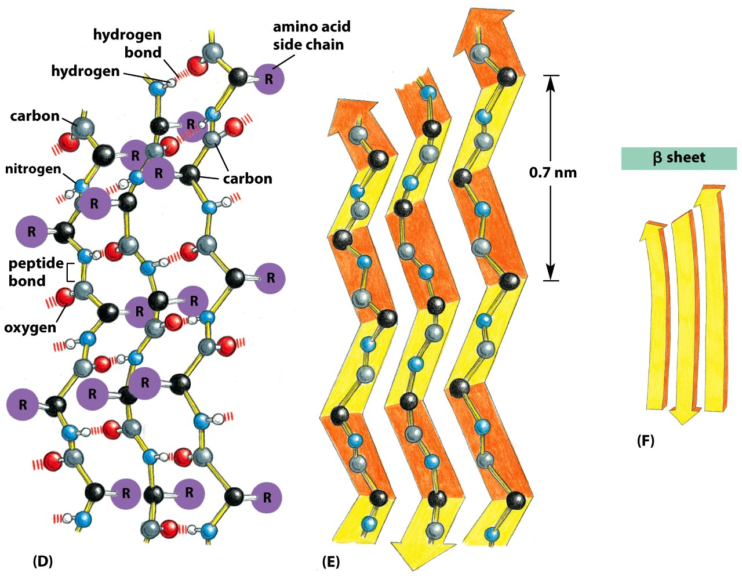
Beta Sheet
Beta-Strands connected laterally by backbone hydrogen bonds that are perpendicular to the strand, forming a generally twisted, pleated sheet.
Sheets can have two or more strands
Side-chains:
project up and down along a strand.
project in the same direction going from strand to strand across the sheet.
Notes:
strands connected laterally by at least two or three backbone hydrogen bonds, forming a generally twisted, pleated sheet.

Slide 17
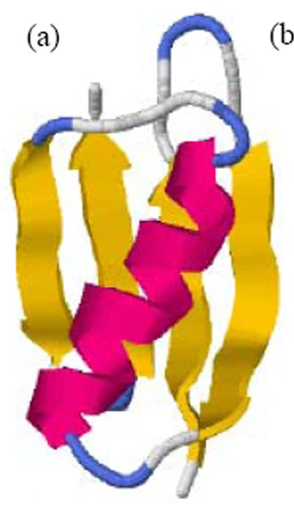
Tertiary Structure - Location of Residues in Globular Proteins
Red - amino acids with neg. sidechains (e.g. Asp)
Blue - amino acids with pos. sidechains (e.g. Lys)
Yellow – amino acids with polar sidechain (e.g. Asn)
Green - amino acids with hydrophobic side chains (e.g. Leu)
Amino Acid Type
 | Inside (I) | Surface (S)
Charged
Polar
Non-polar

Slide 18
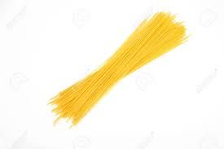
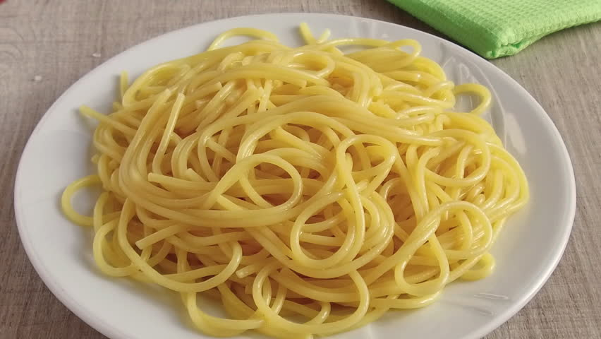
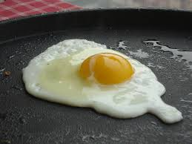
Protein Stability:
H-bonds
van der Waals
Hydrophobic effect
Chain disorder
Native
Unfolded
Protein Denaturation
Exposure to High Heat
Removal of Heat
Often, unfolded protein aggregate, which prevents refolding.

Slide 19
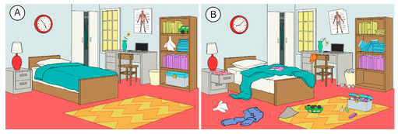
Unfolded Polypeptides Are Flexible – High Entropy stabilizes the Unfolded state
Exposure to High Heat
Energy and Entropy

Slide 20
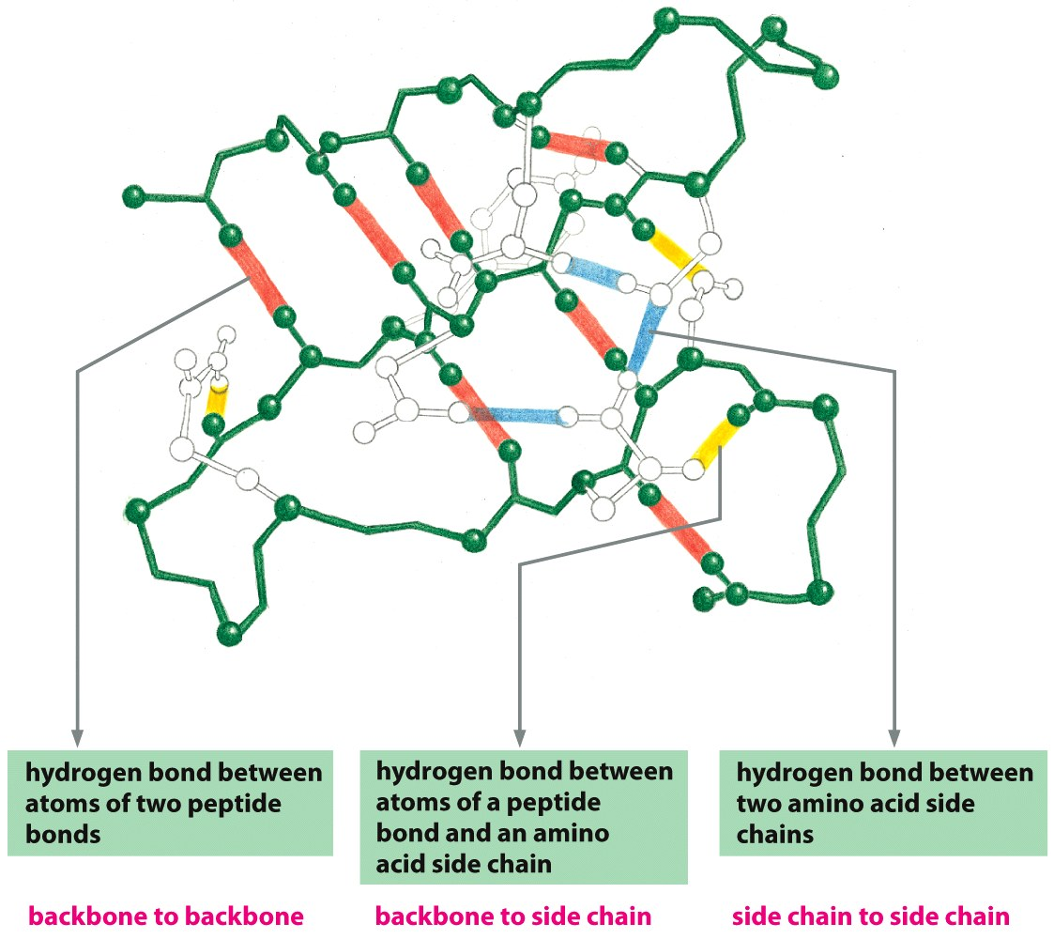
Hydrogen Bonding Stabilizes the Tertiary Structure
Hydrogen bonds form between hydrogen atoms and the carbonyl group in the peptide-bonded backbone – secondary structure
Hydrogen bonds are also found between hydrogen and electronegative atoms in side chains (sidechain-sidechain)
Sidechains can form hydrogen bonds to the mainchain too.
2^{ndy} Structure
3^{ry} Structure

Slide 21
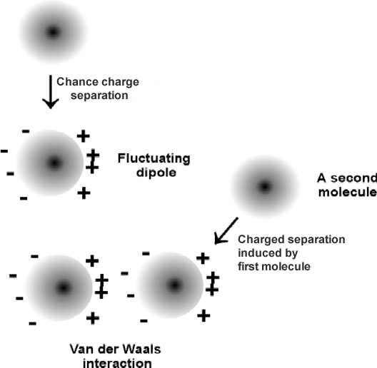
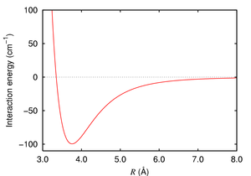
Van der Waals (VdW) interactions Stabilize the Folded State
VdW are weak electrostatic interactions between side chains due to temporary (fluctuating) charges.
Attractive from long distance
Distance at lowest energy is at the van der Waals radii of the atoms.
Optimized in the core of folded proteins by “knobs fitting into holes”
Strength proportional to contact area.
Notes:
van der Waals force (or van der Waals interaction), named after Dutch scientist Johannes Diderik van der Waals, is the sum of the attractive or repulsive forces between molecules (or between parts of the same molecule) other than those due to covalent bonds, the hydrogen bonds, or the electrostatic interaction of ionswith one another or with neutral molecules or charged molecules.^{[1]} The term includes:
force between two permanent dipoles (Keesom force)
force between a permanent dipole and a corresponding induced dipole (Debye force)
force between two instantaneously induced dipoles (London dispersion force).
London forces are exhibited by nonpolar molecules because of the correlated movements of the electrons in interacting molecules. Because the electrons in adjacent molecules "flee" as they repel each other, electron density in a molecule becomes redistributed in proximity to another molecule (see quantum mechanical theory of dispersion forces). This is frequently described as the formation of instantaneous dipoles that attract each other. London forces are present between all chemical groups, and usually represent the main part of the total interaction force in condensed matter, even though they are generally weaker than ionic bonds and hydrogen bonds.

Slide 22
Hydrophobic Interactions are Critical for Stabilizing the Folded Structure
Energy and Entropy
Ordered water hydrating a non-polar group
Hydrophobic interactions within a folded protein increase stability of the folded protein by releasing the ordered water that surrounded exposed non-polar groups in the unfolded protein. Folding increases the entropy of the water – favorable.

Slide 23
Fold Depends on Amino Acid Sequence
The position of non-polar residues (filled circles) mostly affects the final fold:
Which is more stable fold?
A
B
C
Which is the least stable fold?
A
B
C
Why?

Slide 24
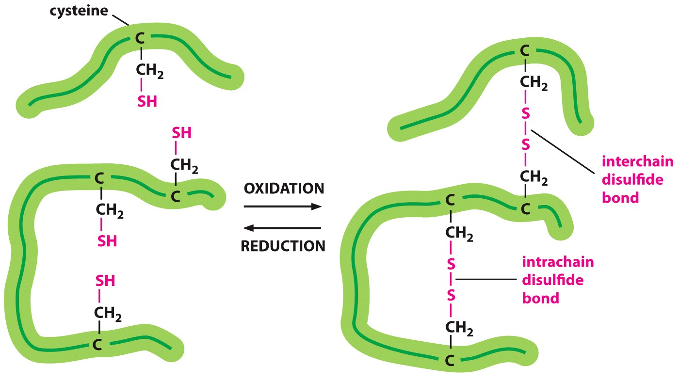
Disulfide Bonds Stabilize Some Proteins Outside the Cell (and body)
Trypsin – a digestive enzyme produced in the pancreas, exported to the small intestine – disulfide bonds within a single chain.
Human Insulin – interchain disulfide bonds

Slide 25
Summary - Interactions that Stabilize Folded Proteins.
H-bonds
van der Waals
Hydrophobic effect
Chain disorder
Hydrogen bonds form between hydrogen atoms (NH) and the carbonyl group in the peptide backbone (mainchain), and between and donors and acceptors on sidechains. Mainchain-mainchain H-bonds are responsible for secondary structures.
Hydrophobic interactions within a protein increase stability of the folded state by increasing entropy due to the release of water that was ordered by the exposed non-polar groups in the unfolded protein.
van der Waals interactions are optimized in the well packed core of the protein.
Covalent disulfide bonds form between sulfur-containing cysteine residues stabilizing them (usually only exported, secreted proteins).
Native
Unfolded
Notes:
Page 47 in the book

