Slide 1


Lecture 3
Protein Function, Carbohydrates, Lipids, DNA Technologies
Proteins as enzymes (PKU disease)
Carbohydrates (Lactose intolerance)
Lipids & Cholesterol regulation
Review of DNA and DNA polymerases
DNA Sequencing
Polymerase chain reaction (PCR) & Applications

Slide 2
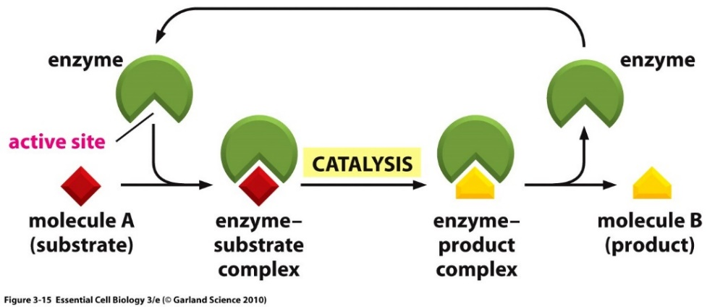
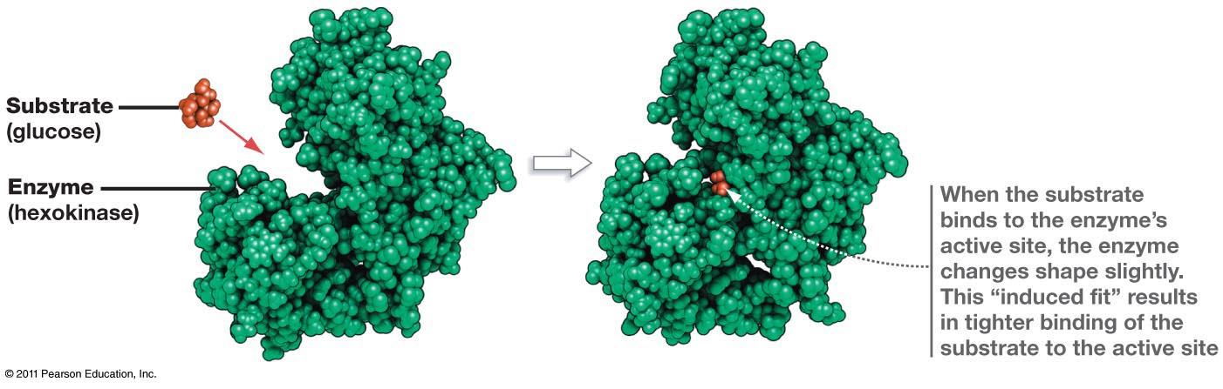













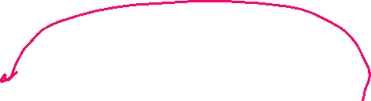



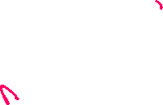



Enzymes
Enzymes are protein or RNA catalysts. They increase the rate of the reaction.
They bind “substrates” and convert them to “products”. The substrate undergoes a chemical reaction and is changed in its structure.
Most biological chemical reactions occur at meaningful rates only in the presence of an enzyme.
Substrates bind specifically to the enzyme’s active site, interacting with amino acid side chains (or RNA bases). Usually, a single enzyme binds one substrate.
The chemical change caused by the enzyme is catalyzed by additional functional groups in the active site.
Many enzymes undergo a conformational change when the substrates are bound to the active site; this change is called an induced fit.
substrates
products

Slide 3
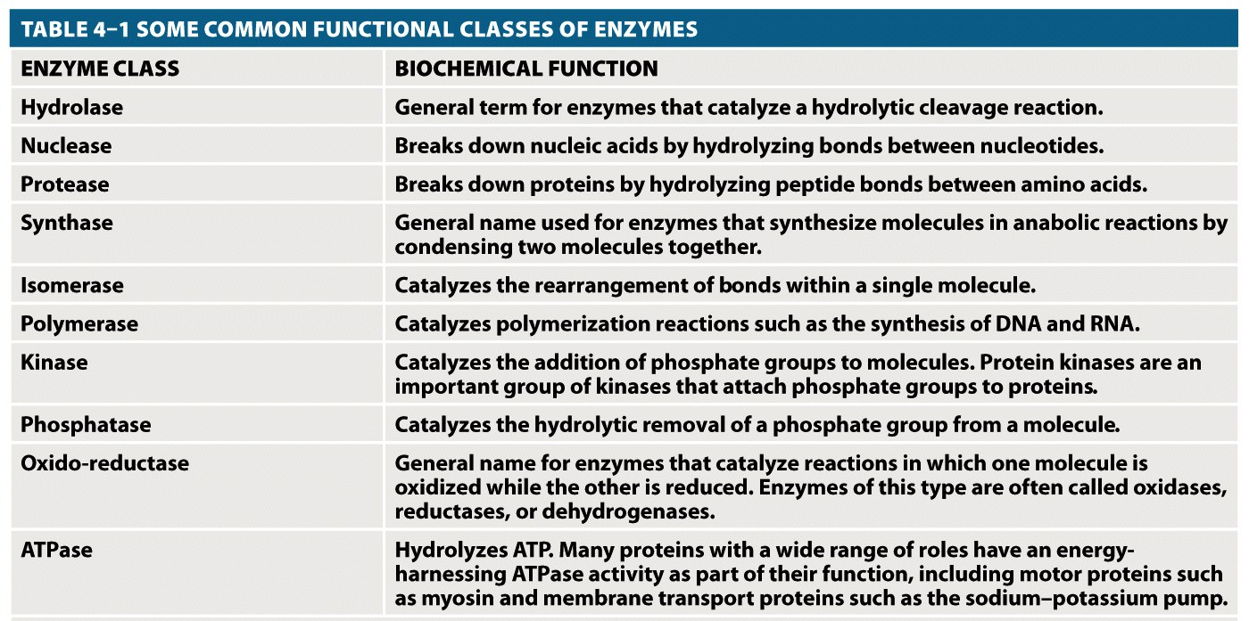


Enzyme – Chemical Diversity
Most enzyme names end in “-ase”
Usually named by their substrates and the reactions they catalyse, i.e. glucose kinase

Slide 4
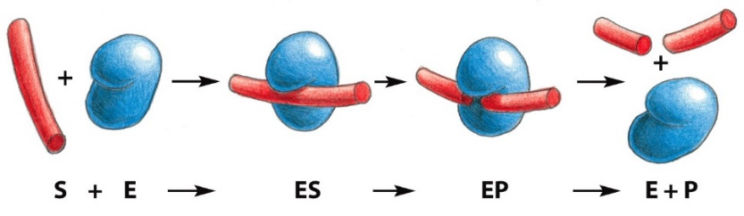


















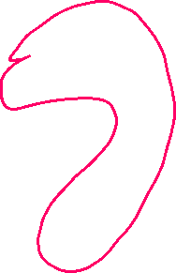
Example of Active Site Functional Groups:
Catalytic triad (Asp, His, Ser) in Protease Trypsin cleaves the peptide bond.
More active with Lys and Arg containing substrates because of a favorable interaction with an additional Asp residues in the enzyme.
Substrate Binding (Asp)
Substrate
Products
Catalytic triad

Slide 5
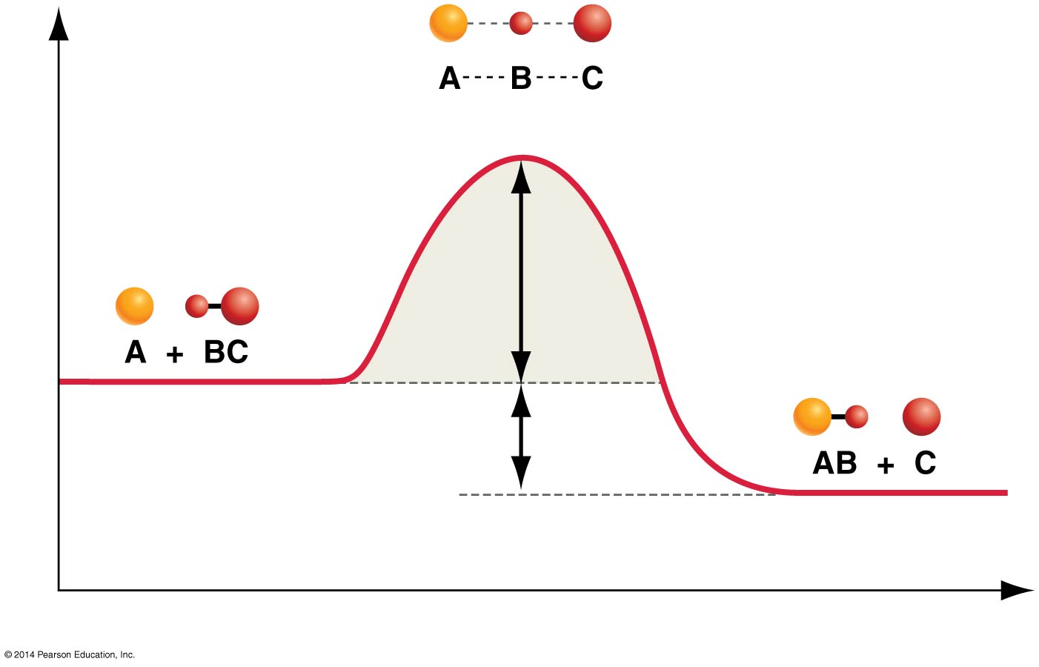
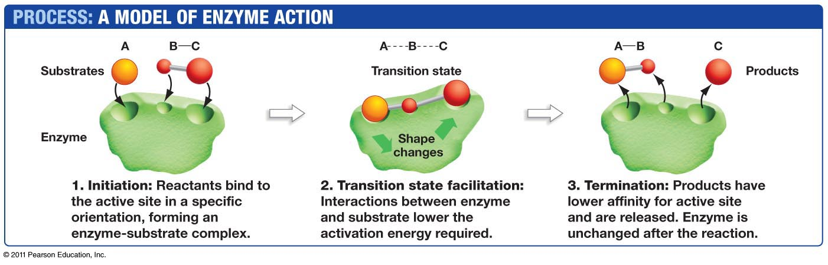


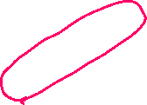





















How Do Enzymes Increase Rates?
Transition state = high energy intermediate that occurs during the reaction.
Energy barrier is called the activation energy (ΔG^{ⱡ}).
Enzyme
|
N
|
H
Interactions between the enzyme and the substrate stabilize the transition state (X) and lower the activation energy required for the reaction to proceed.
Stabilization can include:
  Pre- alignment of key groups in the active site, reducing entropy cost of organizing groups.
  Direct interactions with the transition state (see diagram, N-H group interacts more favorably with the transition state)
B – contains H-bond acceptor
Enzyme
|
N
|
H
Activation Energy

Slide 6
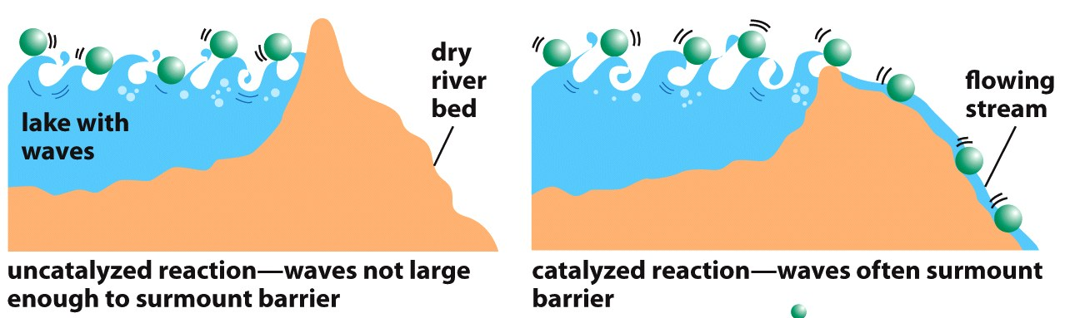










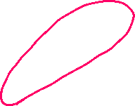













A model of transition state stabilization.
Lower energy of transition state allows more substrates to reach transition state due to their thermal energy.
[S] = 15
[X] = 3
[EX] = 6
Rate of product formation depends on the concentration of the transition state
Low [X] = Slow reaction
How much faster will the rate be when the enzyme is present?
Higher [EX] = Faster reaction

Slide 7
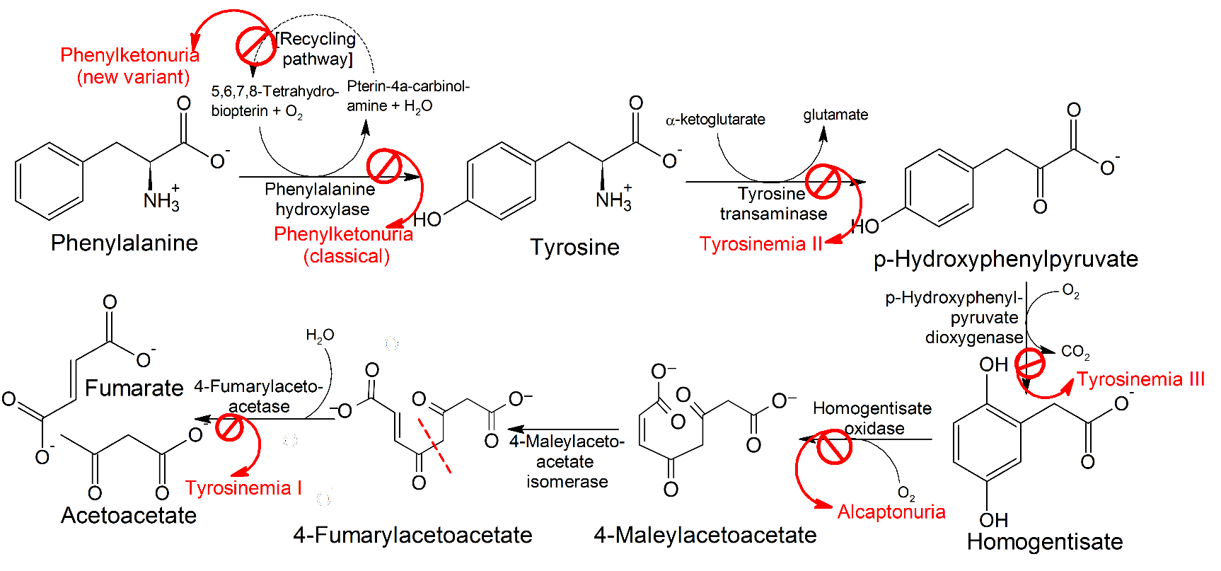
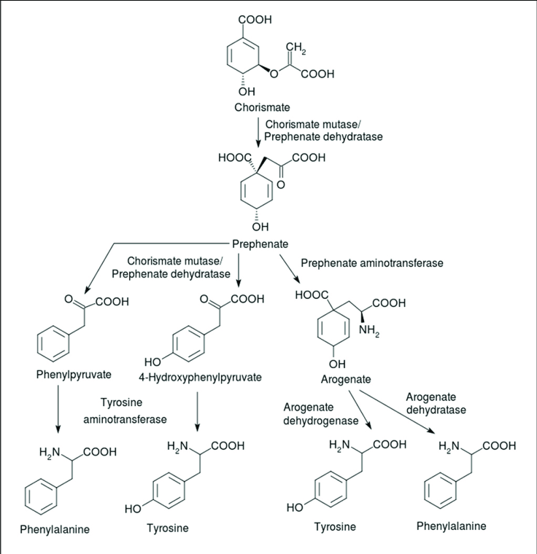
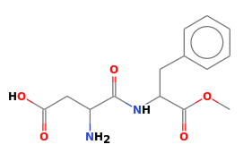










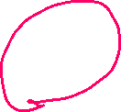









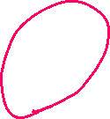


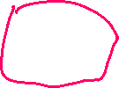


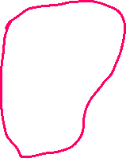





Enzymes, Metabolic Pathways, and Diseases
Synthetic Pathway for Phe, Tyr
(beginning with chorismite)
Each step catalyzed by an enzyme
Pathway for Degradation of Phenylalanine
PKU Disease:
Inactive phenylalanine hydroxylase
Phe levels become toxic:
Neurological problems
  Intellectual disability
  Developmental delays
  Mental health disorders.
Aspartame (artificial sweetener)
Asp-Phe-CH₃

Slide 8
Key Points:
Enzymes:
  Enzymes bind substrates (S), forming (ES) complex in active site, converting to P, releasing P.
  Rate enhancement since the transition state complex (EX) forms more readily with enzymes due to:
    Bringing substrates and functional groups on the enzyme together by binding (less entropy change)
    Directly lowering energy of transition state (X) through favorable interactions that are unique to the transition state, such as forming unique hydrogen bonds.
  Genetic diseases that lead to inactive metabolic enzymes can cause disease due to the build-up of toxic intermediates.

Slide 9
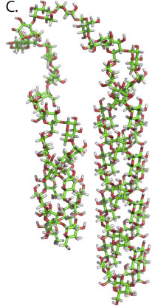
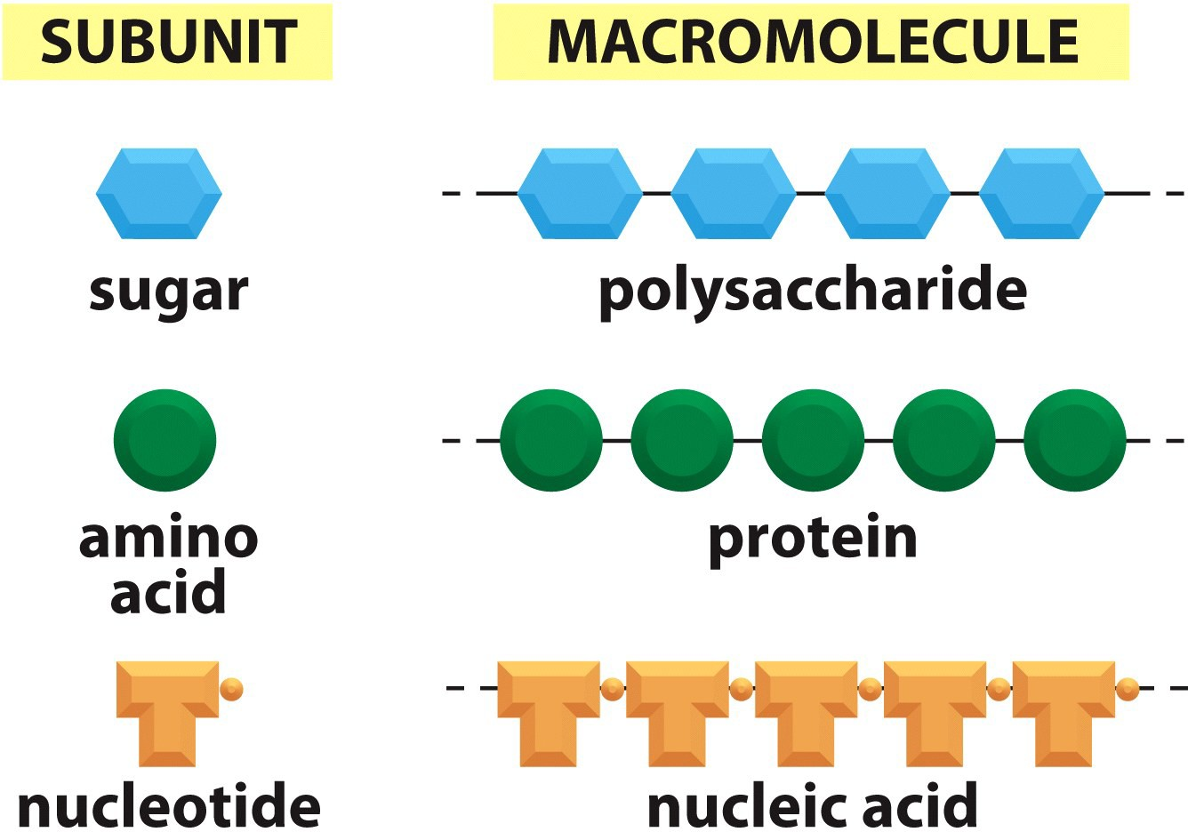
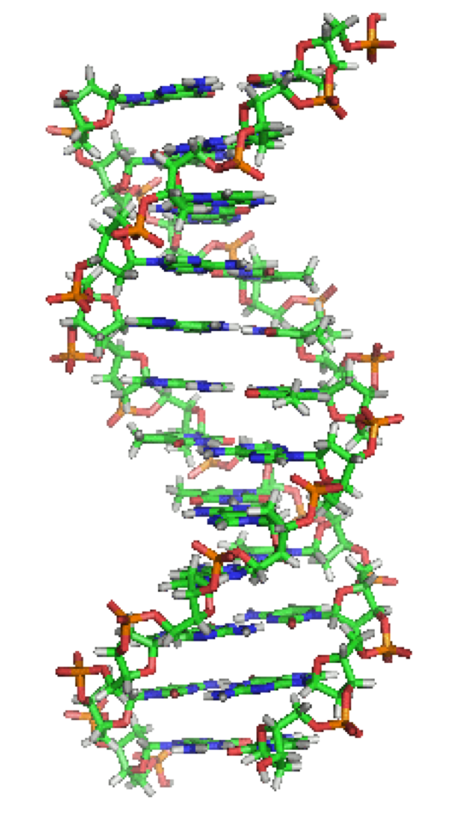






Carbohydrates
Polysaccharide
DNA (Nucleic Acid)

Slide 10


















Carbohydrates
Functional groups:
Monosaccharides (one sugar),
oligosaccharides (few sugars)
polysaccharides (many sugars)
Chemical formula is (CH₂O)_{n} (e.g. hydrated carbon)
They are molecules with:
  one aldehyde or ketone group, on 1st or 2nd carbon
  -OH group on all other carbons, leading to a chiral carbon for most carbons.
Carbonyl group –> C=O
Only one of these is a carbohydrate, which one?
A B C

Slide 11
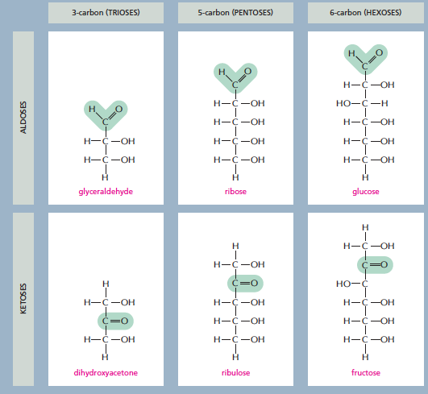
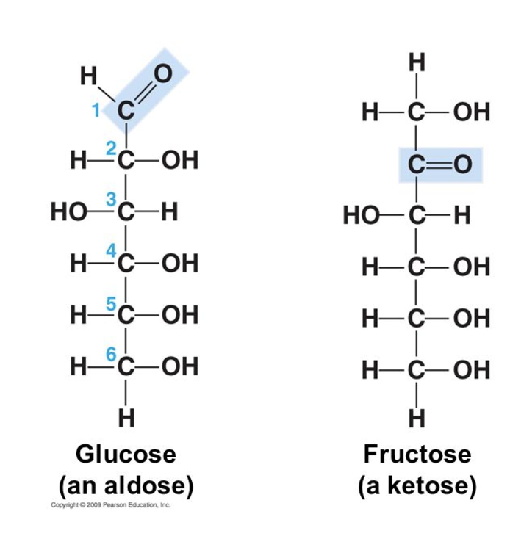










3 ways simple sugars (monosaccharides) differ from each other
1. Location of the carbonyl group
2. Number of carbons
3. Spatial arrangement of atoms (the position of the OH groups)
1. Location of the carbonyl group
2. Number of carbons
3. Spatial arrangement of atoms (the position of the OH groups)
Aldose: Carbonyl group is located on C₁
Numbering carbons:
Carbon 1 is at the end closest to the C=O group.
What carbon is the carbonyl?
Notes:
The C=O group is either on C1 (aldose) or on C2 (ketose).

Slide 12
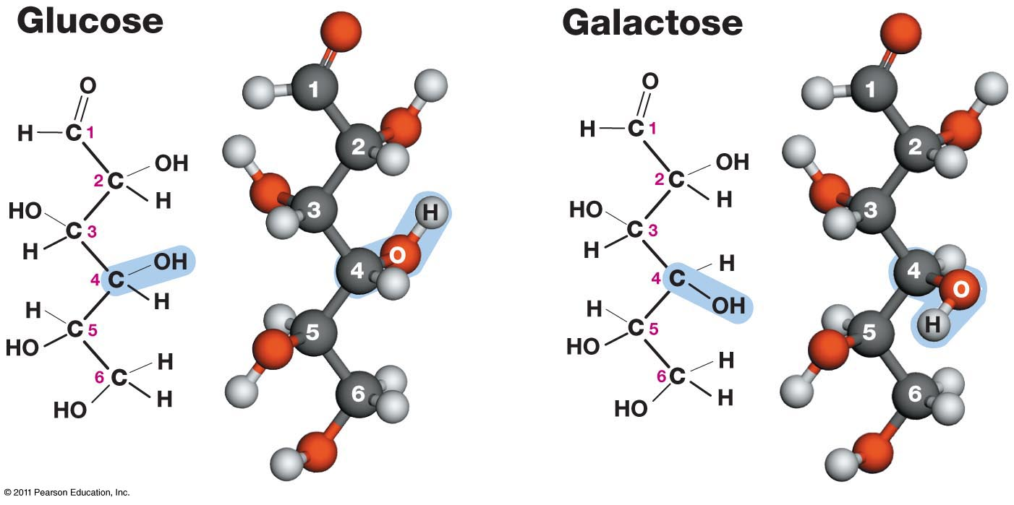

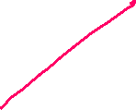



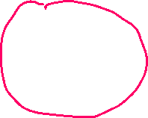

















3 ways simple sugars (monosaccharides) differ from each other
1. Location of the carbonyl group
2. Number of carbons
3. Spatial arrangement of atoms (the position of the OH groups)
Both have the same chemical formula C₆H₁₂O₆. Both are aldose sugars with 6 carbons.
Yet their functions are different.
Glucose can be used for energy immediately.
Galactose has to be converted to glucose before it can be used for energy.
They have different interactions with enzymes due to the different chirality at carbon 4.
OH is down in glucose
OH is up in galactose
Enzyme specific for a-glucose

Slide 13
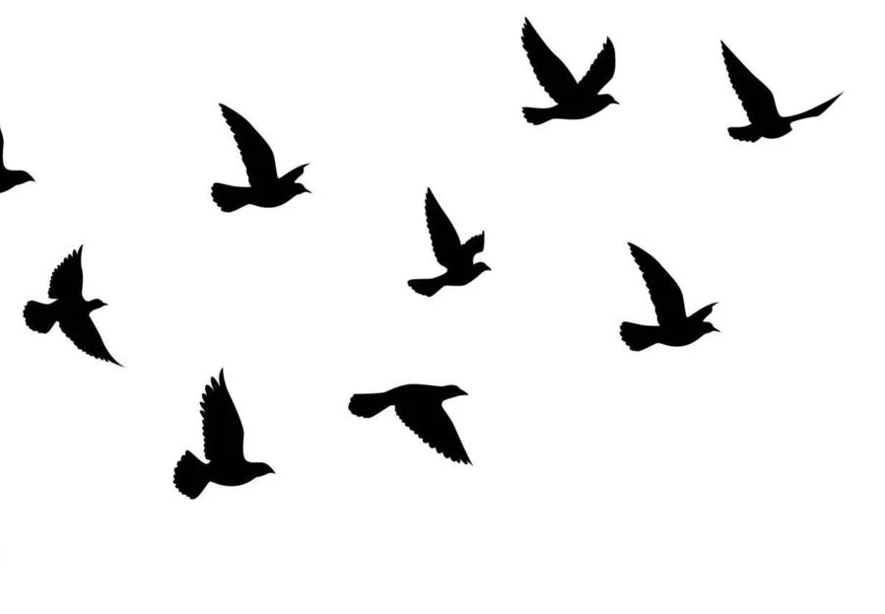
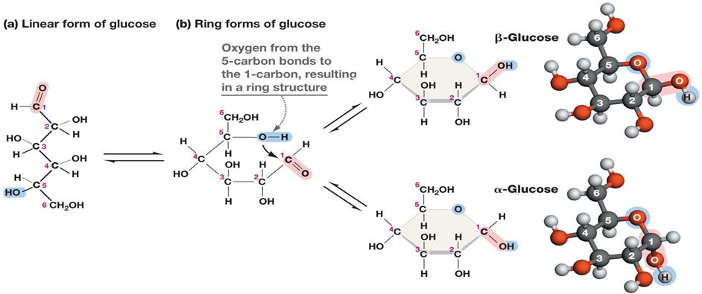
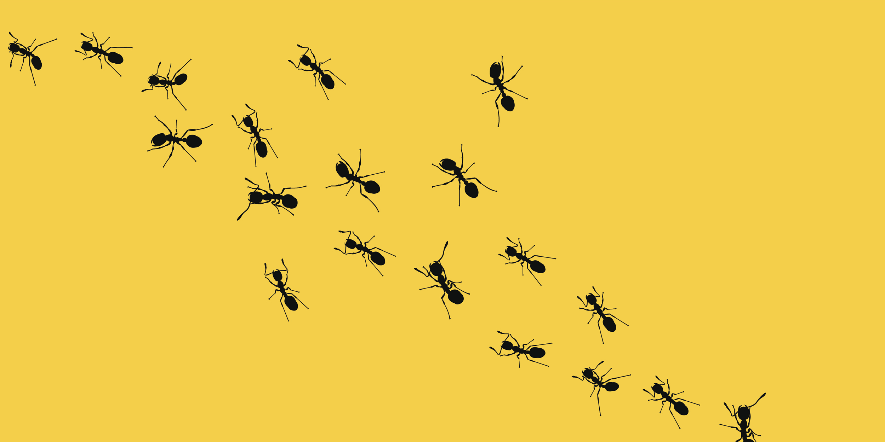









Ring formation in Monosaccharides:
C1 = “Anomeric Carbon”
In aqueous solution, a hydroxyl group reacts with the aldehyde or ketone group on the same molecule, closing the molecule into a ring, with a bridging oxygen
It is usually the 2nd to last -OH group, i.e. C5 in glucose, C4 in ribose.
Stable ring sizes are 5 atoms or 6 atoms
No atoms are lost or gained in this reaction.
The carbonyl carbon becomes chiral and is called the anomeric carbon.
The rings with different chirality at C1 are different:
α (new OH is down), β (new OH is up) “(ants are down, birds are up)”

Slide 14




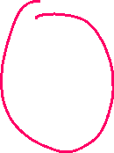
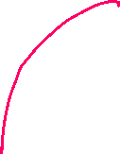



Disaccharides
Linkage of the anomeric carbon of one monosaccharide to the OH of another monosaccharide via a condensation reaction.
The bond is termed a glycosidic bond:
The anomeric carbon is the site of attack by another -OH group.
A water is released
Nomenclature rules for linkage:
Orientation of the anomeric involved in the linkage (α oxygen is down, β oxygen is up)
Carbons involved in the linkage (e.g. 1-4)

Slide 15
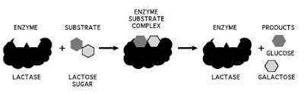









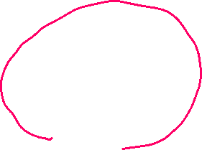




Lactose (milk sugar)
Disaccharides
These kinks are not carbons but are drawn in this way to indicate that the chirality of the anomeric is beta (pointing up). The kinks allow the line to reach the downward pointing –OH on C4 in glucose.
β-galactopyranosyl-(1→4)-β-glucopyranose
Metabolism of Lactose
Lactose is the major sugar in mammalian milk.
Infants produce the enzyme lactase to hydrolyze the disaccharide to monosaccharides.
Lactase expression is turned off in some adults, depending on their genetic background.
Lactase
Galactose
Glucose
Cellular Energy

Slide 16
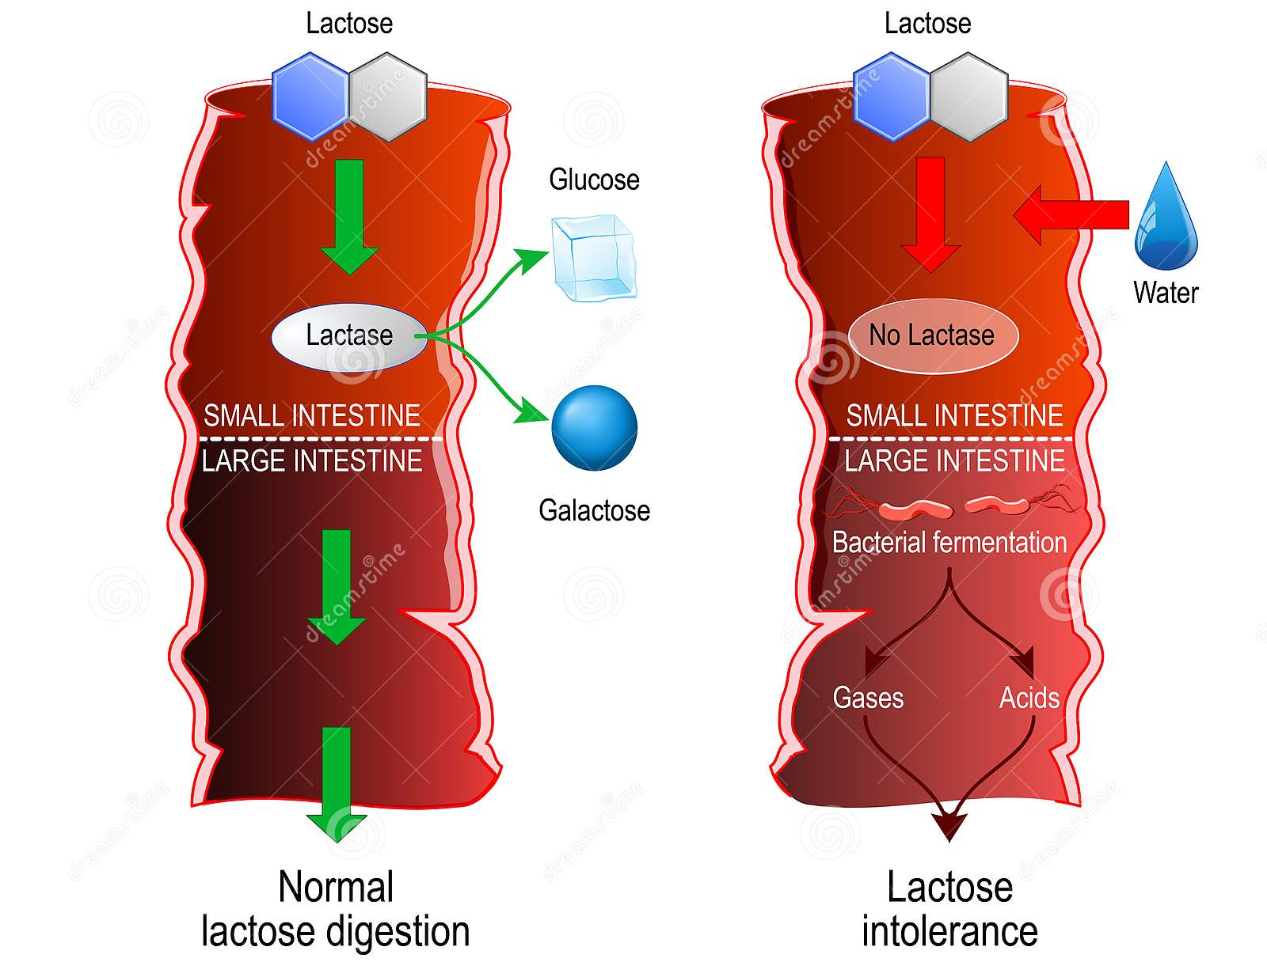
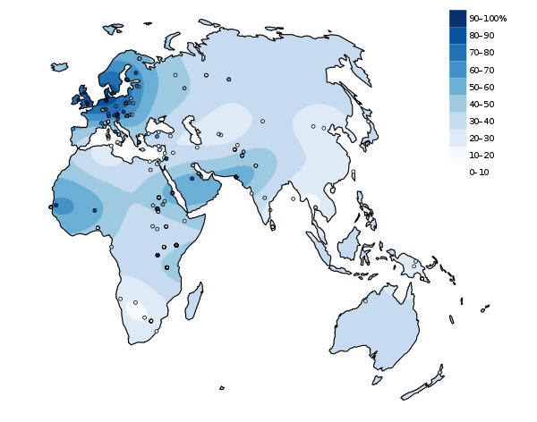
























Lactose Intolerance
Lactase Persistence
In which region do most of the people still produce lactase as adults?
UK
South Africa
In an infant (lactase +):
lactose is broken down to glucose and galactose in the small intestine.
The two sugars are readily absorbed and used for energy
In a lactose intolerant individual (lactase -)
The lactose is not absorbed in the small intestine, but instead draws water into the intestine due to osmosis – leading to bloating and potentially diarrhea.
Lactose enters the large intestine where gut bacteria use it as a carbon source, generating gas.

Slide 17
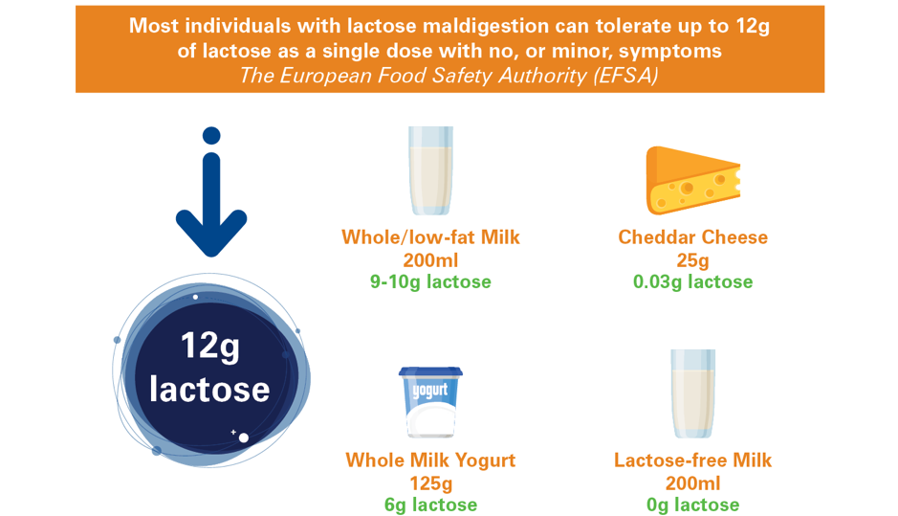
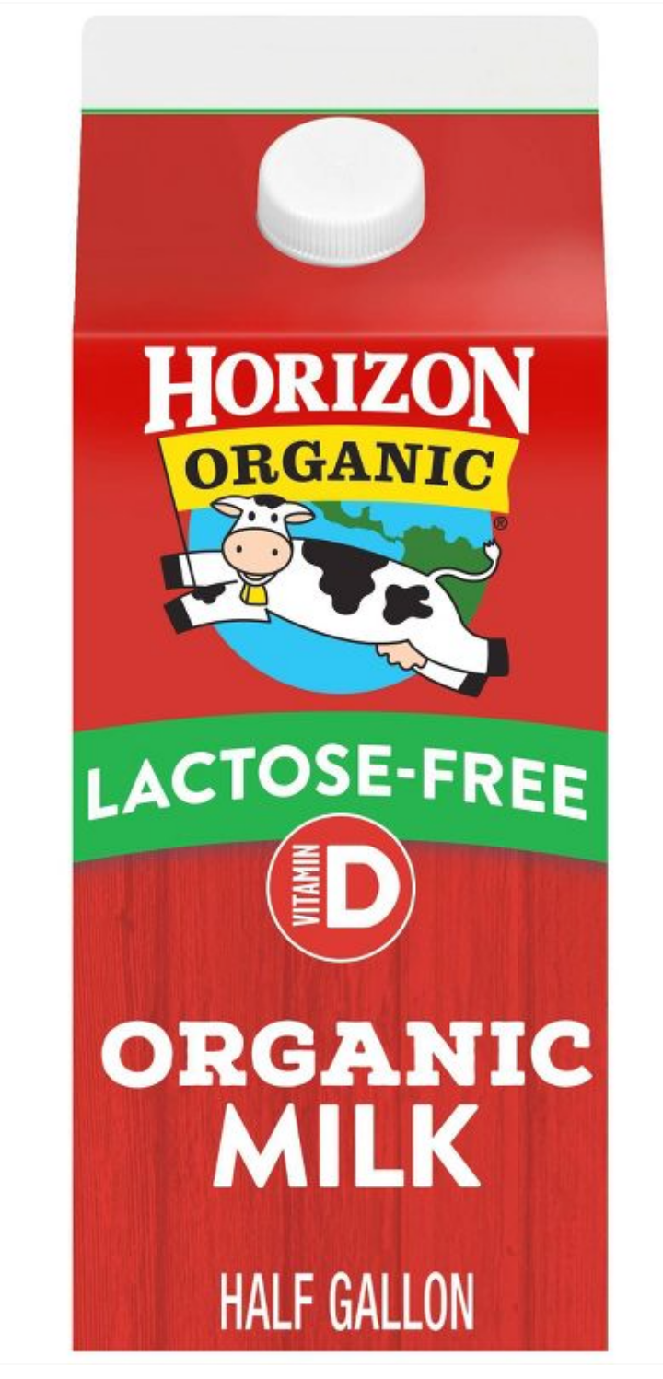
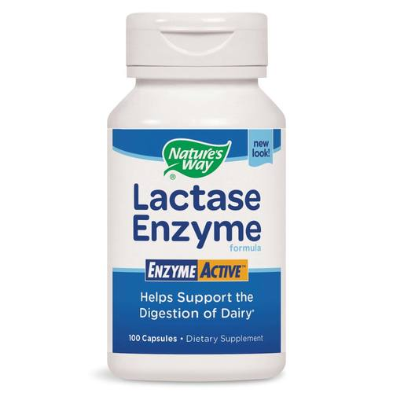



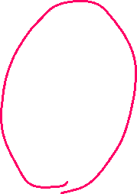

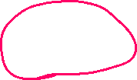

Lactose Intolerance
What to do if you are lactose intolerant:
A. Consume less lactose
B. Hydrolyze the lactose to glucose and galactose before consumption.

Slide 18
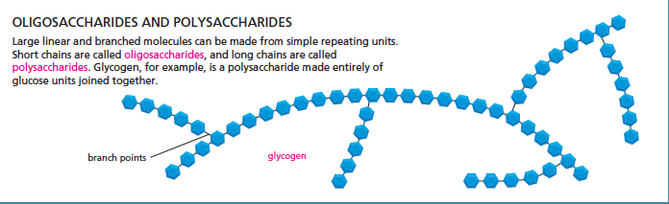
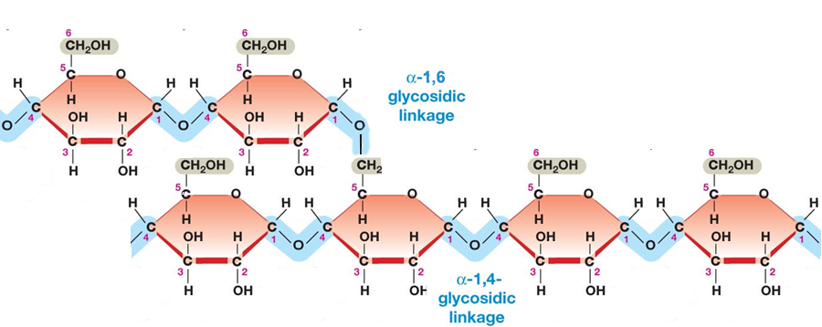


















Polysaccharides as Energy Storage – Glycogen Storage Disease
Glycogen and is made entirely of glucose units and is used for glucose storage.
Glycogen Levels are regulated by hormones secreted due to blood glucose levels.
Glucagon – low blood sugar
Insulin – high blood sugar
Two enzymes degrade or synthesize glycogen
Glycogen phosphorylase – releases glucose from glycogen
Glycogen synthase – stores glucose in glycogen
Branch point
α-1,6- glycosidic linkage
α-1,4- glycosidic linkage
Notes:
GSD III – debranching enzyme required since phosphorylase stops when 4 glucose are remaining. 3 of them are transferred to a new glycogen, and then the a(1-6) is removed. Autosomal recessive, 1:100,000

Slide 19
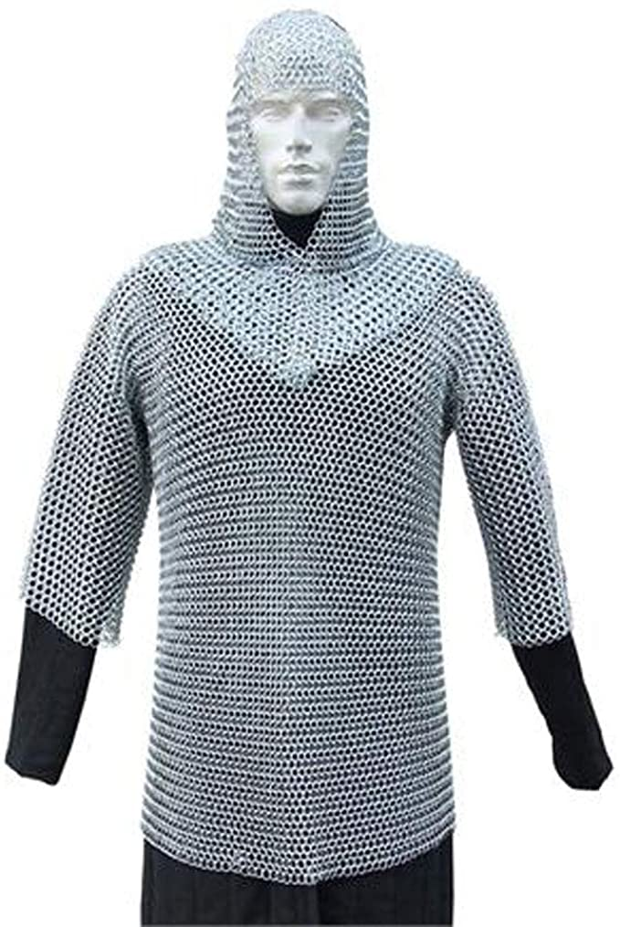
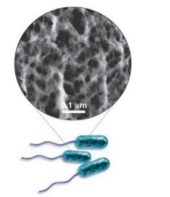




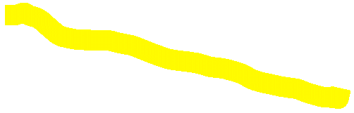


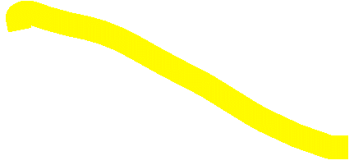
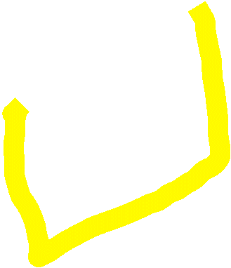
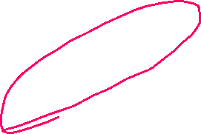

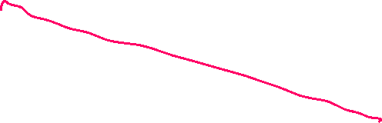












Polysaccharides as Structural Molecules
Peptidoglycan (protein + sugar) in bacterial cell wall
D-Amino acids
Many antibiotics interfere with cell wall synthesis (e.g. penicillin)
Protein Crosslink
Peptidoglycan (Bacterial Cell Wall)

Slide 20
Summary and Expectations for Carbohydrates
Key Points:
General structure of monosaccharides - be able to distinguish between aldose and ketose (and identify compounds that are not sugars).
Know how to number carbons on aldoses and ketoses
Be able to describe the linkage between two monosaccharides (configuration at the anomeric carbon, atoms linked)
Treatments for lactose intolerance
Be able to describe the linkage between glucose molecules in glycogen (glucose storage)
Be able to describe the overall structure of the peptidoglycan in bacterial cell walls.

Slide 21




















Lipids
Lipids
A chemically diverse group of molecules that are generally insoluble in water.
Mostly hydrocarbon with a small number of polar functional groups.
Self-assembly of larger structures without the formation of covalent bonds.
Expectations:
Recognize chemical structure of steroids and phospholipids.
Usage of liposomes in drug delivery
Effect of cholesterol on fluidity of phospholipid membranes.

Slide 22










Phospholipids - Glycerophospholipids:
Head group + phosphate + glycerol + two fatty acids (acyl chains) of various types form a phospholipid.
Various head groups are attached to the phosphate, giving a diverse set of lipids.
Expectations: Know the overall structure.

Slide 23
















Geometry (& Hydrophobic Effect) Determines Macrostructures of Lipids in Water
Physical Properties of Pure Lipid Bilayers:
Phospholipids self-assemble in water to form bilayers (two opposing layers of phospholipids). This assembly is driven by the hydrophobic effect.
Ordered water is released from the non-polar fatty acid tails when the phospholipids form the bilayer.
To remove the non-polar edges, the bilayers form closed, water filled, vesicles with a 40-50 Å thick wall. The non-polar acyl chain width is about 30 Å. These are called liposomes or lipid vesicles.
Liposome

Slide 24


Spontaneous Assembly of the Phospholipid Bilayer:
Gray spheres = water
P. Headgroup
One phospholipid
NP. Tail
Notes:
https://www.youtube.com/watch?v=lm-dAvbl330

Slide 25















Liposomes (pure lipid vesicles) can be used for Drug Delivery
1. Drug delivery.
Non-polar drugs dissolve in the lipids, increasing their solubility
Highly toxic water-soluble drugs can be encapsulated, reducing the exposure to healthy cells.
2. Delivery can be targeted to cancer cells by antibodies that recognize tumor specific antigens.
3. After internalization, the liposome is degraded, releasing the drug.
Lu L, Ding Yue, Zhang Y, Ho RJY, Zhao Y, Zhang T, Guo C. Antibody-modified liposomes for tumor-targeting delivery of timosaponin AIII. Int J Nanomedicine. 2018;13:1927-1944
https://doi.org/10.2147/IJN.S153107

Slide 26















Lipid Phase Transition & Membrane Fluidity
Lipid bilayers undergo a phase transition with a defined T_{m}.
Below T_{m} the lipids exist as a solid-like gel; the acyl chains are tightly packed, the membrane is solid.
Above T_{m} the lipids are in a liquid-like liquid crystal phase. The acyl chains are disordered, and the membrane is fluid. A fluid membrane is required for biological function.
(Note that the bilayer remains a bilayer – due to the hydrophobic effect, the only thing that changes is the order/disorder of the non-polar chains)
Lateral diffusion of molecules within the plane of the membrane is an important biological function.
A. Moving through gel phase would be: Easy (E) or Hard (H)?
B. Moving through liquid crystalline would be:
Easy (E) or Hard (H)?
gel
liquid-crystalline
1.0
Fraction
Melted
0.5
0
Temperature

Slide 27






Steroids
Defined by four-ring structure + functional groups bound to ring structure
  Cholesterol - example of steroid molecule; essential function in plasma membrane
  All steroids (testosterone, estrogen, progesterone…) are derived from cholesterol!
R= OH group
Testosterone ♂
Span ½
Bilayer
  Amphipathic - contains hydrophilic and hydrophobic elements
Estrogen ♀

Slide 28














Cholesterol Affects Fluidity
Rigid ring decreases flexibity at high temperatures
Flexible tail increases flexibility at low temps.
cholesterol maintains fluidity by preventing tight packing of phospholipids due to flexible tail.
Fluidity
At cooler temperatures,
+Chol (5%)
At warmer temperatures,
cholesterol constrains motion of acyl chains due to rigid ring, thus decreasing membrane fluidity
Temperature
In mammals – cholesterol is required to maintain membrane fluidity at body temperature.

Slide 29

















Biological Functions of Transmembrane Proteins
Many are potential drug targets
Genetic defects can cause disease
Notes:
https://www.nature.com/scitable/content/examples-of-the-action-of-transmembrane-proteins-14706234/

Slide 30




































Cholesterol Regulation & Endocytosis
LDL particle
Protein
Triglycerides
Cholesterol
1. Low density lipoprotein (LDL) enters via receptor-mediated endocytosis
1
2
2. LDL and its receptor are internalized in vesicles
4
3
3. The vesicles fuse with endosomes
4. In the acidic environment, LDL dissociates from its receptor. Receptor is recycled back to plasma membrane and LDL ends up in lysosomes
5
E₁
E₂
E₃
E₄
5. LDL is degraded and free cholesterol is released.
A B C D
6. Free cholesterol regulates biosynthesis in liver (feedback regulation)
6

Slide 31


















Some Individuals Inherit a Defective Gene Encoding the LDL receptor
Normal functioning LDL receptor
Receptor is a transmembrane protein:
N-terminus outside the cell, binds LDL
C-terminus Inside the cell, required for internalization
Non-functional LDL receptor:
Mutation in C-terminus that causes loss of interaction with Catherin coated pits.
The coated pits are required for endocytosis of the LDL-receptor.
The altered receptors lack the cytoplasmic domain that enables them to be internalized.
Such cells can bind LDL but cannot internalize it, leading to dysregulation of cholesterol production due to lack of feedback inhibition, the liver cell continues to produce cholesterol.

Slide 32



























Cholesterol Metabolism and Regulation
Cholesterol is produced by a series of steps, each catalyzed by an enzyme:
Statins are competitive inhibitors that inhibit one of the enzymes (HMG-CoA Reductase) that is required to make cholesterol
Notes:
Most drugs we take tp prevent illness or treat it work by blocking the activity of a particular enzyme. Take medicine to lower your cholesterol, taking drugs that reduces activity of enzyme in liver produces cholesterol. Drugs companies screen thousands of chemical compounds of interest to find those able to inhibit the activity of their enzyme of interest, then chemically modify them to make them more or less effective.

Slide 33

Nucleic Acid Technologies
Review of DNA Structure
Review of DNA Polymerase activity
Nucleic Acid Technologies – PCR & Sequencing

Slide 34










Nucleic Acid Structure
Monomeric Units
Nucleoside triphosphates are the building blocks of nucleic acids (dNTP = dATP, dGTP, dCTP, dTTP)
The base ("sidechain") is connected to the C1' of the sugar ("mainchain") by an N-linked glycosidic bond.
  Base + sugar = nucleoside.
  Base + sugar + n-phosphates = nucleotide
The carbon atoms on the sugar are numbered 1' to 5'. The primes distinguish the atoms on the sugar from those on the base.
DNA differs from RNA in the sugar (deoxyribose versus ribose) and one base.
Four different monomers, A, G, C, T in DNA. U replaces T in RNA.

Slide 35







DNA and RNA are Polynucleotides:
Two phosphates are lost during polymer formation.
The phosphodiester backbone is comprised of deoxyribose (DNA) or ribose (RNA) sugars bridged by one phosphate between the 3' and 5' positions of the sugars. Be able to draw this structure.
The phosphates are always ionized (pK_{a}~1), nucleic acids are polyanions. The negative charge is important for protein interactions (and electrophoresis).
Note the polarity: 5' → 3'. Be able to identify the 5’ and 3’ ends:
  Start at the end atom and move down the chain. The first carbon you find defines the end.
Sequence of nucleotide bases is written in the 5'-3' direction.

Slide 36

















Nomenclature
5’ AGT 3’
3’ TCA 5’
= AGT
TCA
https://www.andrew.cmu.edu/user/rule/jsmol/nucleic.html
Double Helical Structures: B-DNA
a) The helix is right-handed; the chains are antiparallel.
b) 10 bp/turn.
c) The helix interior is filled with stacked base, phosphates and deoxyriboses on the outside.
d) T pairs with A via two "Watson-Crick H-bonds"
e) C pairs with G via three "Watson-Crick hydrogen bonds"
f) Opposite strand termed “complimentary strand”. Top strand is always written 5’->3’, lower strand 3’ -> 5’.

Slide 37



















Introduction to Central Dogma
Genome: Entire DNA content of an organism, contains all of the instructions for life. Single circular molecule in Proks, multiple linear molecules (chromosomes) in Euks. The genome is replicated when cells divide.
Gene – a segment of DNA that is converted (transcribed) to RNA. A promoter (P) sequence on the DNA is the minimal requirement for the production of RNA.
P
P
Non-coding RNA
Transcription
Coding RNA
RNA molecules are often processed in Eukaryotic cells before they are functional
mRNA Processing (Euks only)
Possible functions
meG
AAAAA
miRNA
(euk)
rRNA
(p syn)
Proks
Many RNAs are functional on their own
Splicing
(euk)
tRNA
(p syn)
Translation
mRNA are translated to a protein.
Telomerase
(euk)
protein
ribosome

Slide 38
























The Genetic Code – Converting a DNA/RNA Sequence to a Protein
Codon = 3 bases that code for an amino acid
....ATATGCCCATGTGGTAA..
(DNA Sequence)
...AUAUGCCCAUGUGGUAA..
(mRNA Sequence)
..U-AUG-CCC-AUG-UGG-UAA
(Punctuated RNA sequence – how the ribosome interprets the sequence)
Each codon codes for one amino acid.
Many amino acids are coded by more than one codon.
Most organisms use the same codon table – some codons have different meanings in some organisms.
________-________-________-_______
Special Codons:
  AUG = Is used to begin almost all proteins that are synthesized on the ribosome, codes for methionine when found internally.
  UAA, UAG, UGA = stop codons, terminate synthesis
(Protein Sequence)
Notes:
Methionine is also the codon for a start sequence

