Slide 1
Lecture 5 Immunology, Enzyme Inhibitors, Gene Editing
To do:
Presentation topic for approval (ASAP)
Draft slides by Sept 17th for feedback (extended deadline).

Slide 2
B-Cell Biology - From Stem Cells to Pathogen Killing.
1. Generation of high diversity of chains during development of stem cells to B-cells in bone marrow.
DNA rearrangements to generate functional exons for variable segments of both light and heavy chain.
2. Molecular & cellular biology of membrane bound antibodies on cell surface = B-cell receptor (BCR)
Transcriptional enhancers, mRNA splicing
Light chain and heavy chain exported to surface of B-cells.
3. Self tolerance test to prevent autoimmune diseases, autoreactive B-cells eliminated.
4. Encounter and capture of antigen in lymph nodes
5. Activation of B-cells by T_{H} cells
Peptides from pathogen presented on major histocompatibility proteins (MHC II).
T-cell activation by tyrosine kinase receptors (T-cell Receptor, TCR), secretion of signaling molecules.
6. Development of
Plasma cells - Production of soluble antibodies of the same specificity as the parent B-cell.
B-memory cells (basis of immunity)
T-memory cells (basis of immunity)
7. Destruction of Pathogens
Fc region of antibody binds to Fc Receptor on NK cells, neutrophiles, macrophages
Pathogen internalized and destroyed.
BCR – B-cell receptor = antibody + signaling chains.
TCR – T cell receptor = MHC-peptide recognition + signaling.

Slide 3
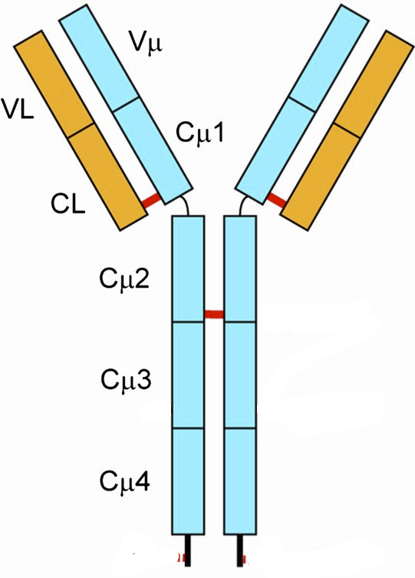
Antibody Genes are Assembled From DNA Segments: Giving many different sequences.
Production of Heavy Chain Gene:
V_{H} exon = V+D+J segment (selected at random)
The mRNA coding for antibodies contains 5 exons.
Germline/Stem cell DNA
←300→
D-J joining
Random selection of D & J segments
L = leader (signal)
V = variable segment
D = diversity segment
J = joining segment
V joining to (DJ)
Random selection of V-segment
Heavy chains have different V-sequences.
B-cell DNA
V_{H} exon differs from one cell to the next.
Heavy chains have the same constant sequences in all B-cells.
Stem cells -> B-cells
The exon that codes for the variable region of the heavy chain is generated by the random joining of a V, D, and J DNA segments.
Each B-cell will generate a unique sequence for its heavy and light chain DNA.
This is a permanent change to the DNA (genome) of the B-cell.
1. If there are 300 possible V-heavy segments, 10 possible D segments, and 6 possible J segments, how many different heavy chains can be made?

Slide 4
Light-chain Genes are Assembled From DNA Segments: Giving many different sequences.
Production of Light Chain Gene
Germline/Stem cell DNA
←100→
B-cell DNA
Light chains have different V-sequences in different B-cells.
Light chains have the same constant sequences in all B-cells.
Antibody Diversity
1. If there are 100 possible V-heavy segments and 5 possible J segments, how many different light chains can be made?
Stem cells -> B-cells
In the case of the light chain, the variable region is generated by VJ joining.
Each B-cell will generate a unique sequence for its heavy and light chain DNA.
This is a permanent change to the DNA (genome) of the B-cell.
2. If any possible heavy chain can pair with any possible light chain, how many different antibodies can be generated, assuming there are 10,000 possible heavy chains and 500 different light chains?

Slide 5
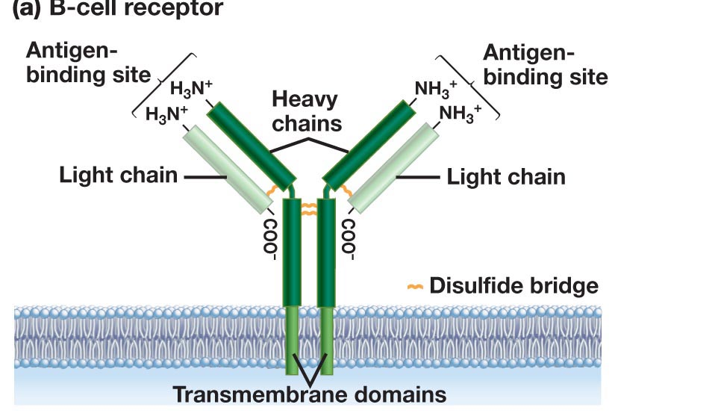
Antibody Production – From Stem Cells to B-Cells
Stem Cell
B-Cell
Rearranged heavy chain gene
Rearranged light chain gene
Transcription
mRNA Splicing
Translation
Export to cell surface (ER -> golgi -> Membrane)

Slide 6
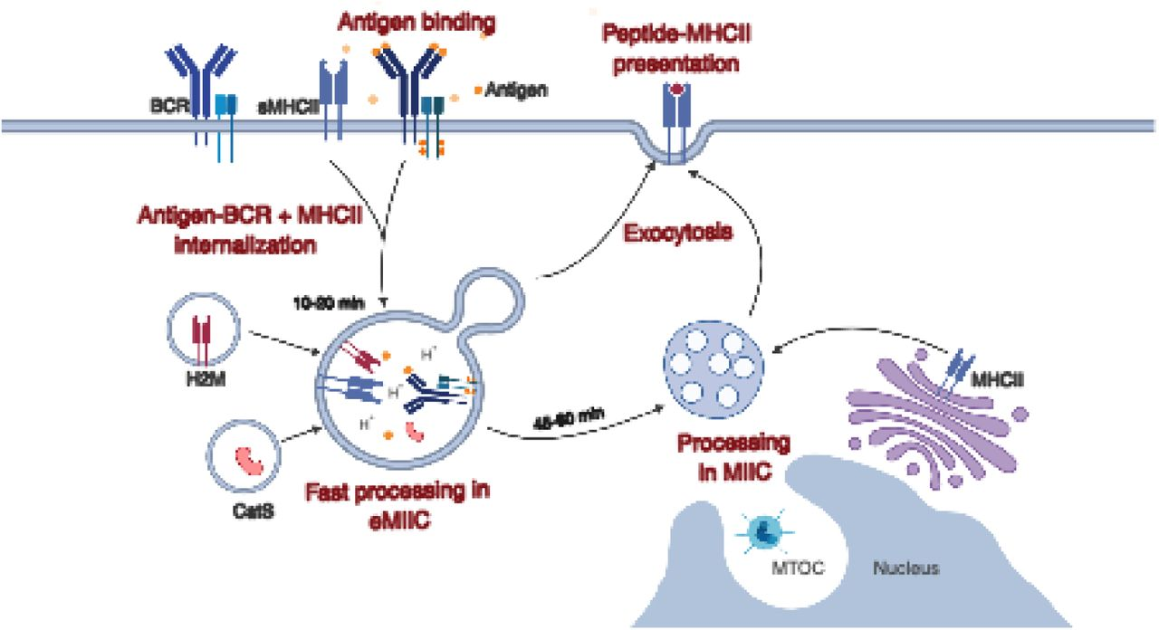
Antigen Capture by B-Cells - Endocytic Pathways
Endocytosis of bacteria by a B-cell
1
4
Bacteria labeled with Green fluorescent protein.
Capture of the bacteria
Internalization (endocytosis)
Degradation of the bacterial proteins, producing peptides.
Antigen binds to variable domains of antibody on the BCR (B-cell receptor)
Antigen is internalized and digested into peptides
Peptides are loaded on to class II MHC
Peptide-MHC displayed on membrane for presentation to T-cells
2
3
Journal of Cell Science doi: 10.1242/jcs.235192

Slide 7
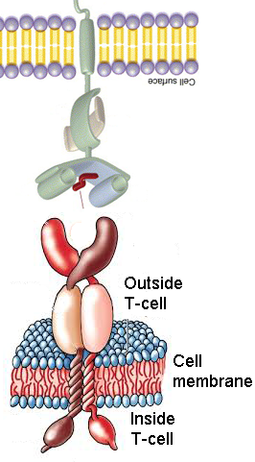
Activation of B cells by Antigen - Lymph Node
B-cell
Peptide from pathogen
(foreign peptide)
T-cell Receptor (TCR)
T_{H} cell
T_{H} Cells
Mature in thymus
High diversity of TCR (10¹⁰)
Homogenous on one T_{H}-cell
Recognize foreign peptide on class II MHC
Events:
Recognition of MHC II-peptide by TCR
Tyrosine kinase signaling in T_{H} cell
Cytokines (protein messengers) produced.
Cytokines activate B-cells.
B-cells develop into antibody secreting plasma cells.
B and T-helper cells develop into memory cells, that are long-lived and are quickly activated by the same pathogen. This is the basis of vaccination.
Soluble antibody from plasma cells has the same light and heavy chains as the original B-cell.
Membrane anchors are missing, so antibody is secreted outside the cell.

Slide 8
Can you:
Describe how the genes for the heavy and light chain are generated, and how this gives rise to many different antibodies?
Do you understand the process of B-cell activation, including presentation of foreign peptides on MHC II and the role of the T-helper cell.
Describe how antibodies inactivate pathogens?

Slide 9
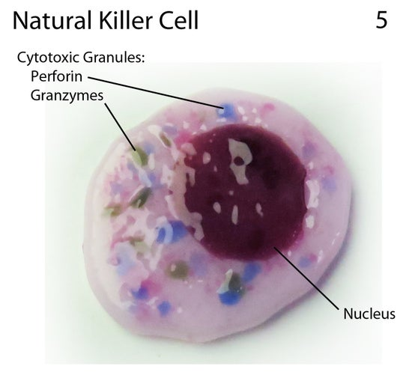
Cell Based Immunology
Key Questions:
1. How does your immune system fight viruses?
2. How does your immune system detect and destroy cancer cells?
3. How can the immune response be engineered to fight cancer?
T_{C}
T_{CTL}
Activation of Tc cells requires:
Recognition of foreign peptide on class I MHC.
Assistance from T-helper cells.
T_{C} Memory
Cell Types:
Innate
Natural Killer (NK) cell
Acquired
T_{H}
T_{C}, T_{CTL}
Activated Tc cell becomes a cytotoxic T-lymphocyte T_{CTL}
T_{CTL}
Kill virally infected cells
Kill cancer cells
Tc memory cells are produced after activation.
NK: Innate
Kill virally infected cells
Kill cancer cells

Slide 10
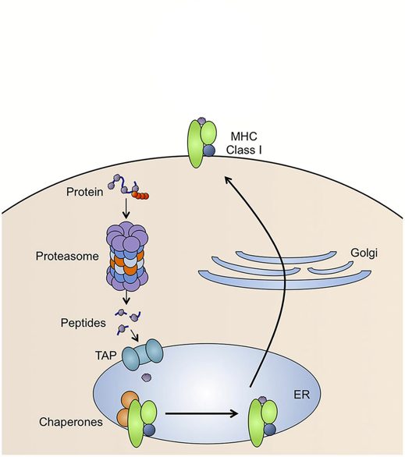
T_{c} Detection of Diseased/Cancer Cells - Role of MHC I
Possible Sources of Foreign Peptides:
1. From replication of viruses in the cell
2. From replication of intracellular bacteria (e.g. TB)
3. New coding sequences in cancer cells due to genetic changes (e.g. mutations in p53 lead to novel sequences).
MHC I present peptides
Peptides are generated from of all of the proteins that are made in the cell.
Steps:
protein targeted for degradation by ubiquitin
Protein digested by proteasome
Peptides transported into ER
Peptides loaded on to MHC I
Peptide/MHC complex transported to cell membrane.
Only foreign peptides activate T-cells
p53 Protein Sequence
Zn Fingers (DNA binding)
10 20 30 40 50 MEEPQSDPSV EPPLSQETFS DLWKLLPENN VLSPLPSQAM DDLMLSPDDI 60 70 80 90 100 EQWFTEDPGP DEAPRMPEAA PPVAPAPAAP TPAAPAPAPS WPLSSSVPSQ 110 120 130 140 150 KTYQGSYGFR LGFLHSGTAK SVTCTYSPAL NKMFCQLAKT CPVQLWVDST 160 170 180 190 200 PPPGTRVRAM AIYKQSQHMT EVVRRCPHHE RCSDSDGLAP PQHLIRVEGN 210 220 230 240 250 LRVEYLDDRN TFRHSVVVPY EPPEVGSDCT TIHYNYMCNS SCMGGMNRRP 260 270 280 290 300 ILTIITLEDS SGNLLGRNSF EVRVCACPGR DRRTEEENLR KKGEPHHELP 310 320 330 340 350 PGSTKRALPN NTSSSPQPKK KPLDGEYFTL QIRGRERFEM FRELNEALEL 360 370 380 390 KDAQAGKEPG GSRAHSSHLK SKKGQSTSRH KKLMFKTEGP DSD
1
5
2
3
4
EVVRRCPHHE Normal seq., ignored by TCR
EVVGGCPHHE Mutant seq. in cancer,
detected by TCR

Slide 11
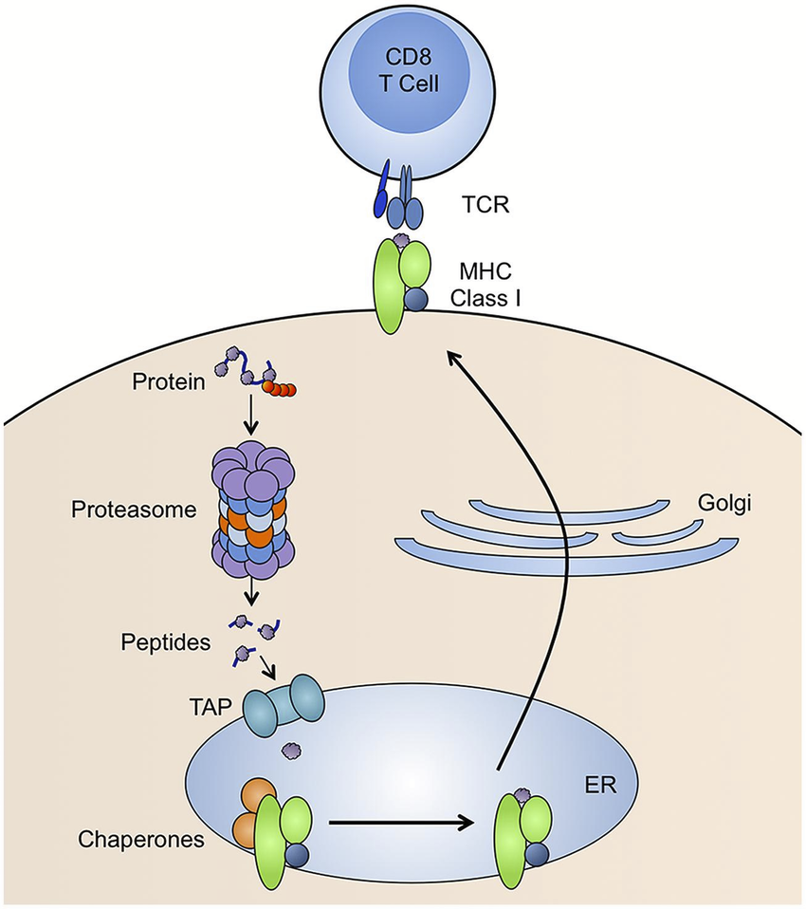
T_{c} Detection of Diseased/Cancer Cells - Activation
Activation of T_{C} cells requires stimulation from activated T_{H} cells via MHC II pathway.
Antigen captured by B-cells and other phagocytotic cells (macrophages, dendritic cells.
Peptides presented on class II – T_{H} activated
Foreign Peptide

Slide 12
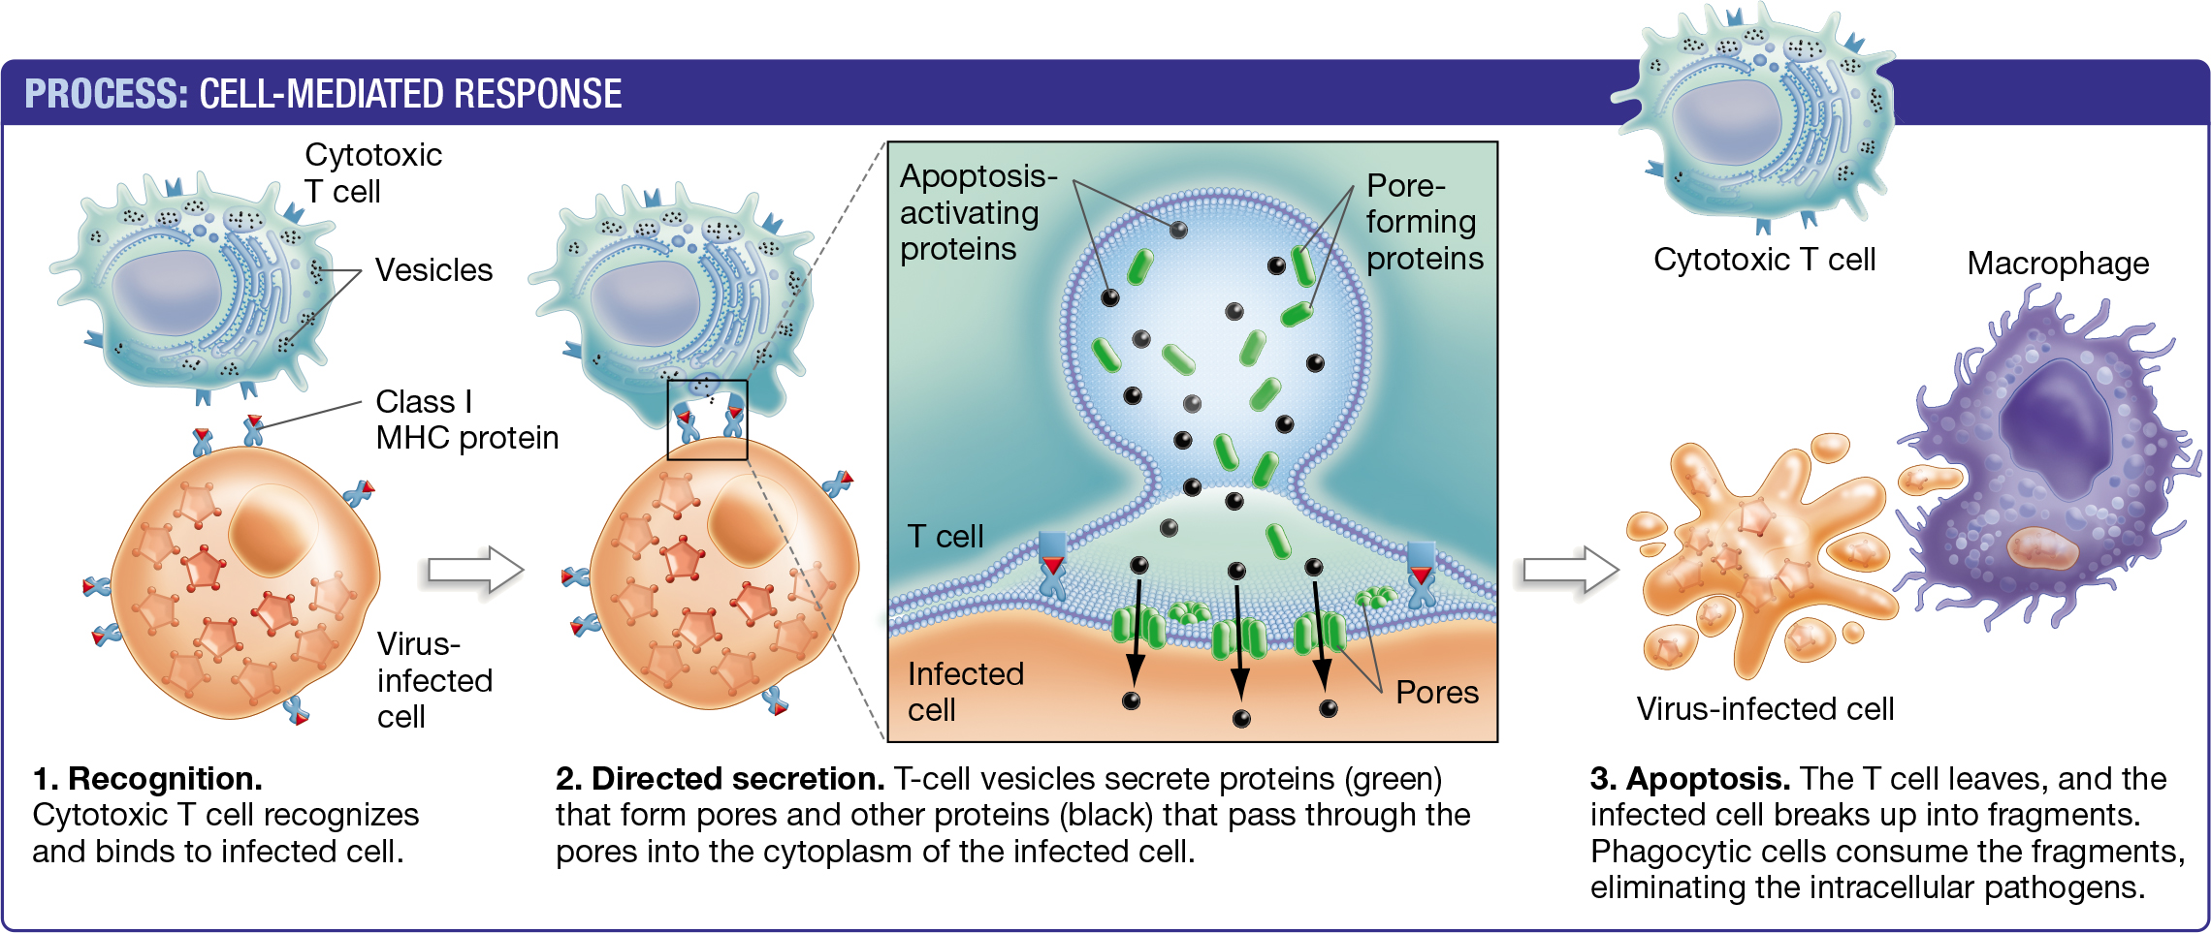
T_{C} Cells: Detection and Killing of Virally Infected or Cancer Cells
(T_{CTL})
Cancer cell or
Infected cell
Granzymes (apoptosis activating proteins) enter through perforin pores and cause cell undergo programmed cell death (apoptosis)

Slide 13
Cancer Evasion Mechanism - Loss of MHC I on Tumor Cell
Loss of MHC I expression means that T_{CTL} cells can no longer recognize and kill cancer cells because T-cell activation requires recognition of the MHC-peptide complex.
How to re-establish T_{C} contact with tumor cell and activation of the T-cell so that the cancer cell is killed?
Cancer
Cell

Slide 14
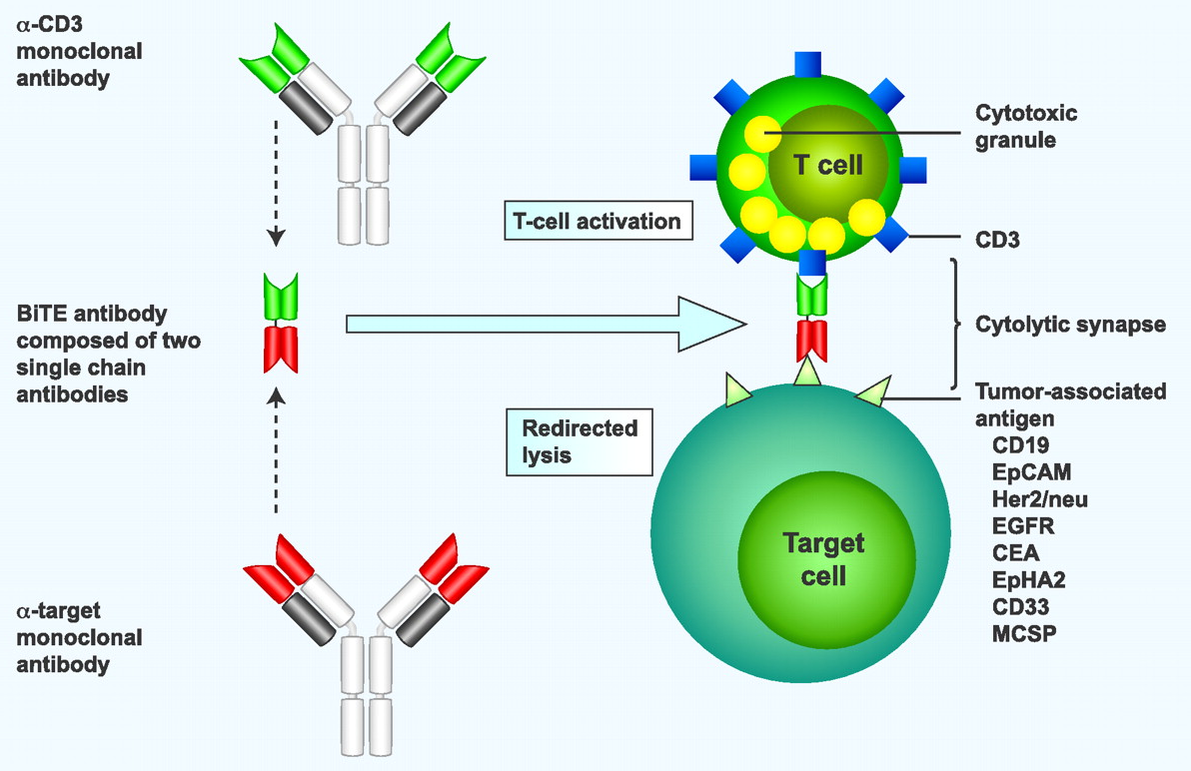
Cancer Treatment with Antibodies - Cancer Evasion - Loss of MHC I on Tumor Cell
Tumor-associated antigen: An antigen that is found only on tumor cells:
Mis-regulation
Mutation
Cancer cell
Cancer
Cell
Bispecific antibodies are generated from two separate antibodies:
One recognizes CD3, which is part of the T-cell receptor (TCR)
Other recognizes a tumor antigen.
The two variable regions are linked into a single polypeptide chain by construction of a synthetic DNA molecule.
The dual binding event mimics the original MHC-I TCR interaction.

Slide 15
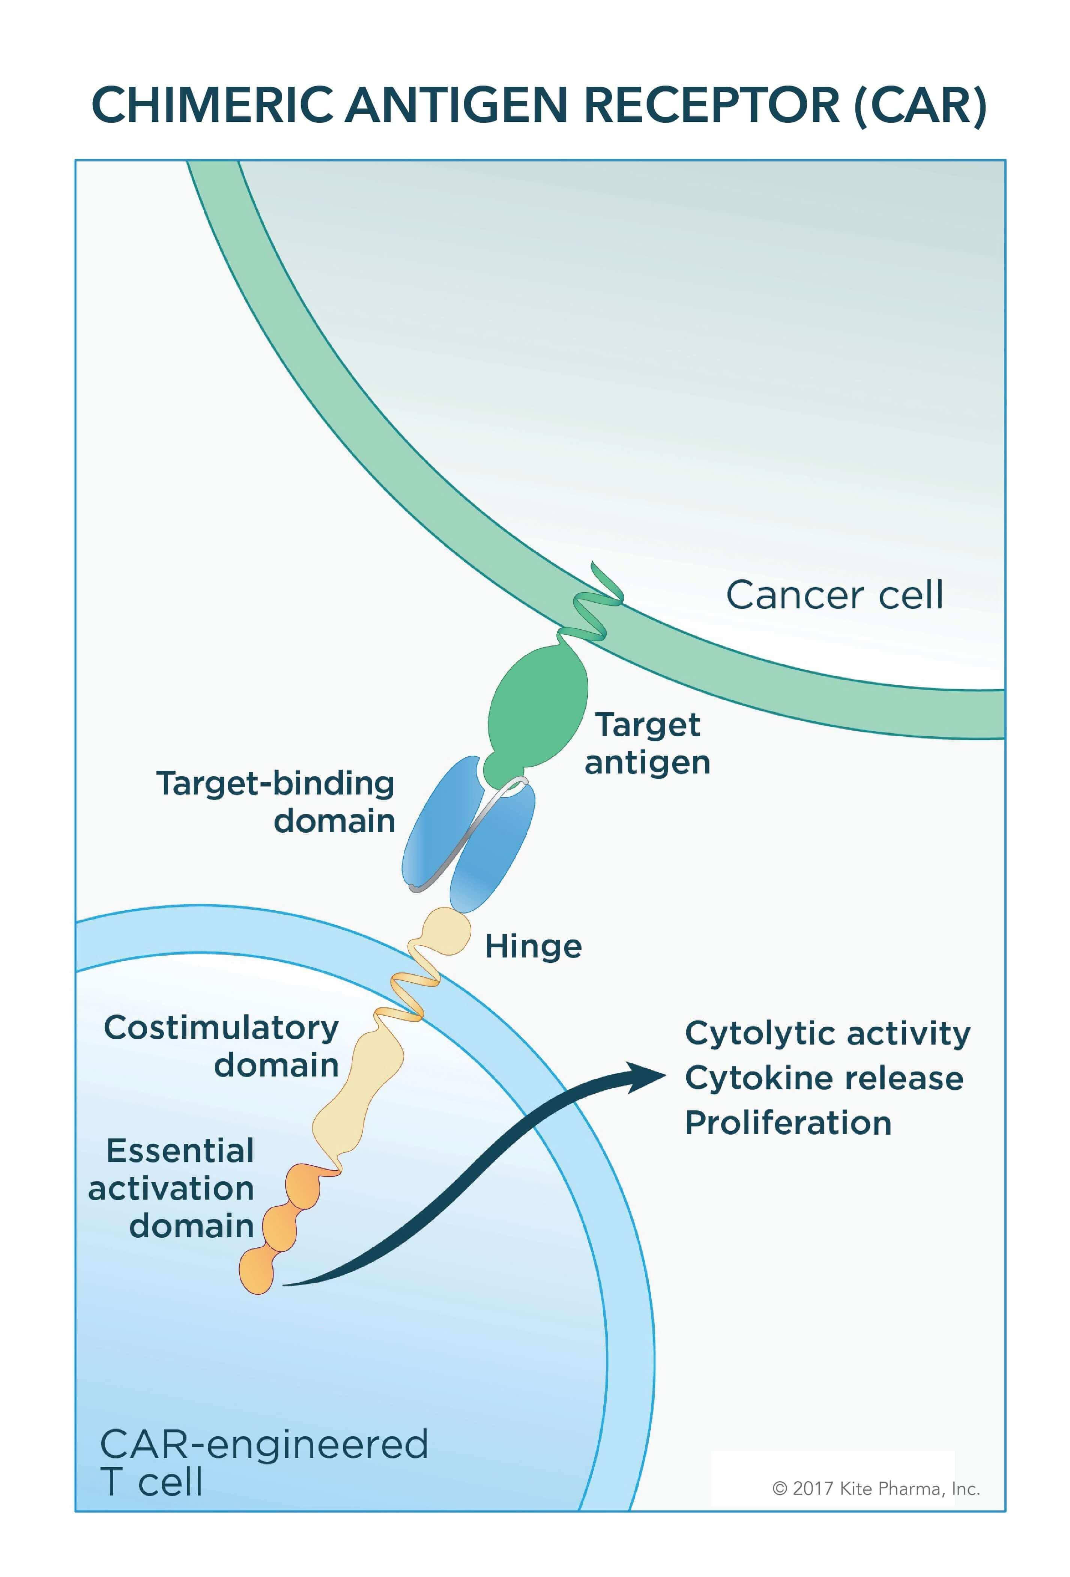
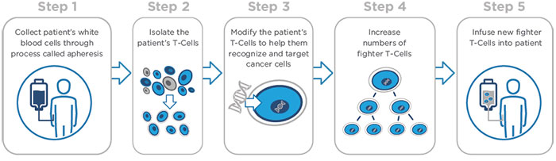
Chimeric Antigen Receptor T-cells = CAR T-Cells
Obtain antibodies against cancer antigen, isolate genes that code for light and heavy chains for those antibodies.
Fuse coding region for variable light and heavy domains to coding region for RTK on T-cells = single CAR-T gene.
Heavy chain gene
Light chain gene
RTK gene
ATG……………….…………..TAA
ATG…………..TAA
ATG…………………..TAA
RTK – receptor tyrosine kinase
Signaling domain on T-cells
V_{H}
V_{L}
RTK
ATG……………….…………………………..TAA
Introduce gene for CAR-T cell into Patient
D. What happens when cancer cell is encountered by CarT cell?
Obtain white blood cells from patient
Isolate T-cells
Introduce DNA into T-cells
Obtain large amounts of T-cells by cell culture
Inject CAR-T cells into cancer patient.
Tumor cell

Slide 16
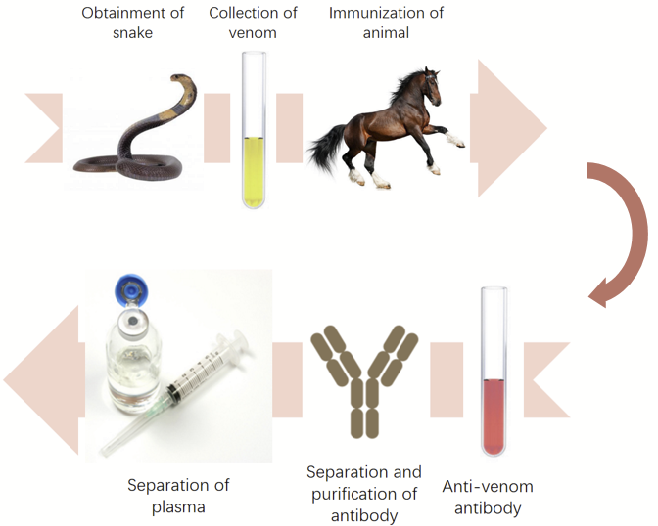
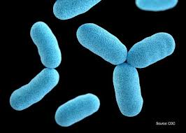
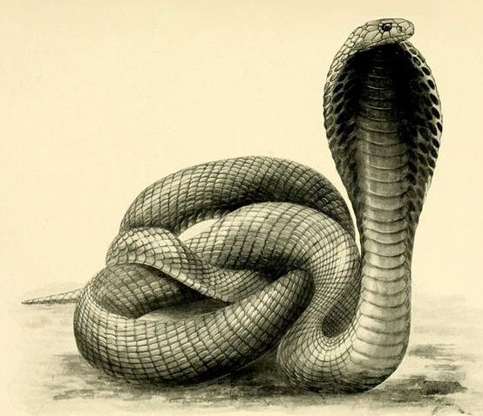
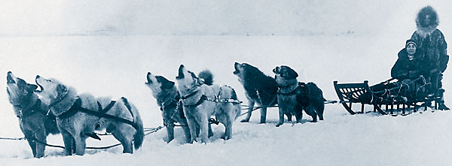
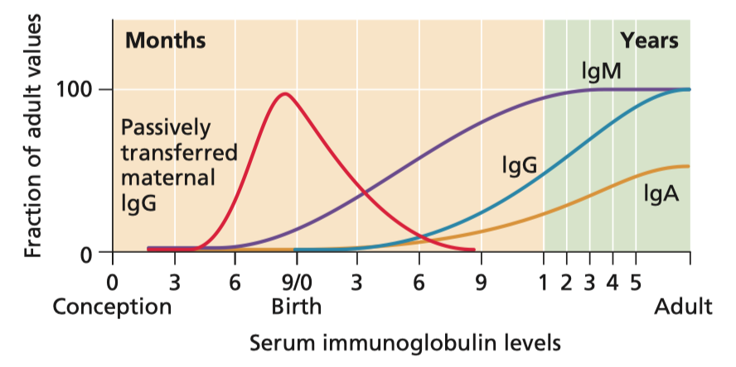
Vaccination
Diphtheria
Types of vaccines:
1. Passive (Ab injected)
2. Active (Antigen Provided)
Breast feeding provides IgA to the newborn.

Slide 17
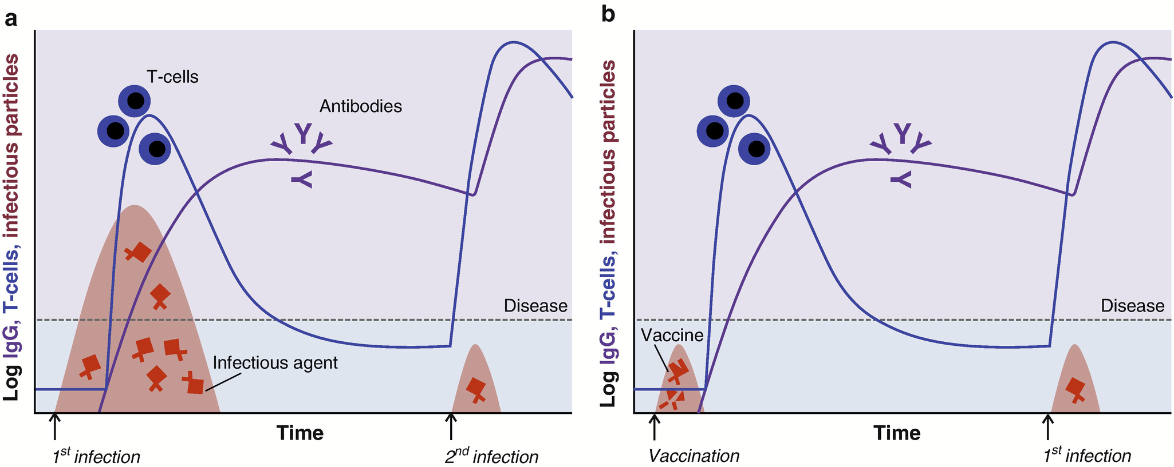
Primary and Secondary Response & Protection by Vaccines
Not Vaccinated
Vaccinated
Large number of pathogens during first (primary) infection causes disease symptoms
Antigen from pathogen prompts acquired immune response.
Vaccine: antigen induces primary response = memory B and T (T_{H} and T_{C}) cells specific for that antigen.
More rapid & intense secondary response prevents extensive pathogen growth – no symptoms.
More rapid & intense secondary response prevents extensive pathogen growth – no symptoms.
Notes:
Jiskoot W., Kersten G.F.A., Mastrobattista E., Slütter B. (2019) Vaccines. In: Crommelin D., Sindelar R., Meibohm B. (eds) Pharmaceutical Biotechnology. Springer, Cham. https://doi.org/10.1007/978-3-030-00710-2_14

Slide 18
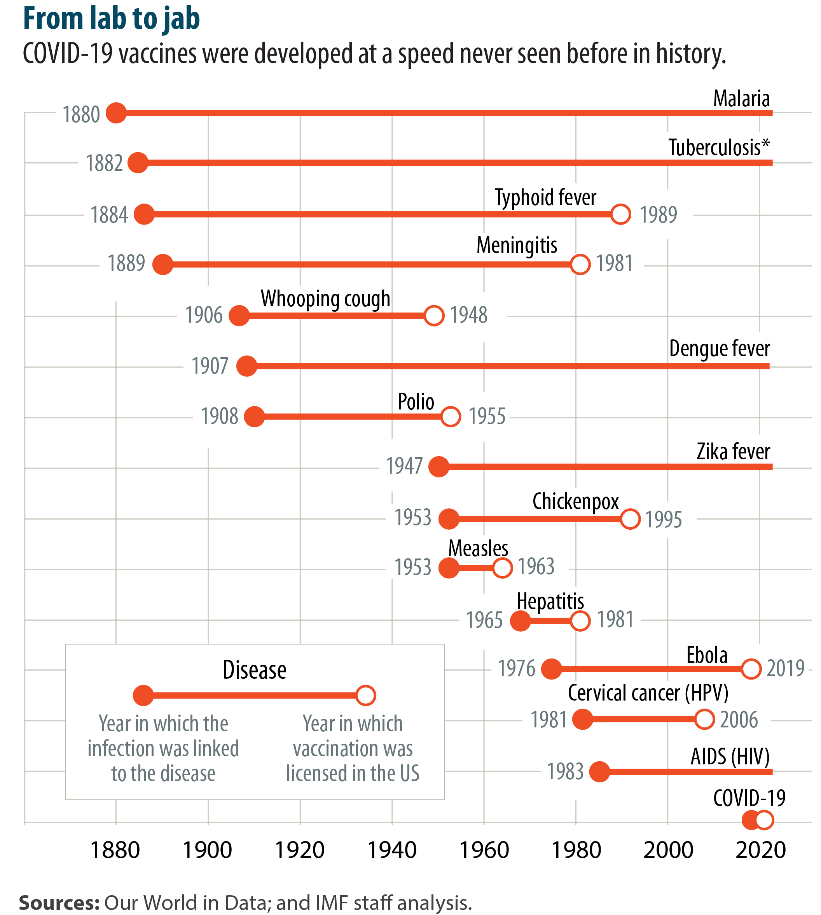
Vaccine History
Some diseases still do not have vaccines (Malaria, HIV)
Many diseases are controlled by vaccination (Typhoid, Meningitis, Whooping cough, polio, chickenpox, measles,…)
A few diseases have been completely eliminated by vaccination (Smallpox)
https://www.imf.org/en/Publications/fandd/issues/2021/12/Journey-covid-19-vaccine-Stanley

Slide 19
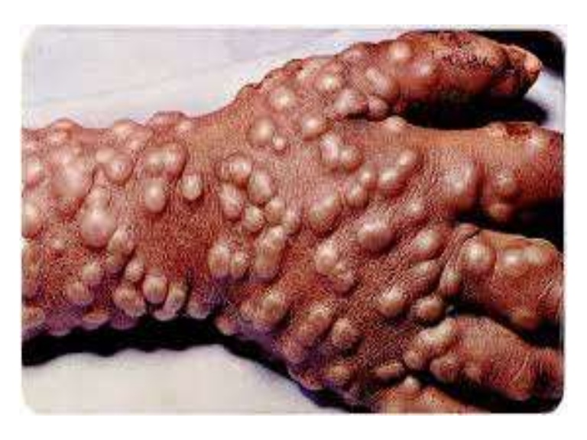
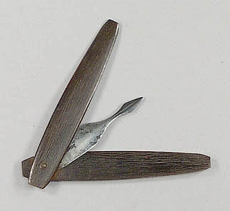
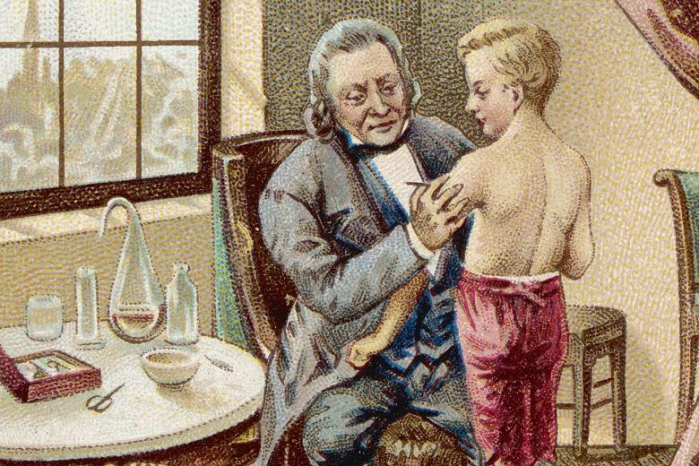
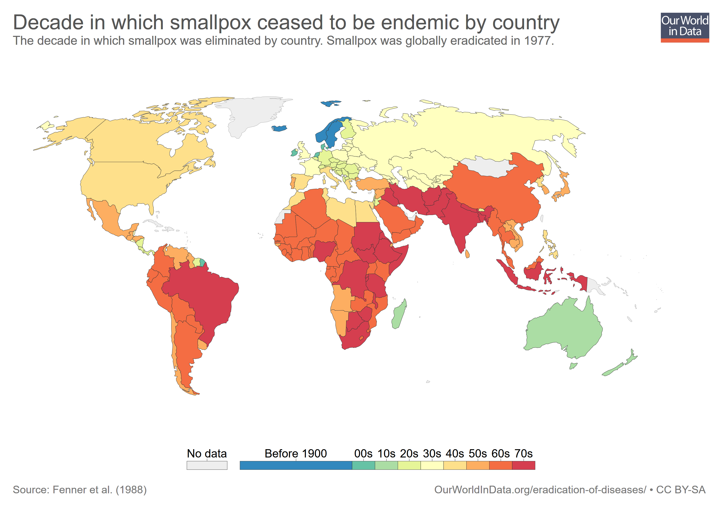
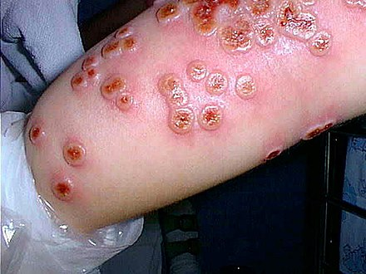
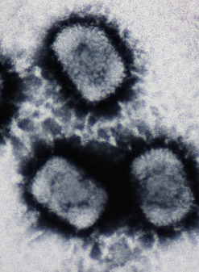
Smallpox - A Success Story for Vaccination
Variolation (1670) provided protection by exposing people to small amounts of smallpox virus (obtained from blisters on infected people). Practice spread from Istanbul to Europe.
Risky because smallpox was used to vaccinate (2% risk of death)
10,000 BC Smallpox – 20-90% lethality
Decade in which smallpox ceased to be endemic
Cowpox virus:
Not lethal
Similar to smallpox virus
Causes production of cross-reactive antibodies that can bind to smallpox
Jenner was the first to use cowpox to vaccinate against smallpox (1796)
Vaccinated with cowpox (ill for 9 days)
Infected with smallpox (2 months later)
Subject did not develop smallpox
Vaccinia virus (similar to smallpox) is one form of the current vaccine.

Slide 20
Types of Vaccines
A. Subunit Vaccine:
A protein from the pathogen is used to induce memory cells, e.g. spike protein from the virus. The protein can be produced by recombinant DNA technology.
A
B. Inactivated Virus
The virus is chemically inactivated before administration. Peptides from virus activate B and T_{H} cells.
B
C. Virus Like Particles:
Proteins isolated from the virus form virus-like-particles, without the genetic material of the virus
C

Slide 21
D. Live Attenuated
The virus is grown under conditions that select for mutant viruses that:
Induce memory cells in humans
Do not cause disease symptoms
D
D
E. Recombinant Virus:
A “safe virus” is used (e.g. cold virus)
Gene for a protein from a pathogen is inserted into the DNA of the virus.
When virus grows it produces the protein from the pathogen generating immunity.
Also includes vaccines that are a mixture of genetic material from human and animal viruses (reassortment viruses)
E
F. RNA Vaccines (Pfizer Covid Vaccines)
RNA coding for a viral protein is introduced into cells. The RNA is used by the cell to make viral proteins, inducing an immune response.
F

Slide 22
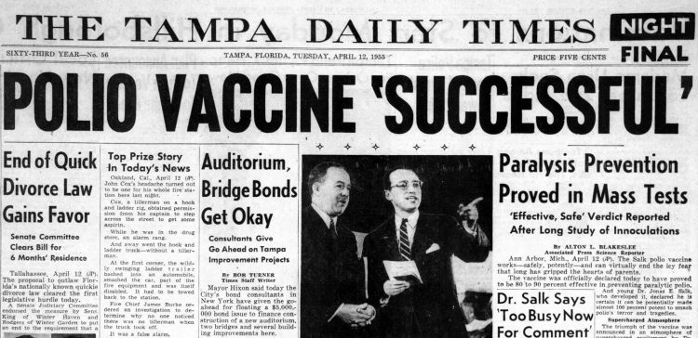
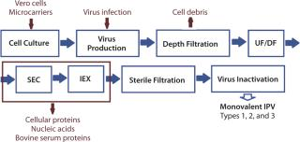
B. Inactivated – Salk Polio Vaccine Viruses

Slide 23
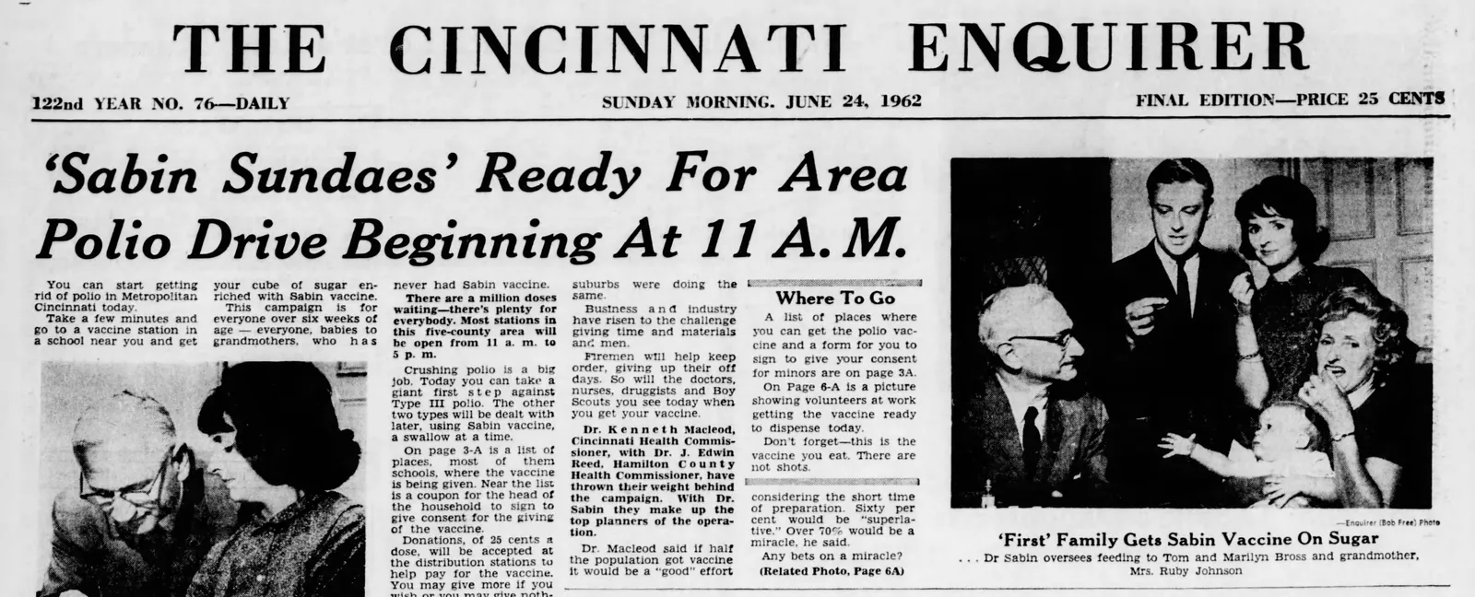
D. Attenuated – Sabin Polio Vaccine
Attenuation Process Requires Mutations  Change growth characteristics on human cells.

Slide 24
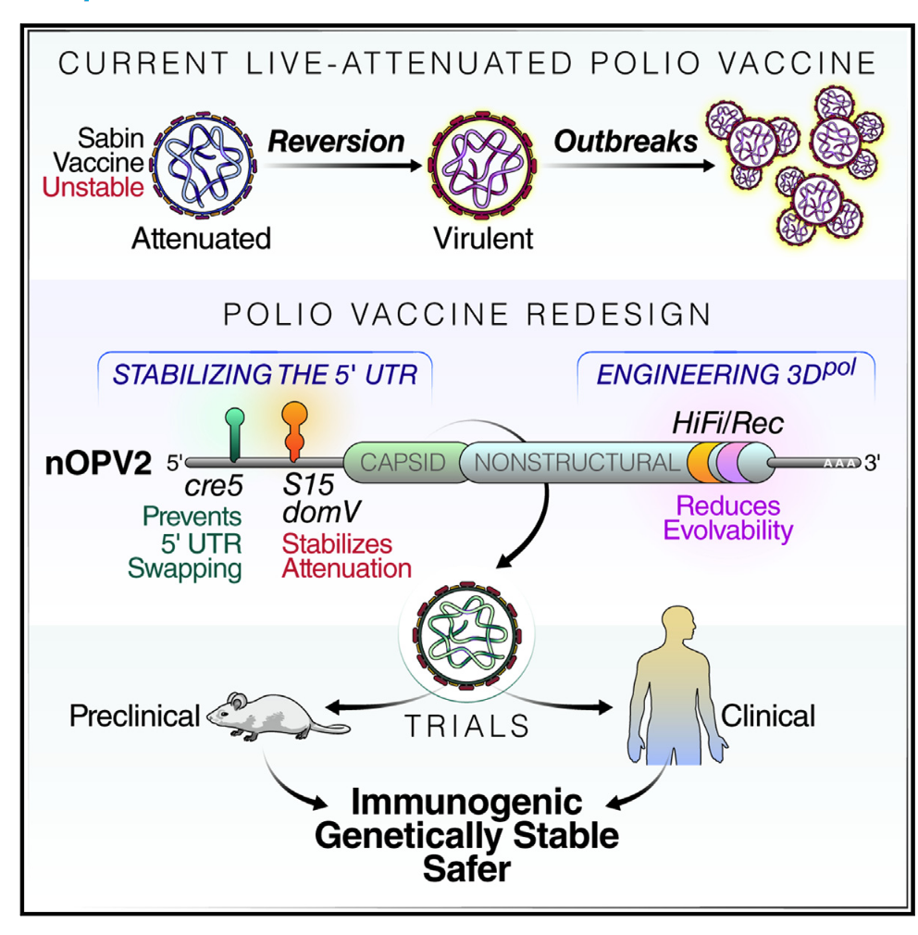
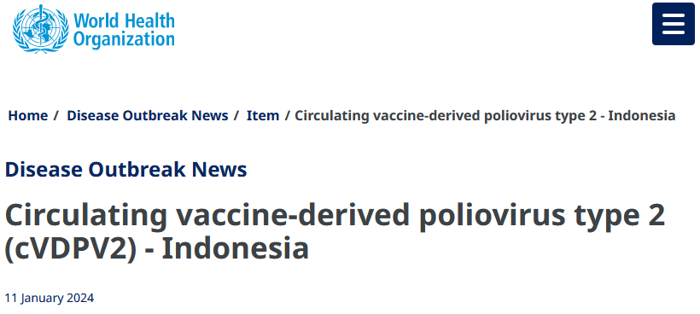
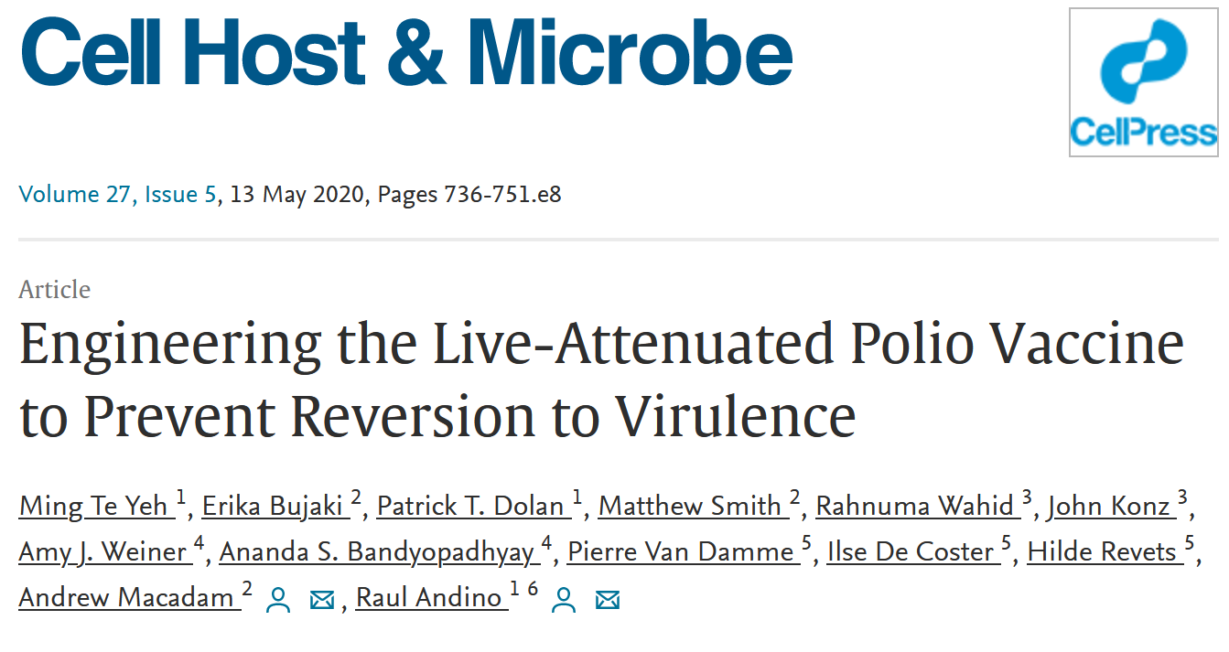
C. Attenuated Viruses – Return to Virulence by Reversion

Slide 25
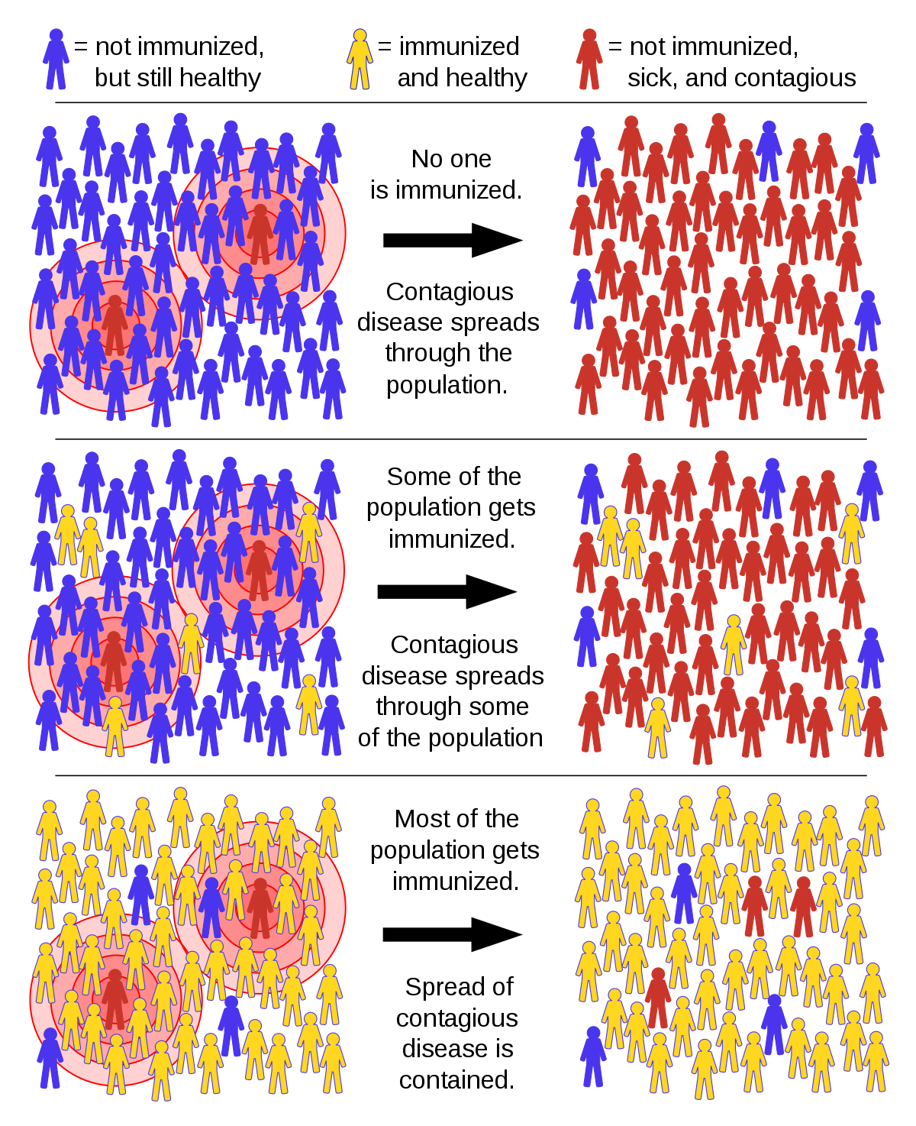
Herd Immunity:
High risk
Can’t be vaccinated
(too young, immune -compromised
Vaccinated individuals prevent disease from spreading from sick to unvaccinated.
At sufficient levels, the “herd” is immune because the virus cannot spread, eventhough some people get sick.
Gets infected
Below herd
immunity
At herd
immunity
Protected

Slide 26
Herd Immunity
How Many People need to be vaccinated to achieve herd immunity?
10% ?
20% ?
50% ?
90% ?
100% ?
It depends on the how infectious the virus is
Our Experimental Viruses:
Ebola: Low infectivity
Polio: Moderate infectivity
Measles: High infectivity

Slide 27
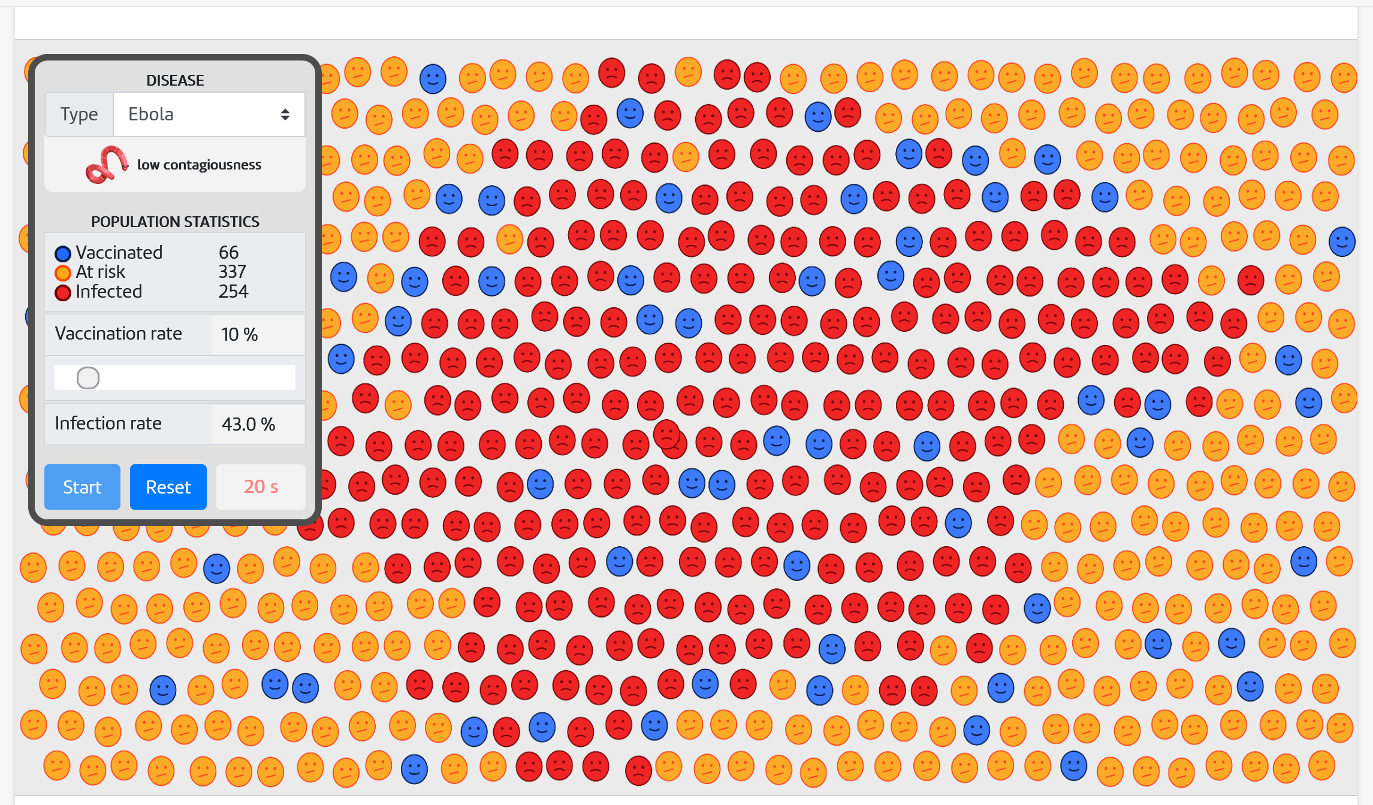
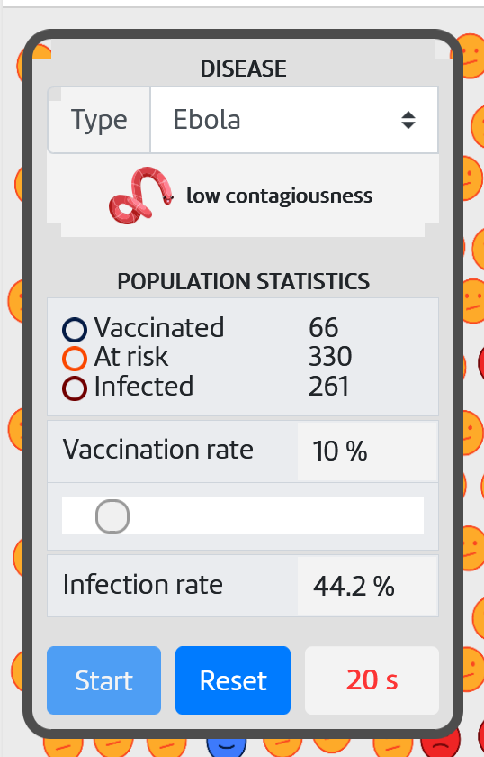
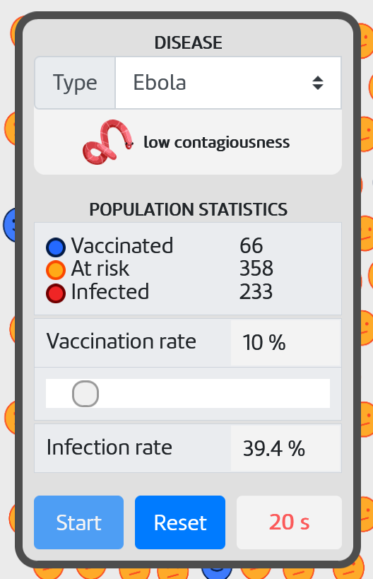
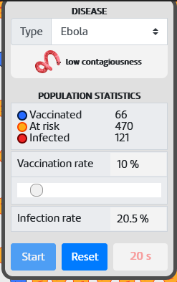
Simulation to Determine Infectivity Versus Vaccination Level (Pset)
Go to the following web site and open both links: http://www.andrew.cmu.edu/~rule/stayin-alive
Copy the googlesheet.
3. On the Infection Simulator link, scroll down (2/3 page) to the image of the plane, and click on it.
A. Select the virus.
B. Use the slider to select the different vaccination levels. Use 10, 20, 40, 50, 70, 80, 90 %. For each of the vaccination levels do three simulations.
C. Enter the value for the % Infection rate at 20s into the appropriate cell of the google sheet. Your data will be automatically averaged and plotted.
3 Simulation Runs at 10%
42.2%
43.0%
44.2%
39.4%

Slide 28
Summary Questions for Immunology:
What are the two major branches of the immune system? Why are both important?
What are the roles of different cell types in each system, e.g. what would happen if T_{H}-cells disappeared?
What is the quaternary structure of an antibody? Can you sketch an antibody and indicate where the antigen binds?
What part of the antibody defines the specificity?
What are the steps in the production of antibody genes, at the molecular level:
How do DNA rearrangements produce functional heavy and light chain genes
What is the difference between the heavy chain for B-cells versus plasma cells.
Can you describe how antibodies kill/inactivate pathogens
How are virally infected cells and tumor cells recognized by Tc cells?
How does the Tc cell kill those cells?
What evasion mechanisms are used by cancer cells and how have these been addressed by antibody therapy?
What was the origin of the idea for vaccination?
What was one of the first “safe” vaccines? What disease has now been eradicated due to this vaccine?
Can you describe one way to generate a vaccine for a pathogen? Do you know the pros and cons for that method?

Slide 29
Enzyme Inhibitors as Drugs
Types of inhibitors
Covalent
Competitive
Allosteric
HIV drug therapy
Antibiotics – inhibitors of RNA and protein synthesis
Genome Editing – Cas9
Discovery & Engineering of CRISPR systems
Off-target effects

Slide 30
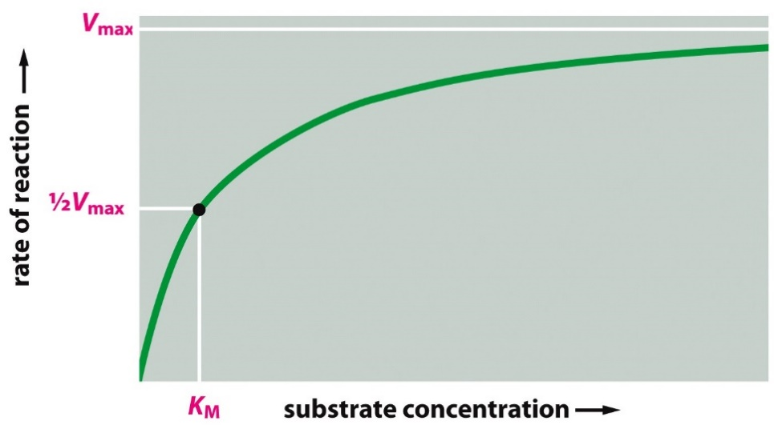
Key Points:
S₃
$$\left(E\right)+\left(S\right) ⇄ \left(ES\right) \underset{→}{ k_{CAT}} \left(EP\right) ⟶\left(E\right)+(P)$$
[P]
S₂
S₁
time
Kinetics
Rate = dP/dt, proportional to [ES].
V_{max} = measured velocity at saturating substrate:
V_{max} = k_{CAT} x E_{total}
K_{M}:
Substrate concentration to ½ saturate the enzyme, v = Vmax/2
Measure of substrate affinity, lower K_{M}, better binding.

Slide 31
Enzyme Inhibitors
Studies on Inhibitors are useful for:
1. Mechanistic studies to learn about how enzymes interact with their substrates.
2. Understanding the role of inhibitors in enzyme regulation.
3. Drugs if they inhibit aberrant biochemical reactions:
penicillin, ampicillin, etc. interfere with the synthesis of bacterial cell walls, acting as suicide inhibitors.
4. Understanding the role of biological toxins.
Amino acid analogs - useful herbicides (i.e. roundup)
Insecticides - chemicals targeted for insect nervous system.
Covalent
Competitive
Types of Inhibitors:
Covalent – inhibitor covalently modifies enzyme, usually in active site, these are generally irreversible – the enzyme is dead! Example – Sarin gas (Tokyo subway 1995)
Competitive – inhibitor blocks substrate, binds reversibly to active site with a K_{D} = K_{I}. Enzyme activity returns when drug is removed.
Allosteric (mixed type) – inhibitor causes allosteric change. Binds reversibly to a different location, with two different K_{D}s: K_{I} and K_{I}’. Enzyme activity returns when drug is removed.
Allosteric (Mixed type)

Slide 32
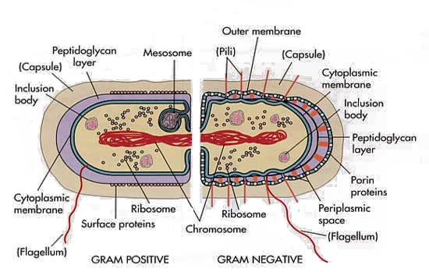
Bacterial Cell Wall
Mechanism of Penicillin – A Suicide Inhibitor
Serine breaks peptide bond between terminal D-Ala residues
Covalent intermediate formed
Amino group of glycine forms peptide linkage with D-Ala = crosslink
Bacterial cell wall:
Linear polymers of alternating NAM (N-acetylmuramic acid) and NAG (N-acetylglucosamine), beta(1-4) linkage
NAM units on adjacent strands are linked via a peptide linker.
Crosslinking catalyzed by serine-containing transpeptidase.

Slide 33
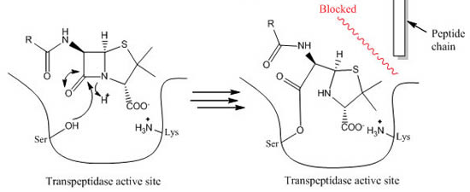
Mechanism of Penicillin
Mechanism of Action of Penicillin:
Penicillin inhibits the transpeptidase enzyme that is responsible for crosslinking the Gly₅ chain to alanine (circled on diagram).
The crosslinking of the cell wall is broken, making the bacteria fragile to breakage.
Inhibition is by formation of a chemical bond between penicillin and the enzyme (covalent inhibitor).
Penicillin

Slide 34
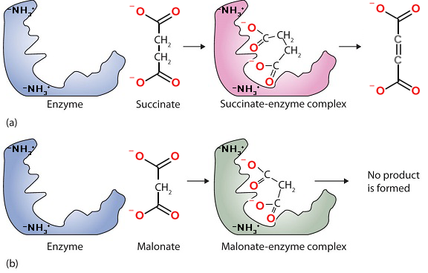
Competitive Inhibitors
Succinate dehydrogenase converts succinate to fumarate by removal of two hydrogens.
Malonate is a competitive inhibitor, because:
It is similar in structure to the substrate – so it binds in active site – substrate cannot bind at the same time.
Malonate cannot undergo the chemical reaction – it is not possible to remove two hydrogens without leaving carbon with too few bonds.
Fumarate
(product)
Substrate
Inhibitor
Notes:
Most cell functions depend on proteins

Slide 35
Quantification of Inhibitor Binding
Fractional Saturation of Enzyme by Inhibitor
$$K_{I}=K_{D}=\frac{\left[E][I\right]}{\left[EI\right]}$$
K_{I} = equilibrium constant for dissociation of inhibitor from enzyme
Low K_{I} = higher affinity (same principle as K_{D})
K_{I} can be found from ½ point in binding curve
K_{I} can be determined by measuring the effect of inhibitor on the enzyme kinetics.

Slide 36
Effect of Competitive Inhibitor on Steady-State Kinetics:
A competitive inhibitor reduces the amount of [E] by the formation of [EI] complex.
The inhibitor cannot affect the [ES] complex since the inhibitor can no longer bind.
There are two consequences of a competitive inhibitor binding on the kinetics of the enzyme:
V_{MAX} is unchanged: At high levels of substrate all of the inhibitor is displaced by substrate, so [ES]=E_{TOTAL}, and v_{MAX} = k_{CAT}[E_{TOT}].
The observed K_{M} is increased: It requires more substrate to reach 1/2 maximal velocity because some of the enzyme is complexed with inhibitor.
K_{M}^{OBS} = αK_{M}
The change in K_{M} can be used to determine how well the inhibitor binds to the free enzyme, if we know how α is related to K_{I}.
v = k_{cat} [ES], k_{cat} =1
$$α=1+\frac{[I]}{K_{I}}$$
No inhibitor
Comp inhibitor

Slide 37
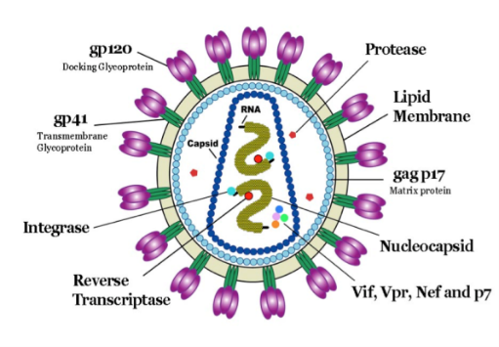
HIV Drug Therapy
Retroviruses & Inhibitors - HIV Protease.
Identify potential drug targets, based on viral life cycle.
Measure inhibitor binding to characterize drug efficiency.
Rational drug design in response to mutations.
Human Immunodeficiency Virus (HIV)
Infects specialized cells in the immune system – T-helper cells (T_{H}) cells, killing them.
T_{H} cells are required for activation of the immune response to all pathogens (bacteria, virus)
Killing of T_{H} cells by the HIV virus causes AIDS (acquired immunodeficiency), making the individual susceptible to serious infection by many otherwise harmless bacteria as well as developing rare cancers.
Viral particle contains enzymes required for the replication of the virus:
Reverse Transcriptase: Copies viral RNA to DNA
Integrase: Integrates viral DNA into host chromosome.
HIV Protease: Cleaves immature viral protein to produce smaller mature proteins.

Slide 38
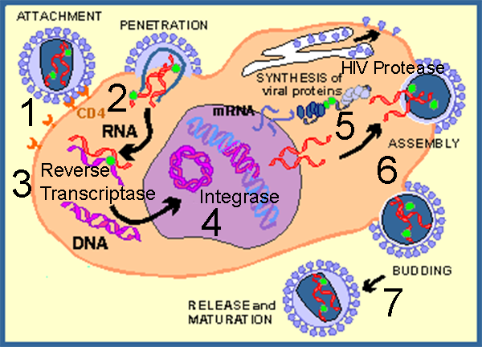
The HIV virus is a retrovirus:
The genetic information is stored in RNA (viral RNA, vRNA) which must be first be copied into DNA: vRNA → DNA → mRNA → viral protein
HIV Viral Infection of T-Helper Cells:
1. Viruses bind to molecules displayed on the T_{H} cell surface.
2. The virus then fuses with the cell membrane and releases its RNA genome from its lipid envelope.
3. The HIV enzyme reverse transcriptase first makes a double-stranded DNA copy of the viral RNA molecule. This process is error prone, leading to mutations in the virus. These mutations cause drug resistant strains of the virus to arise.
4. The DNA is integrated into the host cell’s DNA by an enzyme called integrase, also from the HIV virus.
5. Integrated DNA produces vRNA, the genetic material for new virus particles. mRNA is also made from this DNA, to produce proteins for new particles.
6. HIV protease required for maturation of viral proteins, by cleaving them into smaller proteins that form the mature virus.
7. Mature virus buds out of cell.
Drug Targets to Combat the HIV Virus –
Viral fusion
Reverse transcriptase
Integrase
HIV Protease
These are good drug targets because:
Required for viral replication
Activities are not found in humans

Slide 39
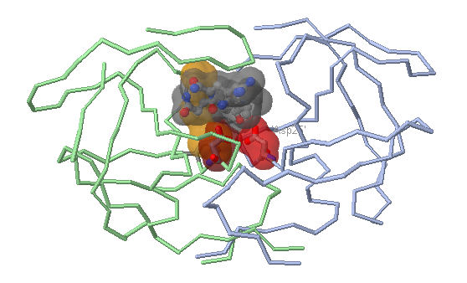
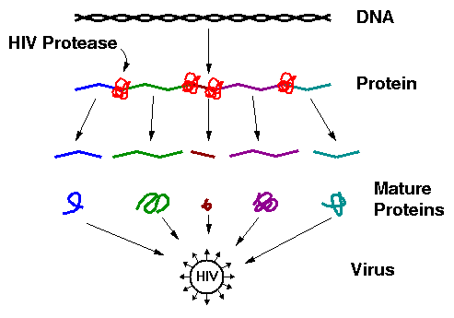
HIV Protease (Aspartyl protease)
The original viral protein is a long pre-protein containing many smaller mature proteins.
HIV Protease cleaves the pre-protein, releasing the smaller mature proteins.
HIV Protease:
1. An essential enzyme in the maturation of the HIV virus. If inhibited, the virus cannot replicate.
2. Prefers hydrophobic substrates (e.g. Phe) due to Val82 plus other non-polar residues in its active site (Pro81, Leu23).

Slide 40
Inhibition of HIV Protease (HIV Drugs):
Most drugs are small peptide-like analogs with non-cleavable bonds that resemble peptide bonds.
Where will they bind on the enzyme?
What will happen to them after they bind?
Drug Design: Compounds A (Isobutyl) and B (cyclohexane) are candidates for HIV protease inhibitors. Which of the two drugs will be more effective at inhibiting the wild-type protease?
Answer: We will assume that these are competitive inhibitors. Therefore, we need to compare the K_{I} values for each inhibitor binding to the protease.

Slide 41
Measuring K_{I} for both Drugs:
a) Acquire velocity versus substrate, no inhibitor.
b) Acquire velocity versus substrate, fixed inhibitor.
Analysis:
i) Plot velocity versus [S]
ii) Obtain α from the observed Km values
[S] | no inh | A | B
0 | 0 | 0 | 0
1 | 17 | 9 | 2
2 | 29 | 17 | 4
3 | 38 | 23 | 5
4 | 44 | 29 | 7
5 | 50 | 33 | 8
10 | 67 | 50 | 15
20 | 80 | 67 | 27
40 | 89 | 80 | 42
60 | 92 | 86 | 52
100 | 95 | 91 | 65
Data | Km | Alpha (K_{M}^{obs}/K_{M}) | K_{I} =[I]/(α-1) ([I]= 10 nM)
No Inh | 5
Inh A | 10 | 2 | K_{I} = 10/(2-1) = 10 nM
Inh B | 54 | 10.8 | K_{I} = 10/(10.8-1)=1.1 nM
The units of velocity are μmoles product/sec.
Once the α values are found, we can calculate the K_{I} for each inhibitor using the formula: K_{I}=[I]/(α-1).

Slide 42
Explain the difference in K_{I} based on the molecular interactions between each inhibitor
Potential Interaction | Drug A (K_{I} = 10 nM) | Drug B (K_{I} = 1.1 nM)
Van der Waals
Hydrophobic effect

